Slide 1
A shared Medication Record for Scottish Patients
Joining the dots
Ian Thompson, Libby Morris and Jonathan Cameron

Slide 2
Scottish medication records

Slide 5
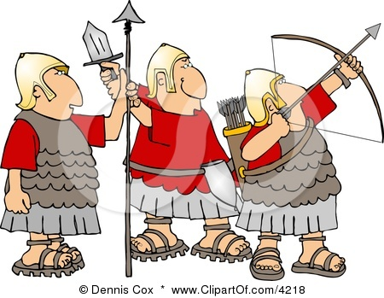

Slide 6
Historical Background
ECS – 2004
SCI Gateway - 2005
e-Pharmacy – 2007
Each designed by separate teams taking prescribing info from primary care systems
Similar, but not identical message content

Slide 7
SCI XML
Structured Clinical Information using eXtensible Markup Language
Moving clinical information around BETWEEN different systems
Nominally a “standard”, but has developed individual variations in each implentation

Slide 10
Medication Message flows
GP Systems
ECS
SAS
NHS24
e-Pharmacy Message Store
Community Pharmacies
Clinical Portals
OOH GP (Adastra)
SCI Gateway
Secondary Care
PSD

Slide 11
Current and Future Developments
Changes in one system have knock on effect on development in all of the others
Developers cant keep up
Not sustainable
Not sensible

Slide 12
Secondary Care
Now realise the need for structured messages
Asked to include DM+D for ECS
Need to define common medication standards
Allergies and adverse reactions
GP2GP leading the way
Need a way of maintaining any new requirements rather than asking for even more new ways of doing things

Slide 13
