Slide 1
openEHR Archetypes, Templates and
Terminology
Dr Ian McNicoll
SCIMP Working Group
Director openEHR Foundation
Clinical Modelling Consultant, Ocean Informatics, UK
Notes:
1
May 8, 2008
Introduction to openEHR
openEHR + SNOMED CT = Making Health Compute

Slide 2
openEHR
Open specification for a clinical information model
  What is a clinical information model?
  Multi-layer modelling
    RM , archetypes, templates
Use
  To help define shared clinical content definitions for interoperability, APIs
  To build and adapt clinical content for applications

Slide 3
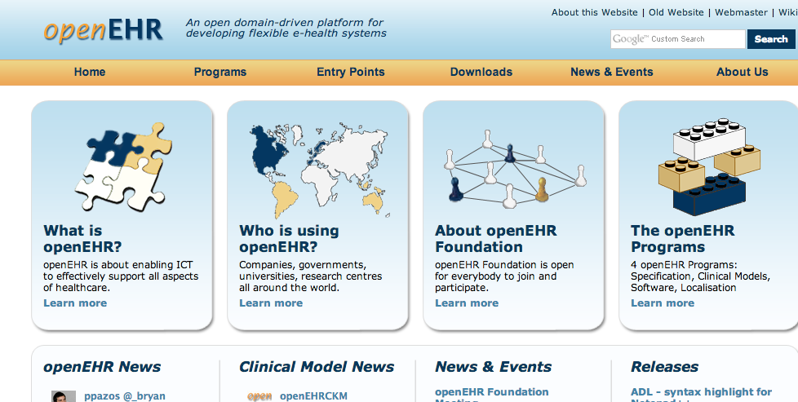
GPSOC - openEHR
www.openehr.org

Slide 4
What is it used for?
Generic application platform
  Does the heavy lifting of database /querying layer
  Agile, clinically-defined content definitions
  Not tied to any single solution or business model
‘Standards’ development
  Clinically –driven and governed
  Scalable and emergent
  Agile, inclusive

Slide 5

Clinical information modelling

Slide 6
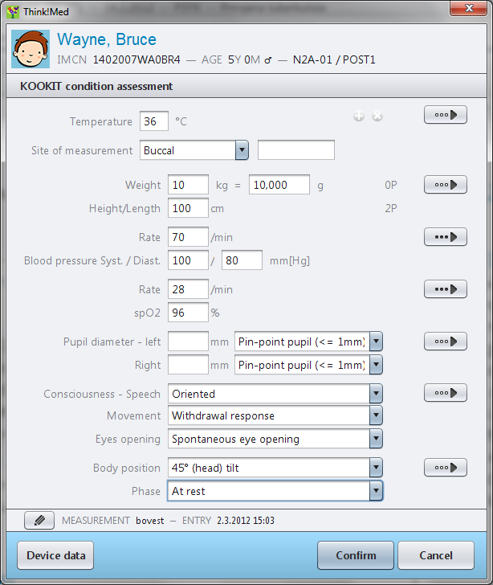
“I want to record Pulse rate”
GUI

Slide 7
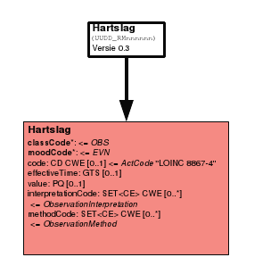
Clinical information requirements
  “What exactly do you mean by ‘Pulse rate’”?
    “Rate, rhythm, date recorded …..”?
Information model (typically UML)
  Structure (OOP classes)
  Business rules
    “Rate >=0”
  Terminology
    SNOMED, ICD, local codes

Slide 8
Existing clinical knowledge
Formally (computably) expressed in:
  Software : Application-specific internal “Information models”, UML, database schema
  Reference terminologies : READ, SNOMED CT, ICD-10,
  Messaging models : HL7, CDA, IHE profiles
  Decision support , guidelines, rules
Informally expressed in:
  Local forms, documents, professional guidelines
  Data dictionaries for govt reporting
Continually evolving: restructured, new, deprecated
3.8
Notes:
8
Session 3 Why is the EHR so difficult
8
The Clinical knowledge required to construct EHR systems is variably captured and expressed. Some of this is computable but is often locked away within vendor systems or inextricably locked in to particular message implementations.

Slide 9
Traditional modelling: the data dictionary
Notes:
9
This is a screenshot of a small part of the extensive Scottish National Clinical Datasets Data Dictionary

Slide 10
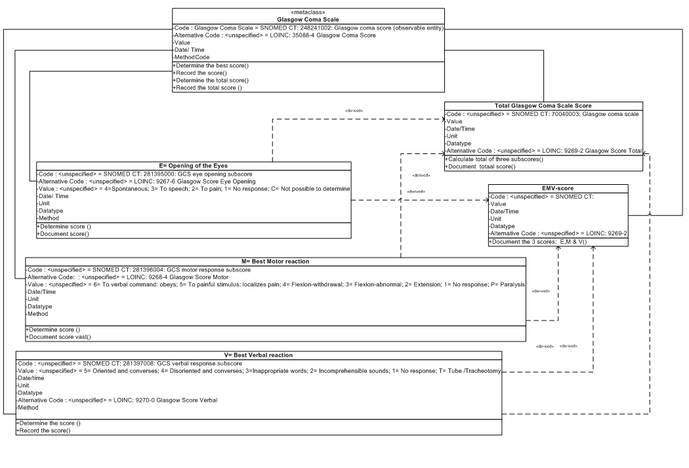
Traditional modelling: UML
Notes:
10
A very popular industry standard method of representing software models is the UML (Universal Modelling Language) Diagram. Although it is possible for clinicians to become familiar with such diagrams, they do not readily convey the content and structure of clinical model to the untrained eye.
Introduction to openEHR
May 8, 2008
openEHR + SNOMED CT = Making Health Compute
10

Slide 11
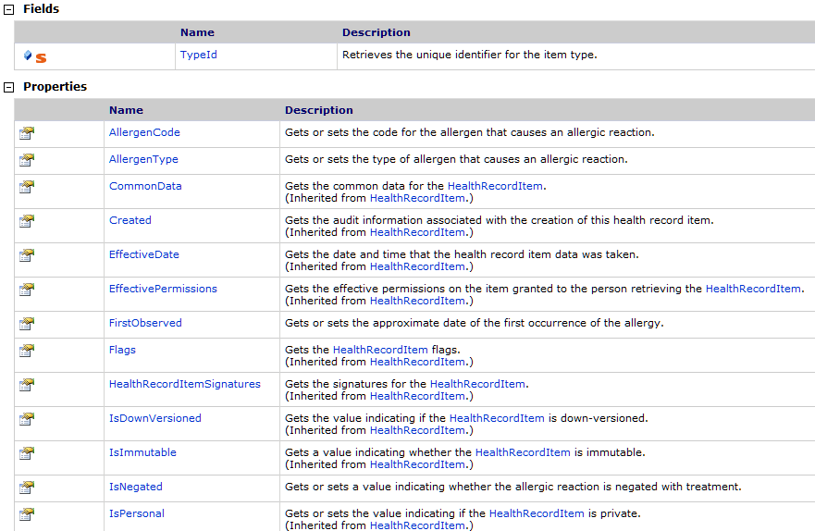
Traditional modelling : application classes

Slide 12

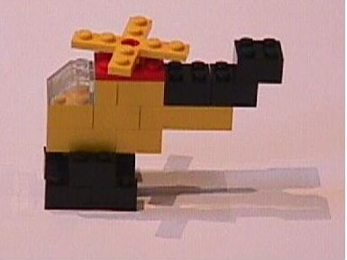
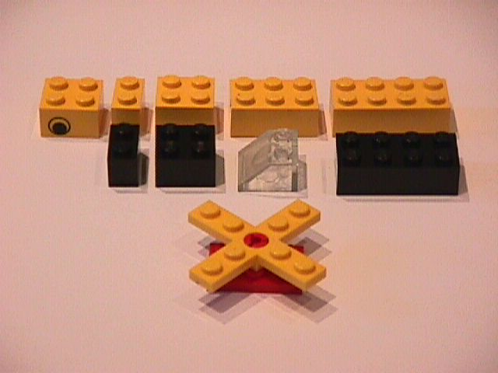
Principle
The components of the Reference Model are like LEGO brick specifications
Archetypes = instructions/designs constraining the use of LEGO pieces to create meaningful structures
Information model
Instances
Archetype A
Archetype B

Slide 13
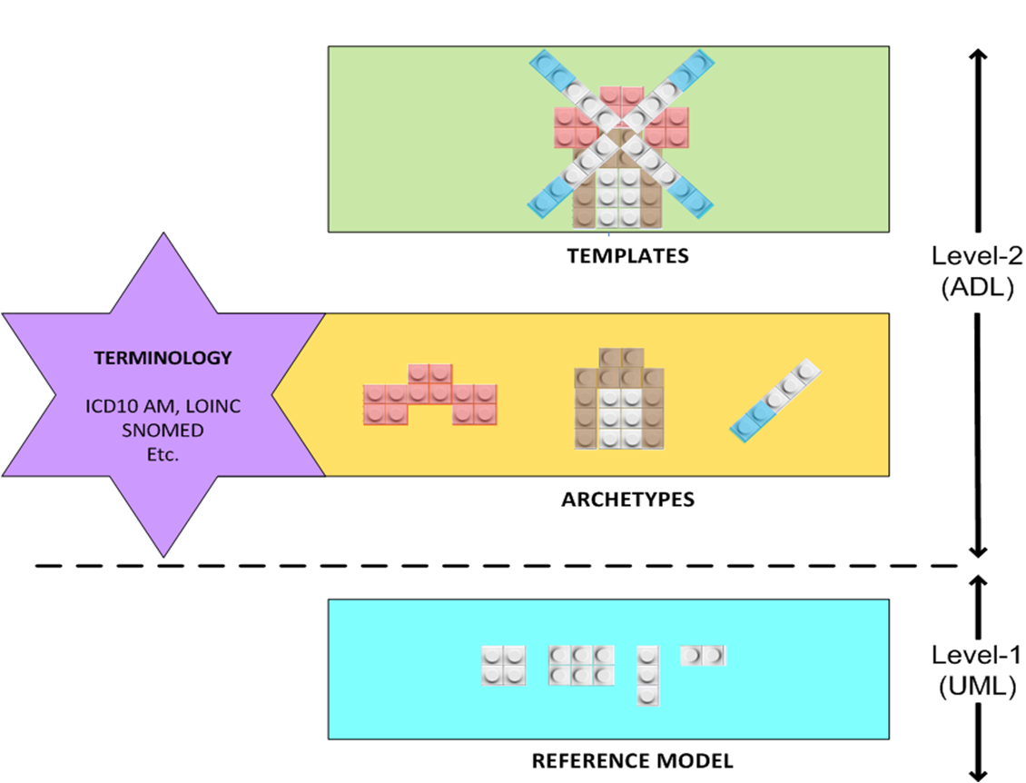
openEHR: Multi-level modelling
Notes:
openEHR design approaches clinical EHR design in a completely different way, known as 2 level modelling. Clinical knowledge resides in archetypes and is completely separate to the information stored in the Reference Model
The Reference Model contains only generic knowledge and business rules from the EHR Reference Model As a result, the reference model is much smaller and simpler, is easier and cheaper to build and maintain.
This enables flexibility in EHR systems – as changes in the clinical knowledge can be embraced without compromising the integrity of the underlying data schema, and gives us the potential for us to keep EHR data for 100+years for the first time.

Slide 14
openEHR Archetypes
Dictionary definition … “a model or prototype”
Computable models of discrete clinical concepts
  Familiar components of a health record
    Blood pressure, Body weight, Symptom
    Medication order, Family history
    Prostate cancer histopathology result
‘Maximal dataset’ philosophy
  Capture as many clinical perspectives as possible
  Universal use case

Slide 15
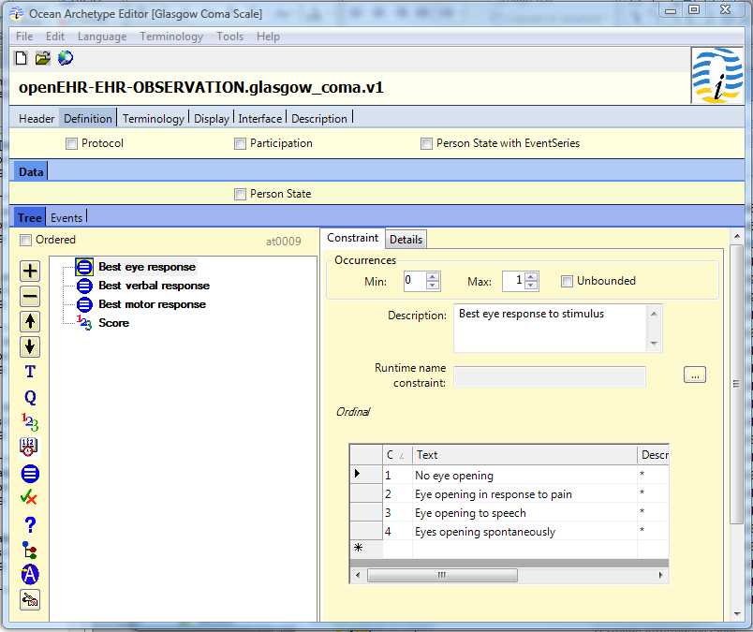
Notes:
15
15
May 8, 2008
Introduction to openEHR
openEHR + SNOMED CT = Making Health Compute

Slide 16
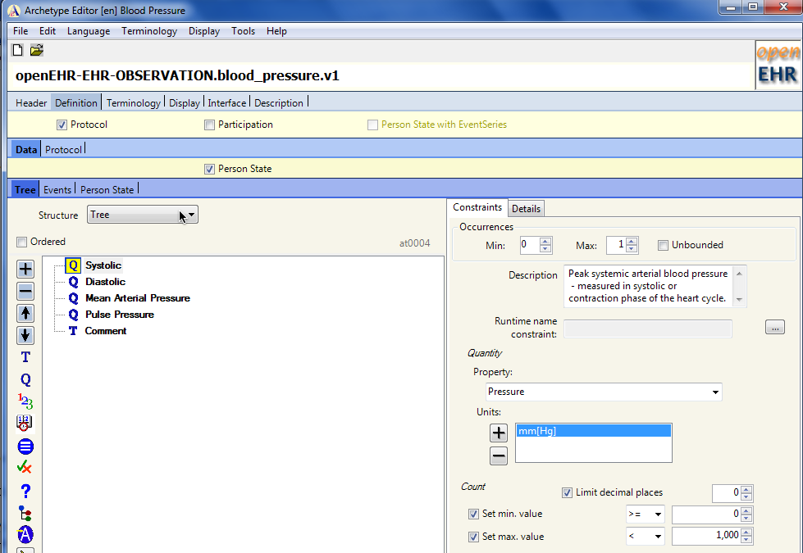

Slide 17
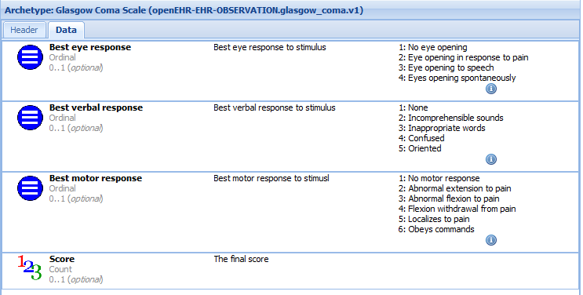
Clinical Knowledge Manager – Web review tool
www.openehr.org/ckm
© Ocean Informatics 2008
Notes:
17
This is a view of the same Glasgow Coma Scale clinical model expressed as an openEHR archetype and viewed in the openEHR Clinical Knowledge manager at www.openehr.org/knowledge.
Introduction to openEHR
May 8, 2008
openEHR + SNOMED CT = Making Health Compute
17

Slide 18
Templates - the openEHR ‘workhorse’?
Archetypes get the glory
  but templates deliver the datasets
  Key clinical endpoint and starting point for generation of technical artefacts
    Class libraries, GUI skeletons, Message schema
Most demand for clinical information content will originate as requests for datasets
  Data entry forms
  Diabetes shared care message
  Discharge summary message

Slide 19
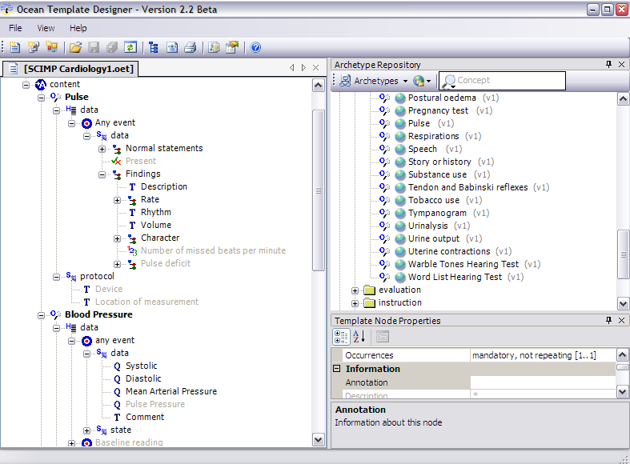
openEHR Templates
Notes:
openEHR templates are used in several different ways:
To aggregate together several archetypes for a particular use e.g to define data-entry requirements, content of a discharge letter or lab message.
To ‘constrain the Maximal dataset approach of individual archetypes to reflect a minimal dataset for local or national use.
To bind terminologies to the information model in an appropriate, safe and Agreed fashion.
This approach allows relatively few archetypes ? 1000’s to be re-used within a large variety of clinical settings while maintaining a high degree of interoperability but allowing for controlled local variability .
19

Slide 20
Archetypes and Templates
Diabetic checkup
Archetypes
Antenatal visit
Tingling feet
Feeling tired
FH
Back pain
Weight
66 kg
76 kg
BP
102/64 mmHg
124/92
HbA1c
142/min
7.5%
Issues
NAD, see 4/52
Excellent control
Assess
Template
Template
Notes:
20

Slide 21
Where does terminology fit?
Each archetype carries its own unique local terminology, with multi-lingual capacity
  “Diastolic” [at0005]
‘Bindings’ to multiple external terminologies
  Define a mapping to an external term, carrying both the mapped term and local archetype term in the data

Slide 22
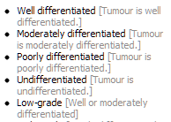
1. Termset binding to node value
LOINC: “Any Histopathology test”
2. Termset binding to node value
LOCAL: “Any Diagnostic service”
3. Term binding to a node name “Histological grading” SNOMEDCT::1256879
4. Term binding to a node valueset

Slide 23
Questions ?

Slide 24
Coffee break

