Slide 1

Vive la différence?
Dose Vs Product
Dose instructions syntax
Dr Paul Miller
paulmiller@nhs.net

Slide 2
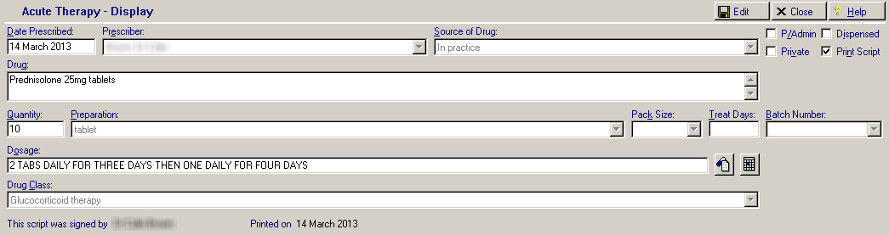
Prescribing Model

Slide 3
La différence…
Dose Based
Hospital / Secondary Care
Furosemide 80mg oral at 8am
Product based
General Practice / Primary Care
Furosemide 40mg tablets , take 2 at 8am

Slide 4


Interface
Furosemide 80mg oral at 8am
Furosemide 40mg tablets, take 2 at 8am

Slide 5
dm+d
Furosemide 40mg tablets
Furosemide 80mg oral at 8am
Furosemide
Furosemide 40mg tablets take 2 at 8am

Slide 6
Solve this with?
Models of dose & directions – ‘dose syntax’
Would allow calculation of e.g.
  Daily quantities
  Compliance
  Safety
  Dose comparison
Translation of
  Dose to Product
  Product to Dose

Slide 7
Model of dose and frequency
Dose
  40mg
  0.5mcg
  5ml
  2 tablets
  Thinly
  2 puffs qds
  If Systolic >160 take 80mg
Frequency
  Daily
  Three times a day
  Once daily at 18:00
  Every Wednesday
  Reducing by 1 tab a week to zero
Complex!

Slide 8

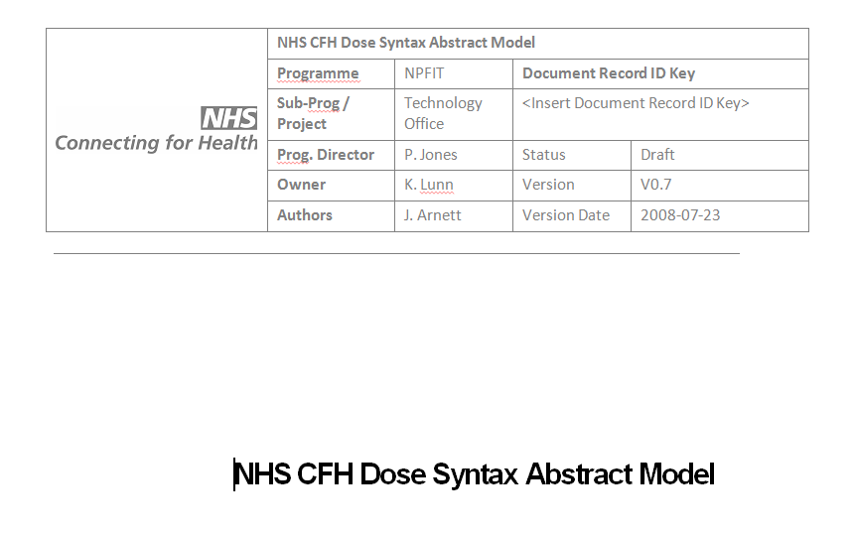
Work to date…
2005
2008

Slide 9
Dose Syntax Project
…all dosage instructions require human reading and interpretation and transcription between different systems, both of which offer a variety of opportunity for patient critical error to enter

Slide 10
Dose Syntax Project
Therefore, having a representation of dosage instructions in a format to support electronic use is a key requirement to move forward in such areas as automated data entry into prescription
Many systems have local vocabularies to produce dosage instructions ; however these are non -standard in both content and structure

Slide 11
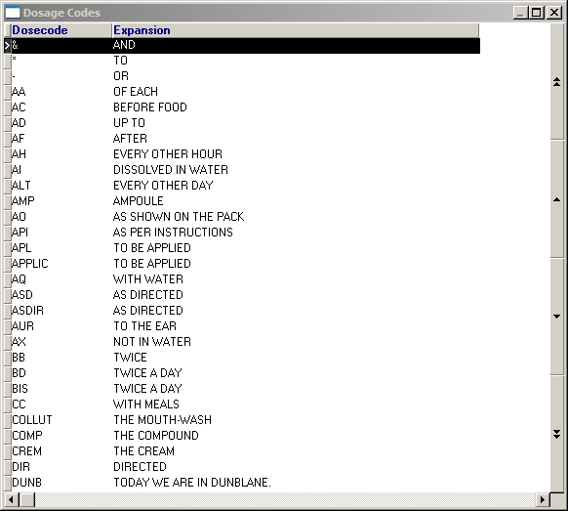
Vision ‘vocabulary’ example

Slide 12
Dose Syntax Project
Core Components
  dose quantity
  timing of the dosage
  route, site and method of administration
  rate of administration
  “additional information”
    (e.g. swallow whole, on an empty stomach).

Slide 13
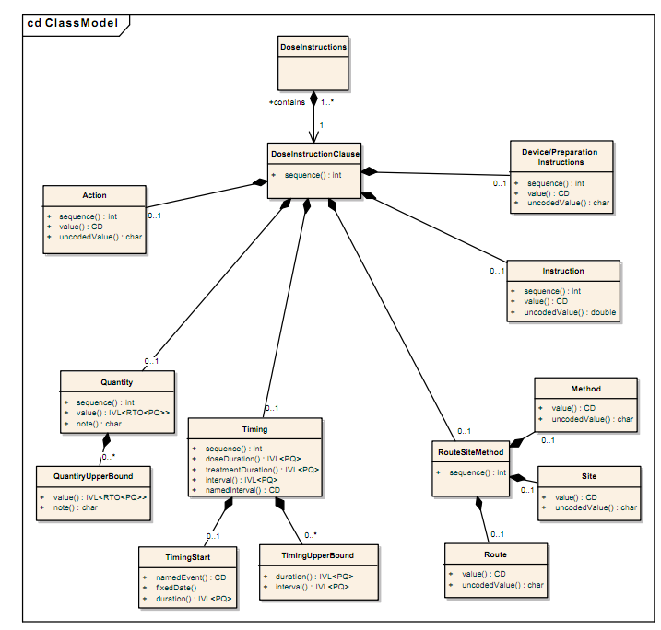
Dose Syntax Class Model

Slide 14
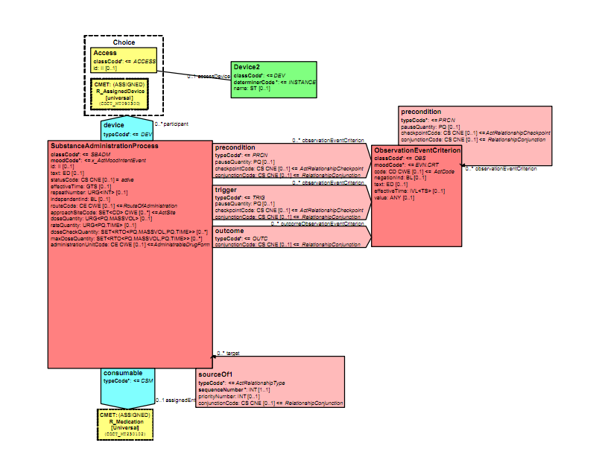
In HL7 V3 Pharmacy Model

Slide 15
Issues
Dose / Quantity
  Reducing doses
  mg/kg
Timing Issues
  ‘during waking hours’
  ‘except Mondays and Fridays’
Modelling issues
  “0.5 initially. If no joy, take 1 next time. Again if not successful take 2 next time”

Slide 16
NHS CFH Dose Syntax Abstract Model
“The Dose Syntax Abstract Model is intended to be independent of any technology standard or software platform and has been developed with the aim of specifying the necessary clinical requirements precisely and unambiguously”

Slide 17
NHS CFH Dose Syntax Abstract Model
Dose Comparison
Dose Conversion
Dose/Volume Calculations
Dose Range Checking
Ward Medicines Management
Usage within Primary Care
Dosage Presentation

Slide 18
Medication Administration
…contains the set of classes, and their relationships and constraints required to describe the administration of a medication

Slide 19
Described Medication
…the set of classes, and their relationships and constraints that represent aspects of a medication item relevant to specifying a structured Medication Administration Instruction.

Slide 20
Dose Quantities
…represent the key physical quantity attributes of dose quantity, dose timing and, for continuously administered medications, dose duration and dose rate…

Slide 21
Together…

Slide 22
Dosage Calculations
Dose Syntax Model:
  dose conversion calculations;
  dose / volume calculations; and
  dose rate calculations
…to be able to convert VTM or product-based dose quantities … into equivalent product-based quantities
…handling medications and prescriptions between primary and secondary care.
Discharge medication instructions…converted into product-based quantities.

Slide 23
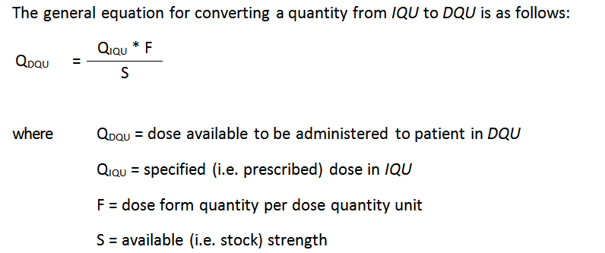
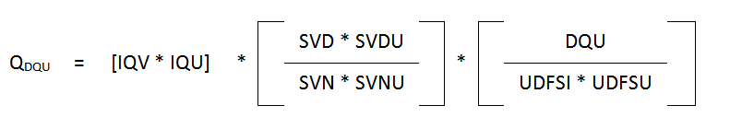
Using this!
Complex!

Slide 24
Example 45:
During an in-patient stay, a patient is given Atenolol 75 mg daily basis. When the patient is discharged, the discharge instructions to the GP ask for the patient to remain on Atenolol 75 mg daily until the GP is satisfied with the patient’s condition. If the GP wants to prescribe 318434003|Atenolol 25mg tablets|, how many tablets should be taken daily?

Slide 25
Example 45
doseInstruction
medication
medicationId | 87652004|Atenolol|
form | 3319411000001109|tablet|
doseQuantity
value | 75
unitOfMeasure | 258684004|mg|
unitOfMeasureType | IQU (ingredient qty unit)
administrationProcedure
route | 26643006|oral|

Slide 26
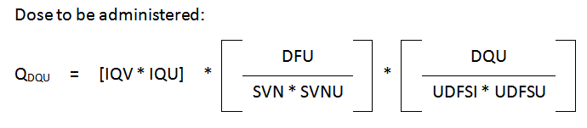
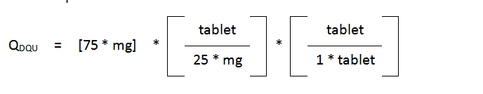
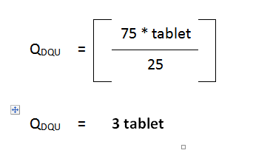
Example 45

Slide 27
So.. why not?
Still some issues
  29 noted
Basic problems to solve first
Implementation challenges
  Complexity
  User interfaces
  Safety
  Terminologies
But one day soon…

Slide 28
Summary
My ‘tds’ is not your 8:00; 14:00; 18:00
Patients swallow products
Prescribers advise doses
The interface needs a brain
Solvable problem
  But Complex!

