Slide 1
Playing all the right notes: next steps for medication models
Dr Libby Morris and Dr Ian Thompson
SCIMP
March 2013

Slide 2
Houston, we have a problem
Multiple methods of communicating medicines and allergies information from primary care to other parts of the NHS.
Challenge number 1: agree on one way of communicating these
Wider issue: lack of a sustainable mechanism for developing and maintaining clinical content standards
Challenge number 2: produce a mechanism to achieve this in a sustainable fashion

Slide 3
Scottish medication records
GPs
acute prescriptions, repeat prescriptions, ‘just in case’, anticipatory care
Nursing
extended prescribers, specialist roles eg palliative care, Community Psychiatric nurses and clinics
Drug clinics, Sexual health, care of the elderly
Pharmacists
chronic medication service, repeat dispensing
Secondary Care
Transitions of care, medicines reconciliation

Slide 4
Historical Background
Emergency Care Summary – 2004
SCI Gateway eReferrals- 2005
e-Pharmacy – 2007
Each designed by separate teams taking prescribing info from primary care systems
Similar, but not identical message content
Replicated *4 around the UK

Slide 5
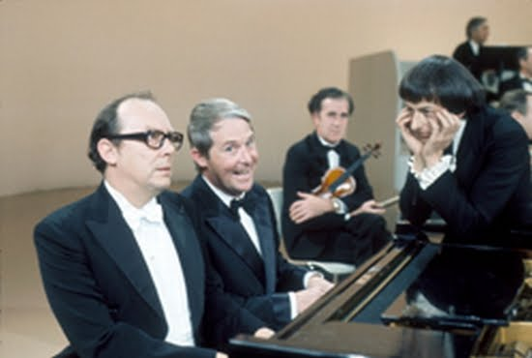
“I am playing all the right notes”…
“but not necessarily in the right order”.”

Slide 7
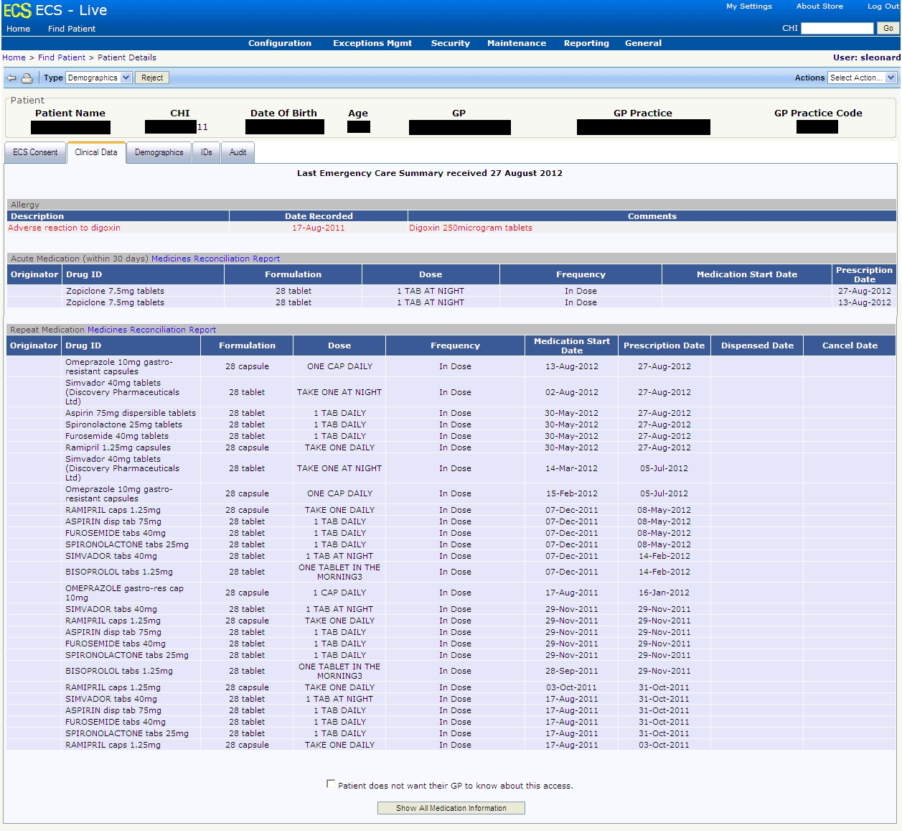

Slide 8
Medication at Transitions of Care
Secondary Care now recognise the need for structured messages
Asked to include DM+D coding in ECS
Need to define common medication standards
Allergies and adverse reactions
GP2GP leading the way ‘Allergy archetype’
Change is inevitable
Need a sustainable way of managing new requirements

Slide 9
A wider issue..
Medication ‘muddle’ is replicated for all clinical content
Not unique to NHS Scotland!
Ineffective ‘clinical content’ standards development
unresponsive to projects, vendor requests
which are forced to bypass ‘standards’ process
Unsustainable
Re-duplication of clinical requirements gathering
Impedes and delays information sharing efforts
Notes:
The issues that have been identified with Medication are really only part of a wider problem with the current management of clinical standards development. A lack of clear governance and change management forces message developers and vendors to bypass any standards to deliver their projects in a timely fashion.
As Scottish e-Health strategy demands increasing sharing of computable clinical information to support patient care e.g. telemedicine, patient pathways, health/social care integration, the current situation is becoming unsustainable. It forces needless reduplication of clinical requirements gathering, delays projects and adds significant cost and resource demands to both NHS Scotland and the vendor community.

Slide 10
Clinical content definition is not a technical problem
“Everything is vague to a degree you do not realize till you have tried to make it precise.” Bertrand Russell
Clinical content standards must underpin sharing of computable information
Clinical practices and needs often overlap and sometimes contradict
alignment can only be achieved by communication and discussion by all stakeholders
evolution is the norm and must be managed
Notes:
Local Scottish and wider International experience makes it clear that while sharing of computable clinical information must be underpinned by standards, the development and maintenance of those standards has proven very difficult in the past.
Successful clinical content standards can rarely be imposed by national e-health programs or professional bodies but must emerge through clinical practice and project need.
Continual change and evolution is the norm for clinical information and inevitably many of these emerging requirements overlap or contradic
Alignment can only be achieved by good communication between stakeholders guided by a light-touch national standards infrastucture which takes advantage of web-based, open-source methodologies to facilitate this process.

Slide 11
Summary
Medications and allergies modelling
Small scope but high value
Trial a different approach to standards development
Front-line clinical and vendor engagement
Needs web-based collaborative tools
Clinical content standards
Are vital to the aspirations of eHealth programs
Must be openly published and managed
Must be implementable

Slide 12
Mission statement
“Making the impossible very difficult”

