Slide 1
NHS Scotland Clinical Knowledge Manager
An introduction
Dr Paul Miller – paulmiller@nhs.net

Slide 2
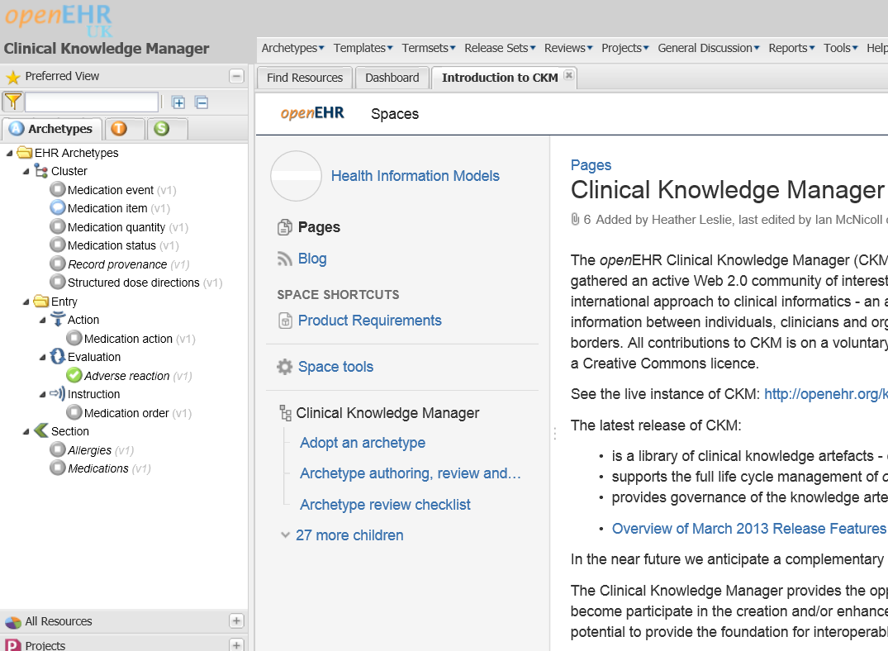
What is it?
Web based
Collabarative
‘Clinical Knowledge Resource’

Slide 3
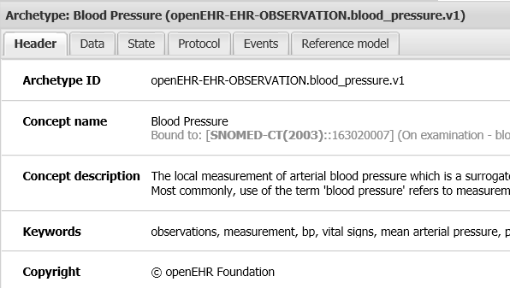
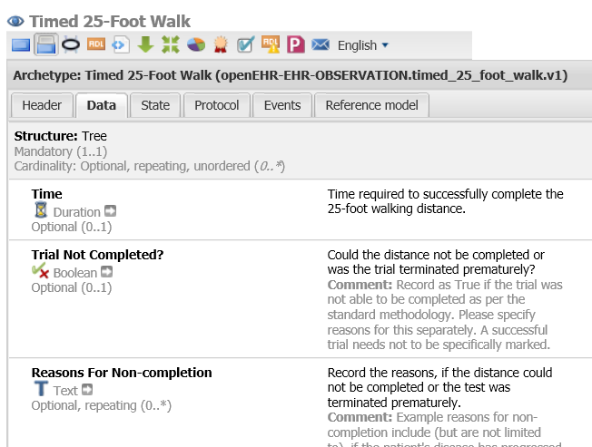
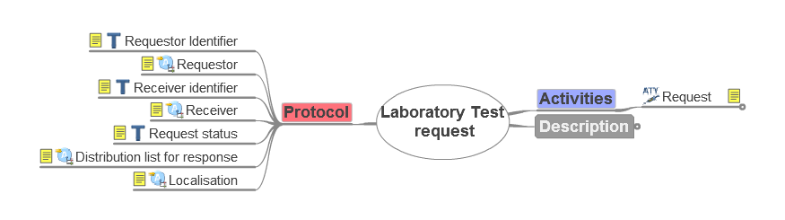
‘Clinical Knowledge Resource
A library
Supports review and publication
Provides governance
‘Clinical Knowledge Artefacts’
Archetypes
Templates

Slide 4
“The Clinical Knowledge Manager provides the opportunity and means for users interested in modelling clinical content to participate in the creation and/or enhancement of an international set of archetypes, and these in turn have the potential to provide the foundation for interoperable Electronic Health Records.”

Slide 5
Notes:
But a problem: the requirements of clinical data differ in different care contexts. Us simple GPs may only want to know about diastolics and systolics, but super duper clever hospital doctors may want to know all sort of other things, like position and cuff size.
So how do we get around needing multiple models for different care contexts?
In health informatics the concept of ‘Clinical Archetype’ is well established.
This is essentially just a model with all the elements in it that we need to cover most situations. So this is the blood pressure archetype with all the diastolic, systolic, korotkoff, laterality, cuff size position, machine etc – the works.
This is more stuff than is required in most clinical situations. So when it comes to using this archtype in real world situations we talk about using a ‘template’. This uses all the defined elements from our archtype that we require.

Slide 6
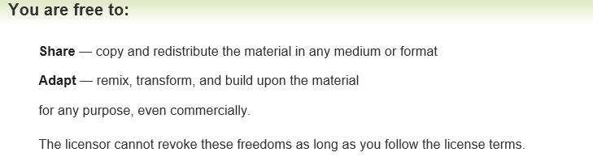
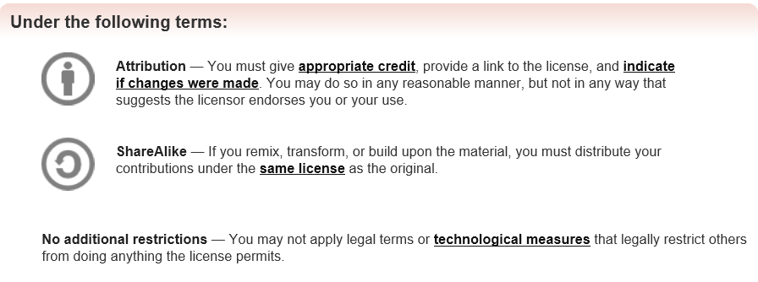


‘Open Source’
“All contributions to CKM are on a voluntary basis, and all CKM content is open source and freely available under a Creative Commons licence.”

Slide 7

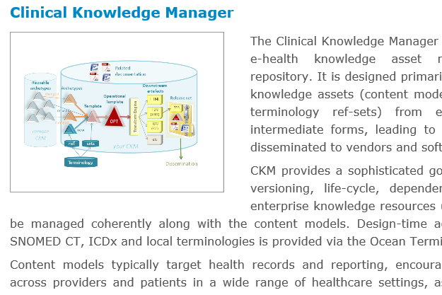
Ocean Informatics
Modelling toolset
Other software?

Slide 8
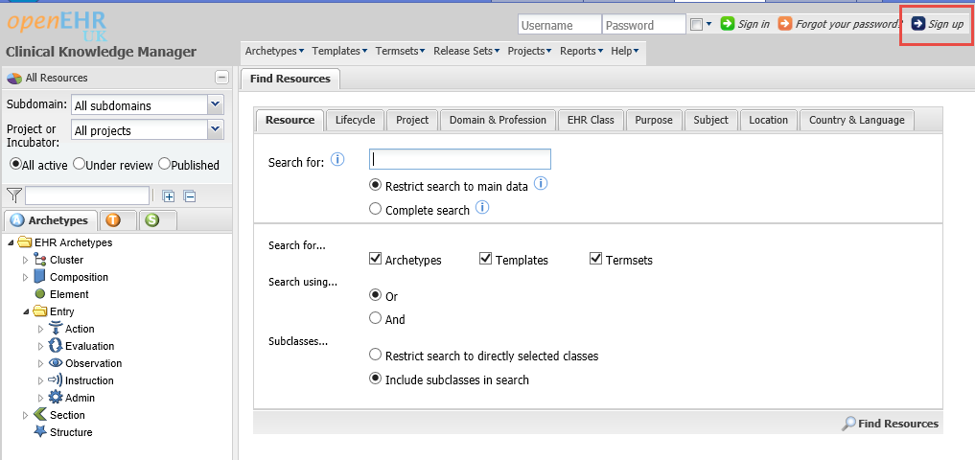
Go to: www.clinicalmodels.org.uk
Click on ‘Sign Up’

Slide 9
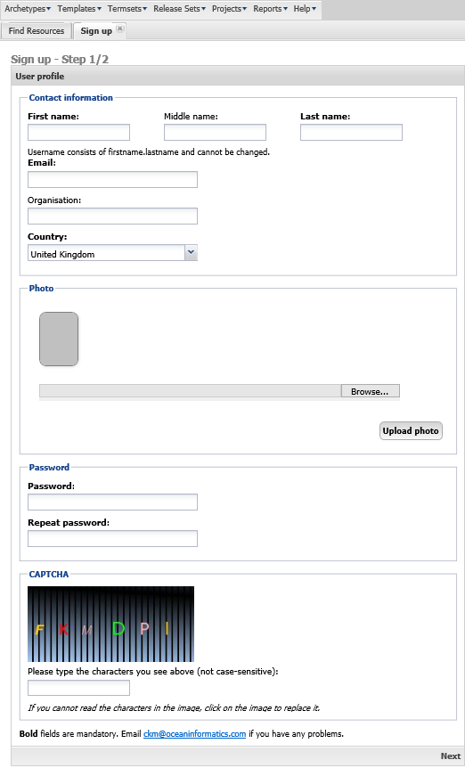
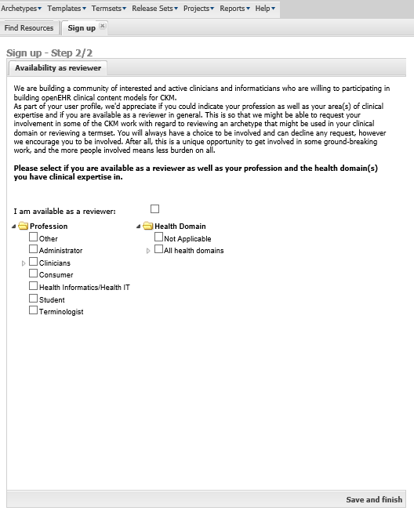
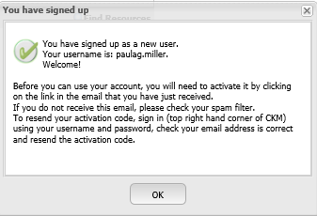
Register

Slide 10
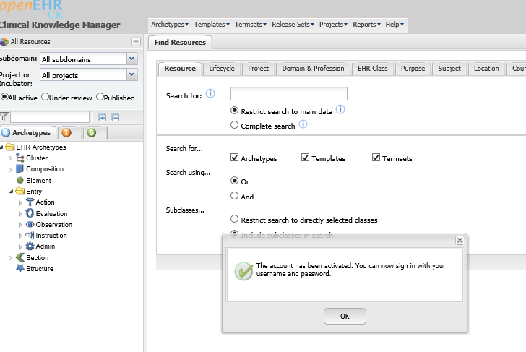
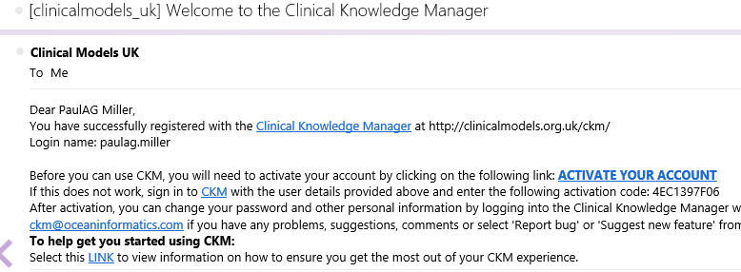
Activate
Follow this link!

Slide 11
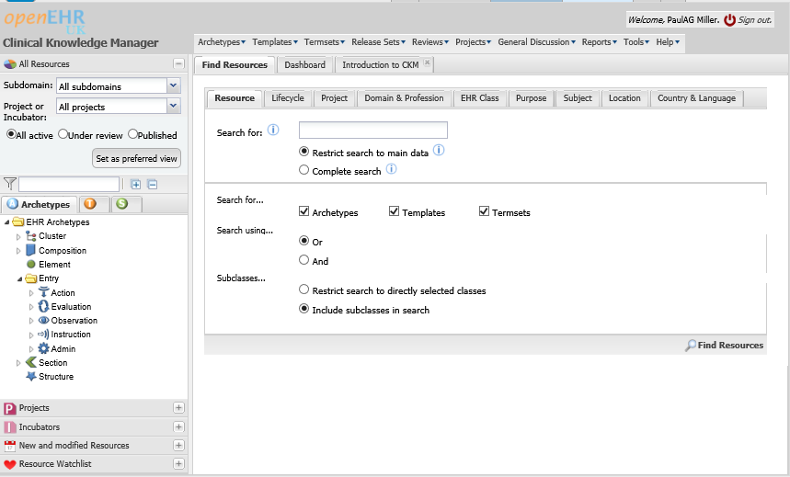

Sign in…
Navigation
Content

Slide 12
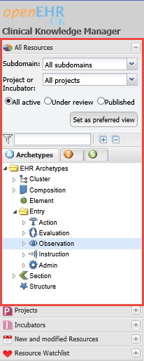
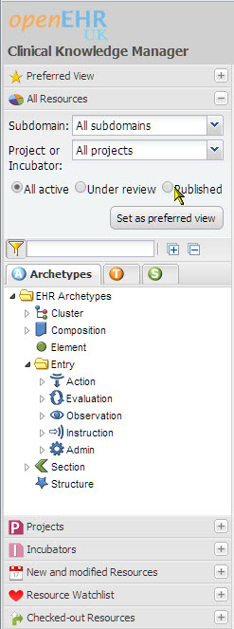
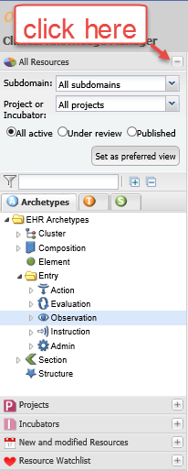
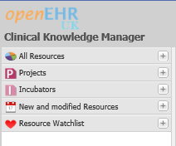
Accordion Tabs

Slide 13
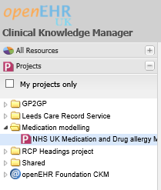
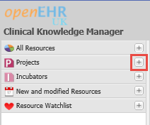
Projects
Double Click this

Slide 14
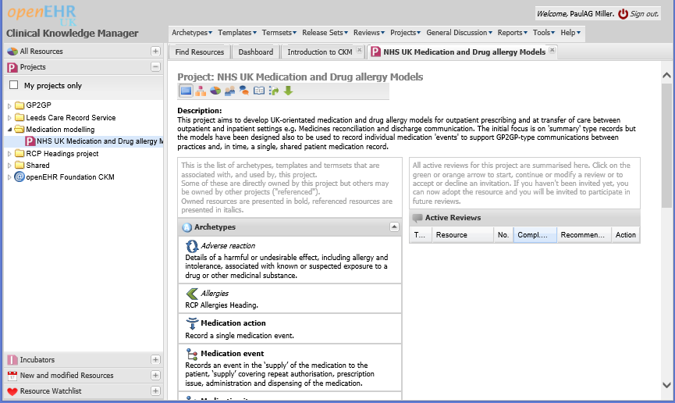
Opens in a tab…
Introduction
Archetypes
Reviews

Slide 15
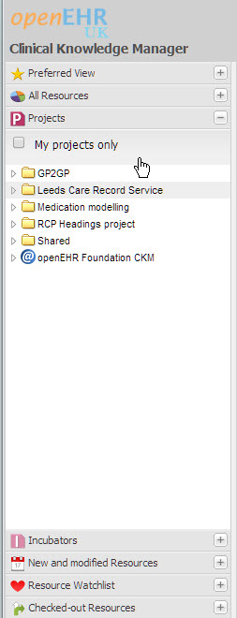
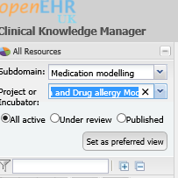
Set Preferred View
Select
Click Here

Slide 16
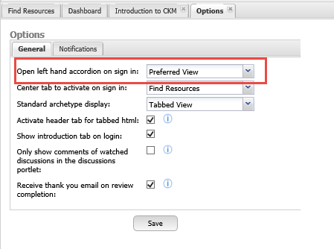
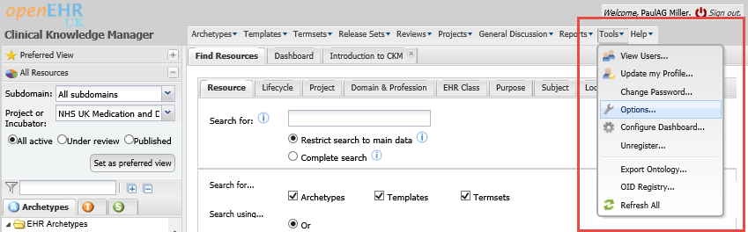
Make this the default
‘Preferred view’
Select ‘Options’

Slide 17
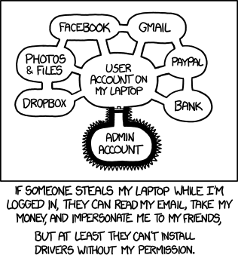
Log out!

Slide 18
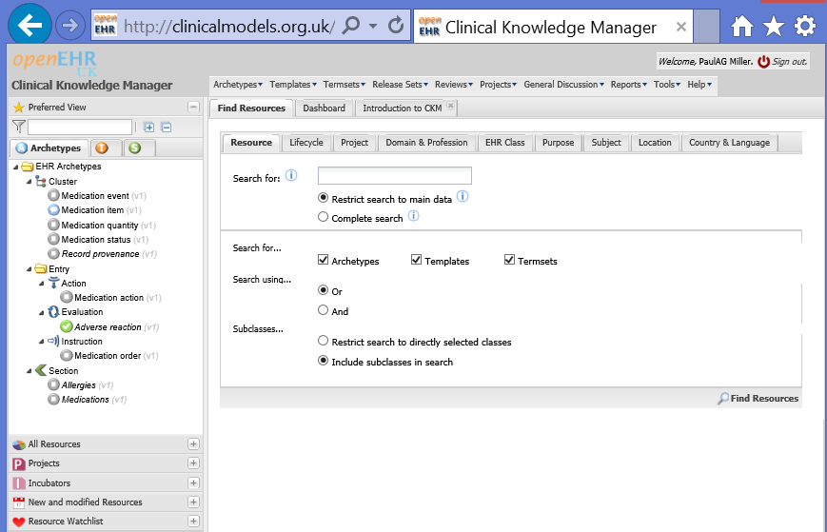
Log back in!

Slide 19
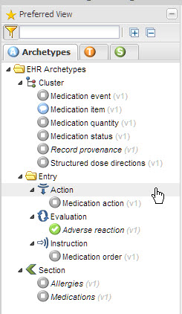
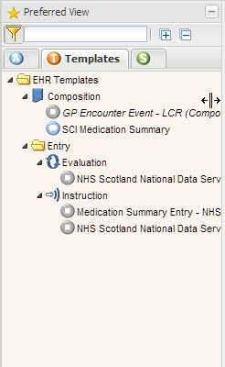
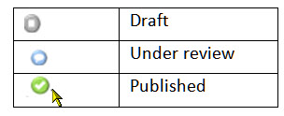
Preferred View Tabs
Cluster
Entry
Section
Composition
Instruction

Slide 20
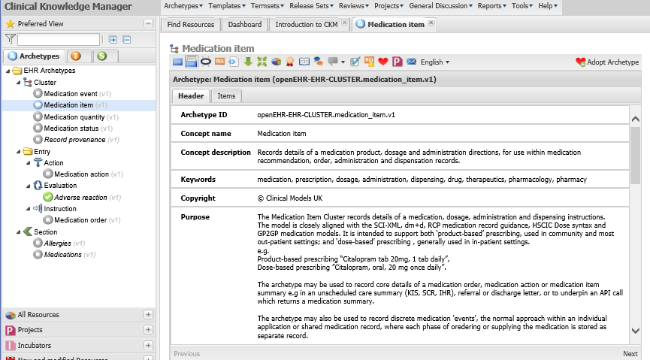
Open an item

Slide 21
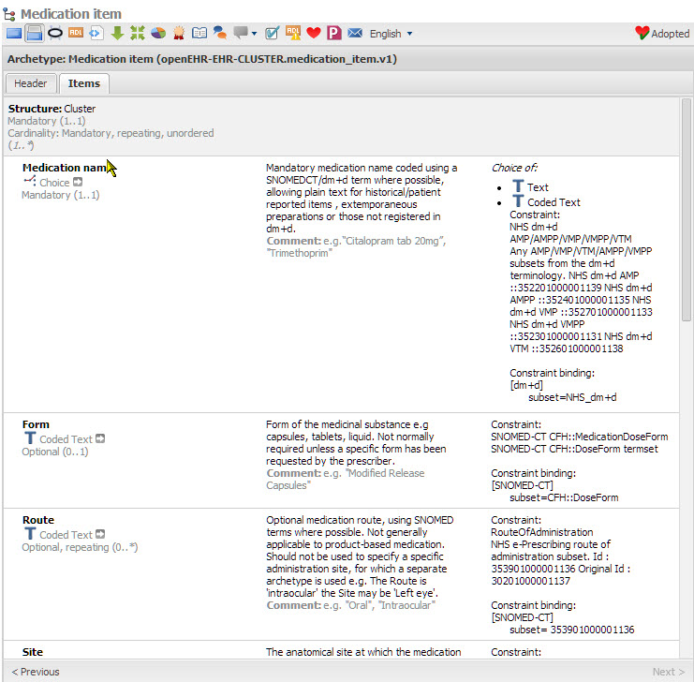
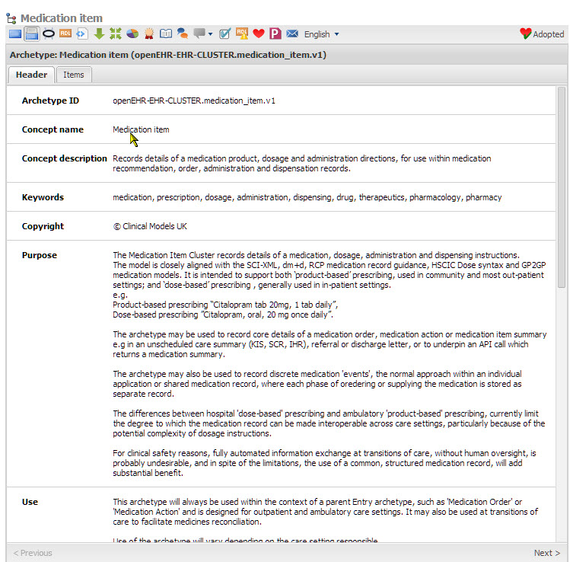
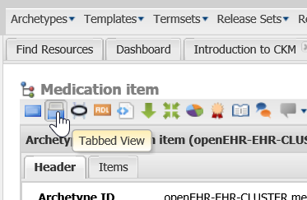
Views

Slide 22
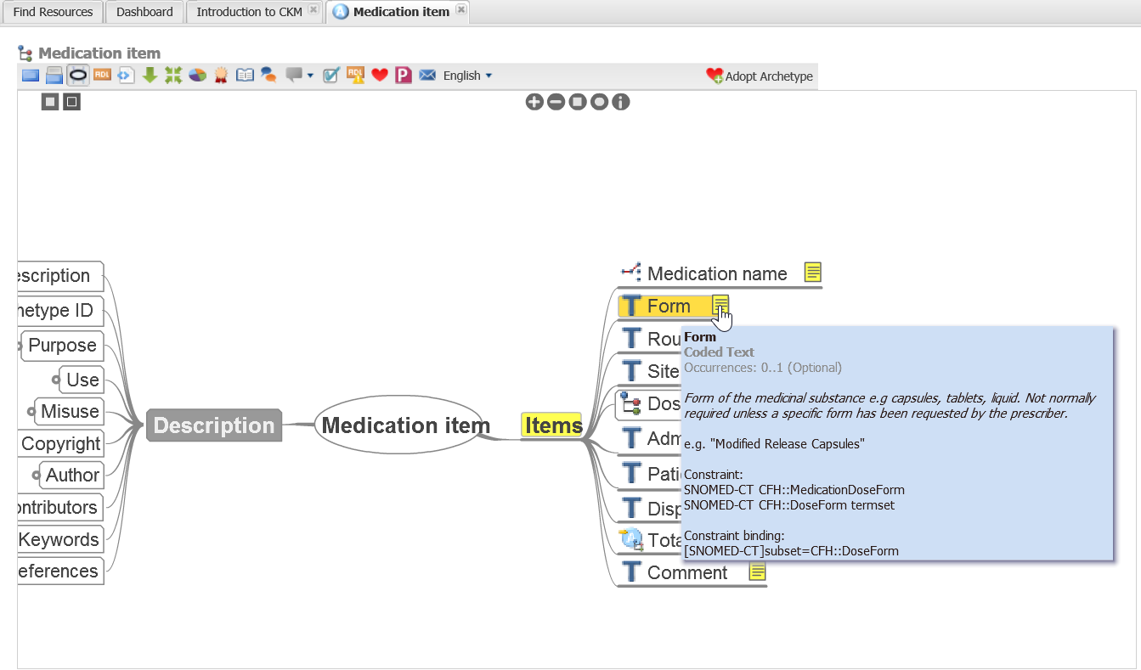
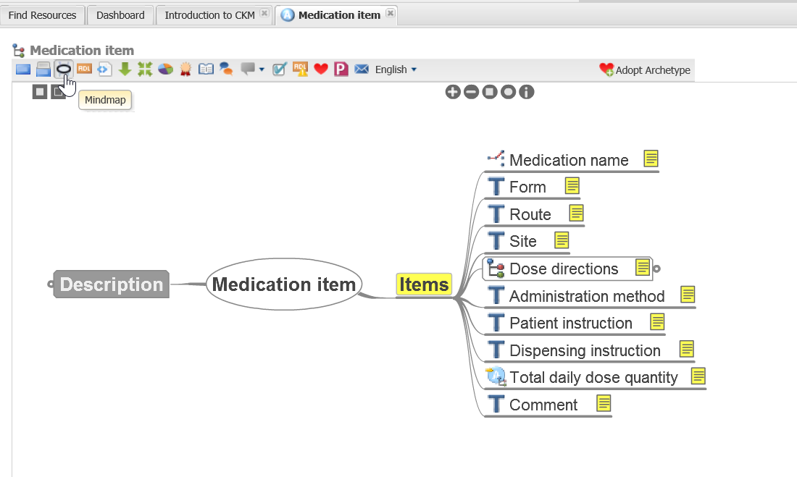
Mind Map

Slide 23
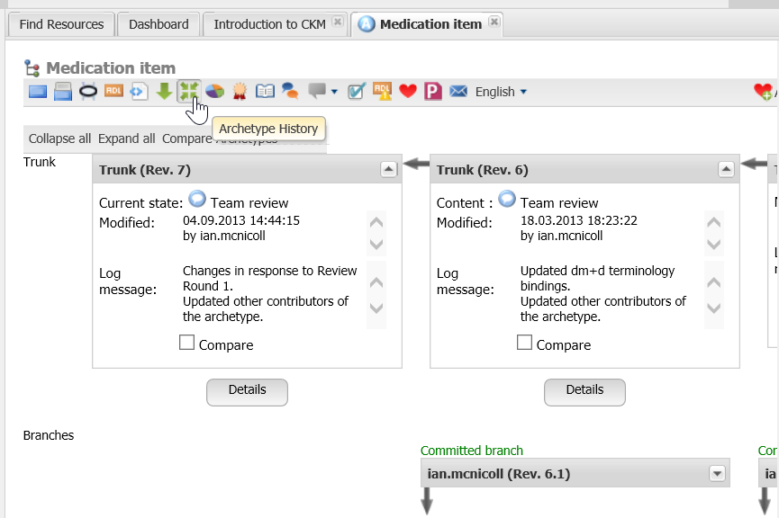
History

Slide 24
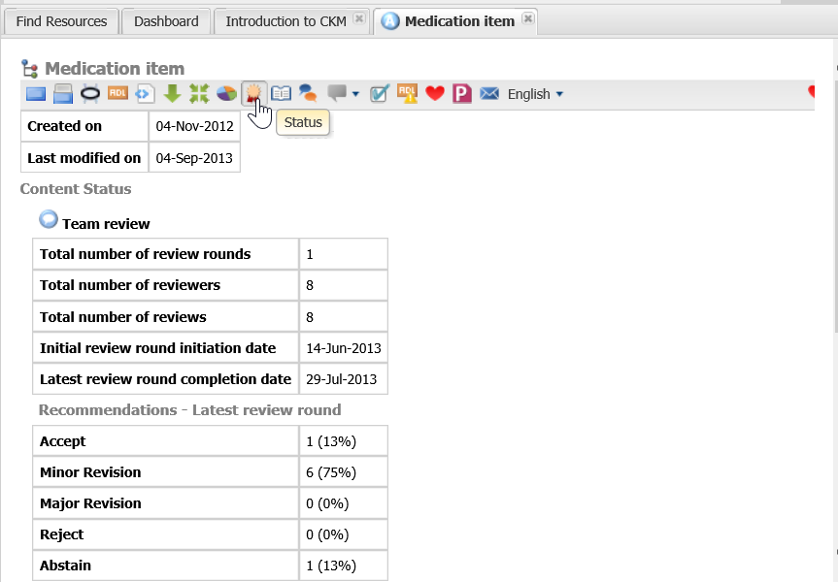
Status

Slide 25
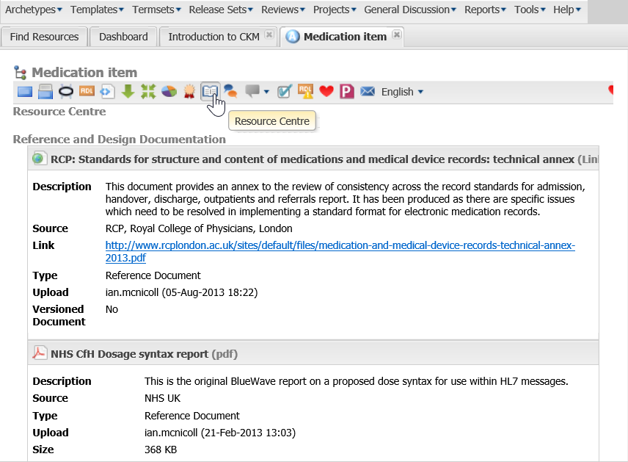
Resources

Slide 26
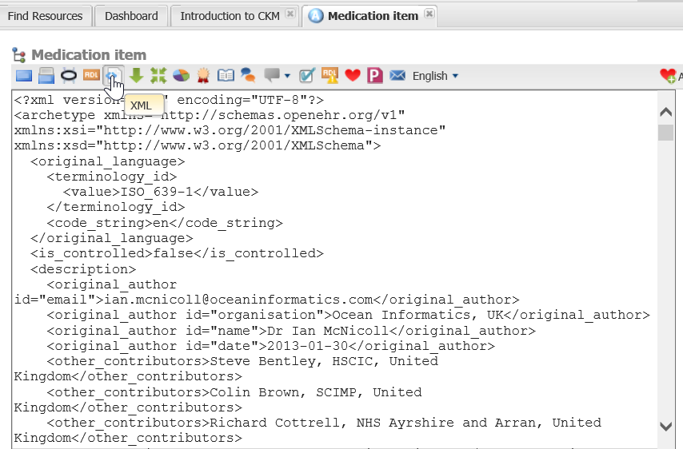
XML

Slide 27
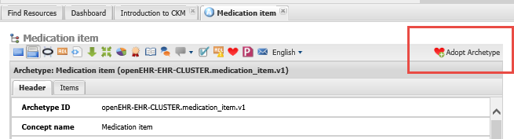
Adopting
Adopt all archetypes and templates that interest you

Slide 28
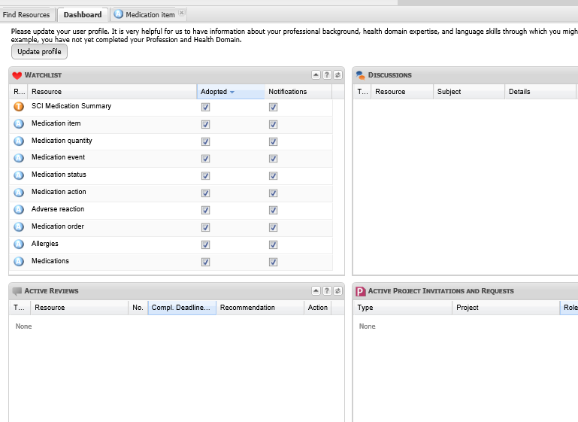
Dashboard

