Slide 1
NHS Scotland Clinical Knowledge Manager
Clinical Models and Reviews
Dr Paul Miller – paulmiller@nhs.net

Slide 2
How we roll

Slide 3
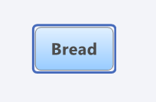
Take a real thing

Slide 4
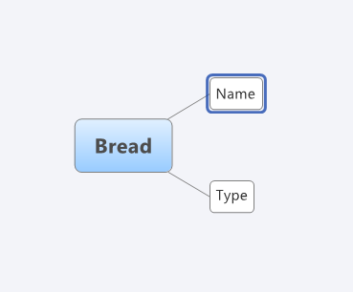
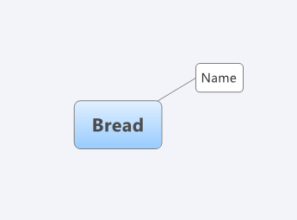
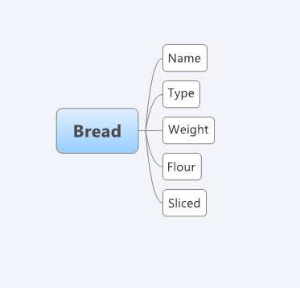
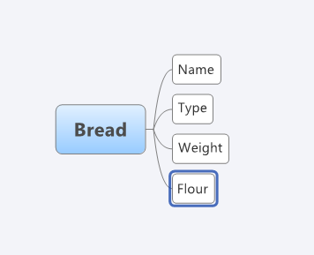
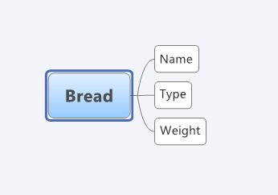
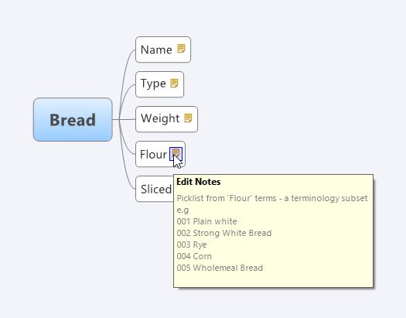
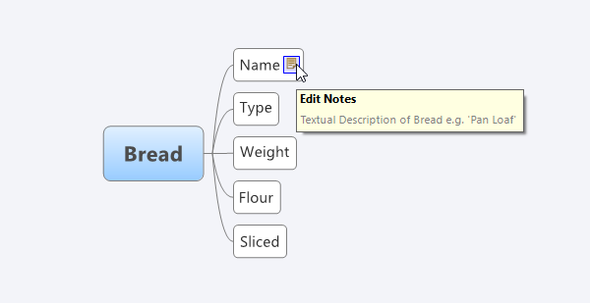
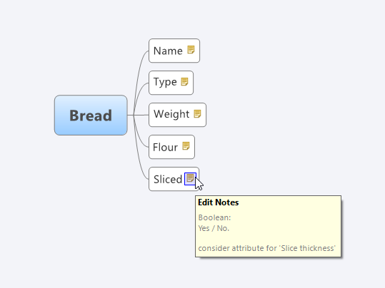
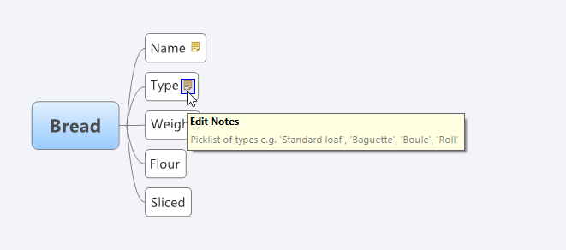
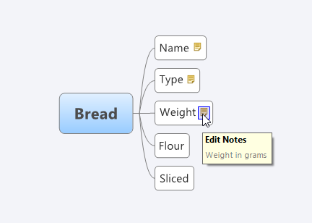
And ‘describe’ its parts

Slide 5
Agreement?

Slide 6
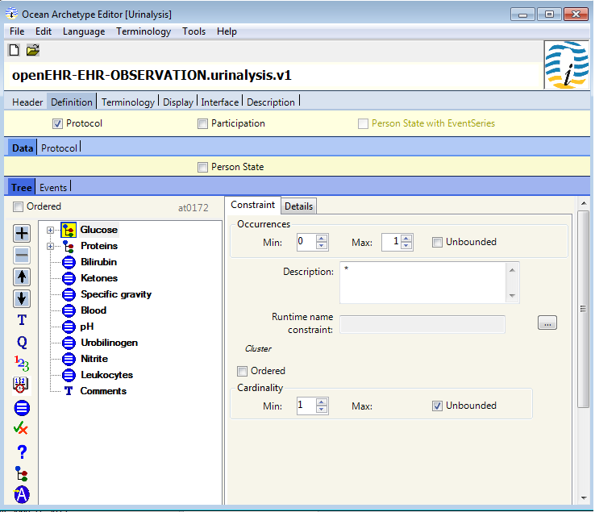
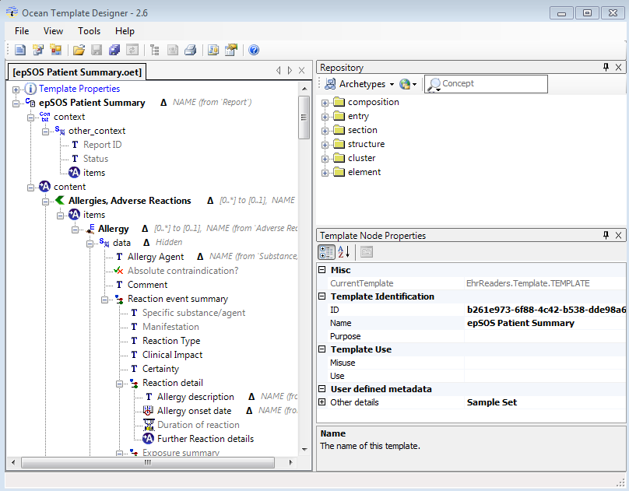
Design and Edit

Slide 7
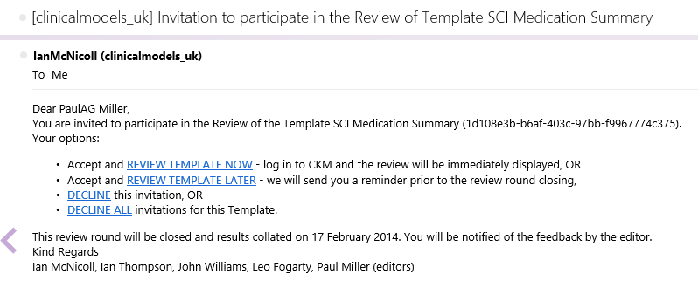
But Review…
Allows stakeholders to comment, discuss, argue and agree (!) on the models

Slide 8
Some guidance
Your perspective!
Does it ‘make sense’?
Not always a right or wrong
Editors final say

Slide 9
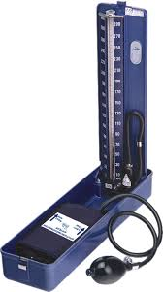
Content
Is the content:
Correct
Complete
Usable
Sensible?

Slide 10
Descriptions
A long handled, flat bladed, implement for digging?

Slide 11
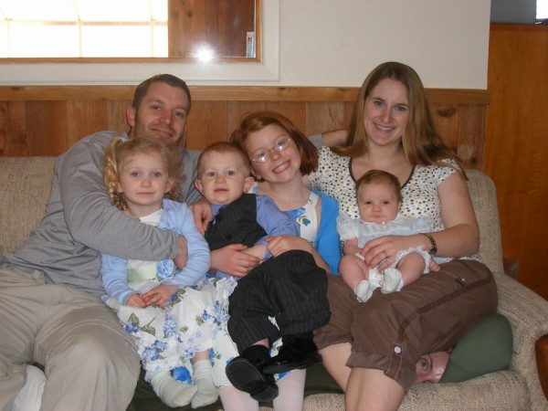
Anything wrong?

Slide 12
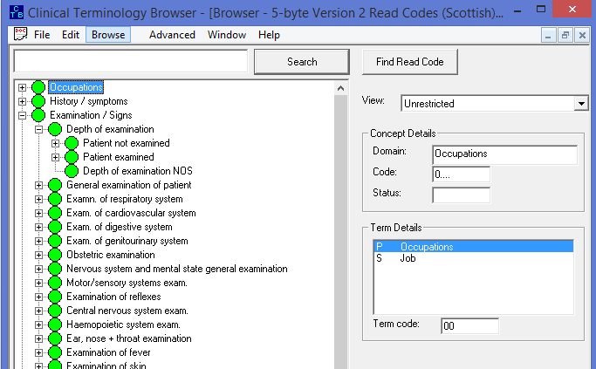
Terminology?
Or ‘Mandatory’ / ‘Optional’ status
Or data types
Or pick lists

Slide 13
Tpyos & Gmmara
Comment on any you find
How to review video:
http://www.youtube.com/watch?v=Uy-LfrG5U7Y

Slide 14
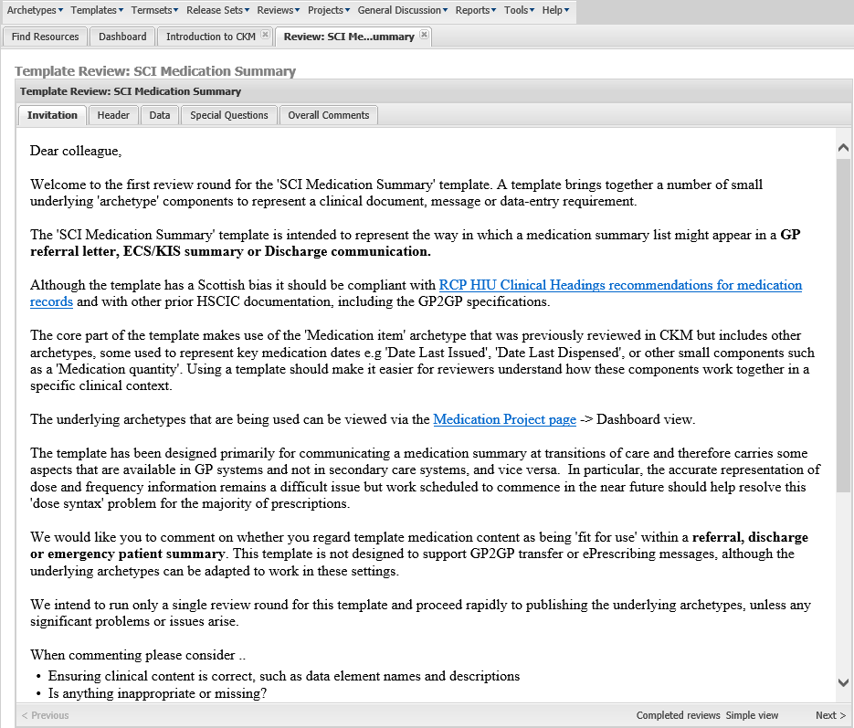
Review Introductions

Slide 15
Tabs

Slide 16
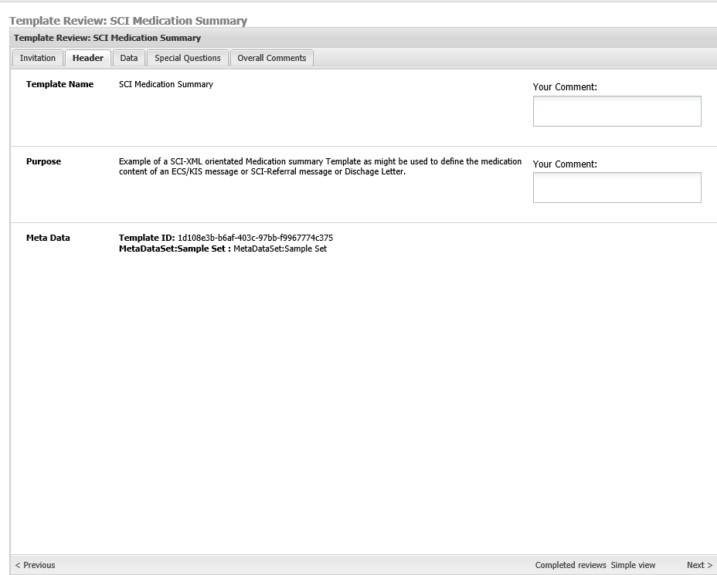
Header

Slide 17
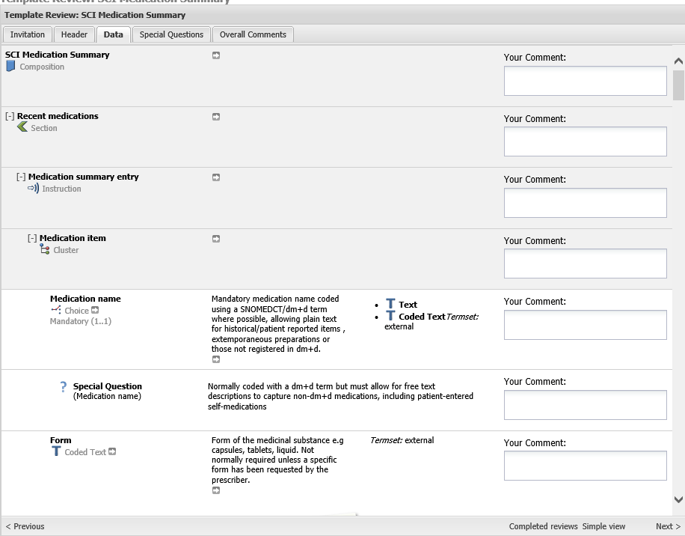
Data

Slide 18
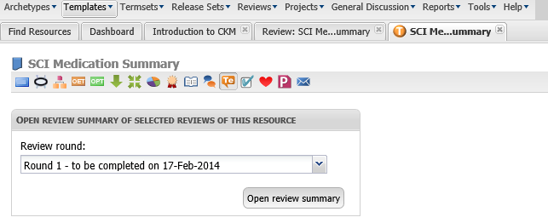
Other Reviewer’s Comments

Slide 19
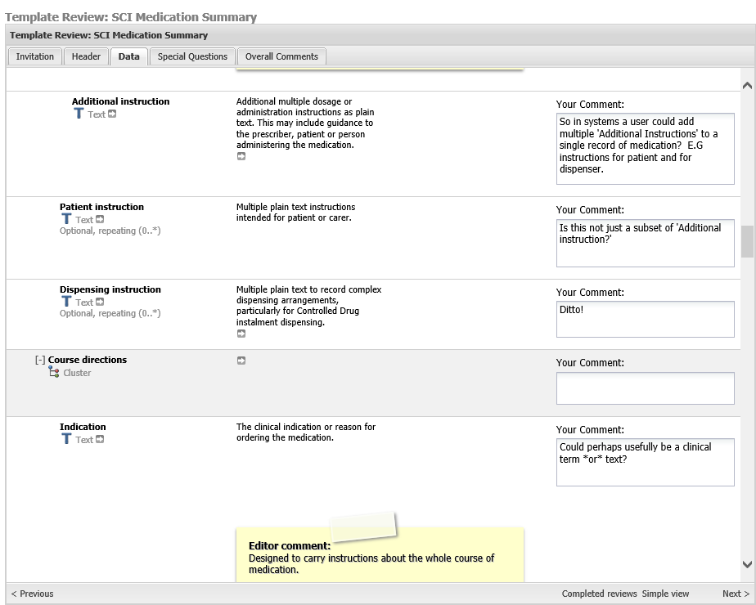
Your comments

Slide 20
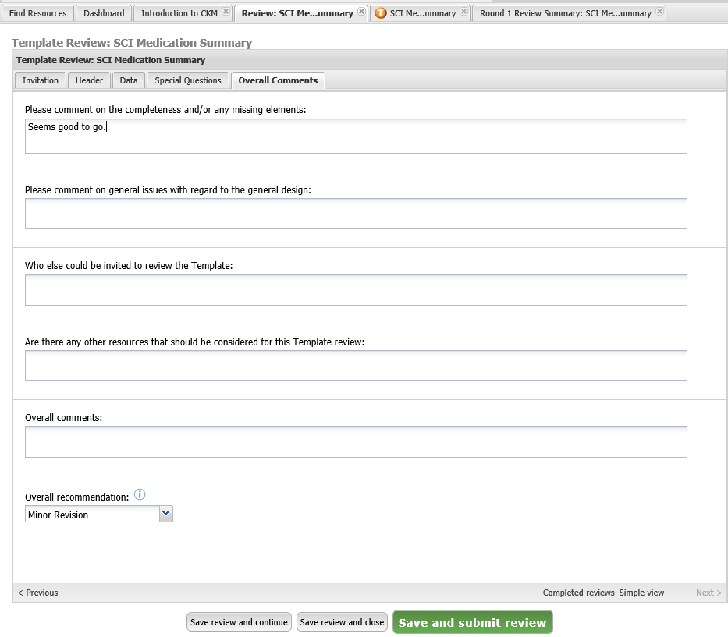
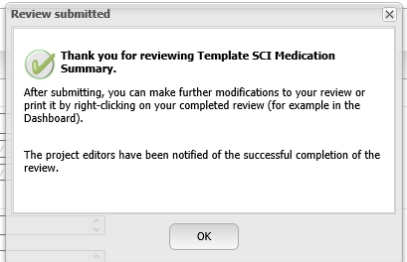
Complete your review

