Slide 1
Clinical Coding An Introduction
SCIMP
Dr Paul Miller , Dr Karen Lefevre

Slide 2
Terminologies – a variety
Read (1988 – Mainly used in Primary Care)
CTV3 (1999 - Clinical Terms Version 3)
OPCS Classification of Interventions and Procedures
ICD10 (International Classification of Diseases)
DM&D (Dictionary of Medicines and Devices)
SNOMED- CT (Systematised Nomenclature of Medicine – Clinical Terms)
+ various homemade systems

Slide 3
Read – a history
Initial V1 – 4 byte Read structured like ICD9 (last release 2009)
V2 - Only Version in use in Scotland nhs
Also V3 – CTV3
Heirachy of Clinical terms with codes (~88000)
Standard vocabulary to record findings, diagnoses and procedures
Extended to include drug and appliance dictionary (same structure).
Named after Dr James Read, Loughborough GP 1985 (V2 1991)
Purchased by UK government 1999
V2 was 6 monthly updates, Last update April 2016. No further updates
Being retired and replaced by Snomed-CT

Slide 4
Read – a history
V3 devised in 1990’s
Retained 5 byte codes but polyhierarchical
Codes independent from terms associated with them.
Enabled authoring – movement of codes and terms, deletions
Significant expansion of codes compared to READ V2, more suitable for other professionals, AHP’s, nursing
Able to ’post coordinate’, combine codes to form compound expressions. Eg, procedure combined with laterality.

Slide 5
READ V2
A…. Infectious and parasitic diseases
B…. Neoplasms
C…. Endocrine, nutritional, metabolic and immunity disorders
D…. Diseases of blood and blood forming organs
E…. Mental Disorders
F…. Nervous system and sense organ diseases
G….Circulatory system diseases
H…. Respiratory System diseases
J…. Digestive system diseases
K…. Genitourinary system diseases
L…. Complications of pregnancy, childbirth and the puerperium
M…. Skin and subcutaneous tissue disorders
N…. Musculoskeletal and connective tissue diseases
P….Congenital anomalies
Q…. Perinatal conditions
R…. [D]Symptoms, signs and ill-defined conditions
S…. Injury and poisoning
T….Causes of injury and poisoning
U…. [X]External causes of morbidity and mortality
Z…. Unspecified conditions
0…. Occupations
1…. History / Symptoms
2…. Examination/Findings
3…. Diagnostic Procedures
4…. Laboratory Procedures
5…. Radiology / Physics in medicine
6….Preventive Procedures
7…. Operations, Procedures, sites
8…. Other therapeutic procedures
9…. Administration
Medication codes all start lower case letters.

Slide 6
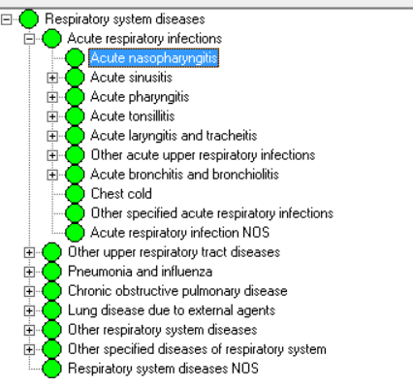
Read Codes
Flat Hierarchy
Parent & Child
One way up or down

Slide 7
Read V2 Heirarchical
Always 5 bytes (so dots ‘…’ important).
0.... Occupations
03... Education/welfare/health prof.
03D.. Medical practitioners
03DC. General medical practitioner
G.... Circulatory system diseases
G3... Ischaemic heart disease
G30.. Acute myocardial infarction
G307. Acute subendocardial infarction
G3071 Acute non-ST segment elevation myocardial infarction

Slide 8
Read V2 - Preferred and Synonym terms
Different terms for same code. Each has own Term code.
G30.. 00 Acute myocardial infarction - Preferred Term
G30.. 11 Attack - Heart - Synonym
G30.. 12 Coronary Thrombosis - Synonym
G30.. 14 Heart attack - Synonym
G30.. 15 MI - Acute Myocardial Infarction - Synonym

Slide 9
Read - Abbreviations
NOS – Not Otherwise Specified (use when nothing more specific available or wanted)
NEC – Not Elsewhere Specified -
Chapter R – [D] terms – ‘Symptoms Signs and ill-defined conditions’. Coding a symptoms as a Disorder
[SO] - Site of. Under 7N…but doesn’t describe an actual procedure
[M] – Morphology of Neoplasms. Codes start BB…
H/O – past medical history. In 14… Chapter but not a diagnostic code.
FH – Family History of… Chapter 12…
[X] – Indicates code has an equivalent code in ICD10. Usually in Eu… Mental and behavioural disorders.

Slide 10
Read V2 - Issues
Absence or negation (Issues for searches)
171.. C/O – cough
1711. No cough
1712. Dry cough
Incorrect Synonyms
M07z. 00 Local infection skin/subcut tissue NOS
M07z. 11 Infected insect bite
M07z. 12 Infected skin ulcer
M07z. 13 Septic spots
M07z. 14 Dermatitis
M07z. 15 Sinus

Slide 11
Read V2 Issues
Local Codes
Emis has ability to create own codes, in the form EMISxxxxx or EGTONxxxxx. Similar across EMIS systems. Often similar READ code. Others in form PCSDTnnnnn_ccc are site specific used codes from previous clinical systems not yet mapped, or PCSnnnnnaac are created by specific site.
Redundant terms – difficult to retire
Was done with derogatory terms for learning disabilities

Slide 12
Read V2 Issues
Limited Space for new codes
Leads to codes in wrong hierarchies and duplication of codes.
Not suitable breadth of terms to accommodate different needs across health and social care.

Slide 13
Snomed- CT stands for
Systematised
Nomenclature
Of
MEDicine
Clinical
Terms

Slide 14
Snomed-CT about
A comprehensive clinical terminology used to code, retrieve and analyse clinical data (includes dentistry, veterinary, pharmacy, laboratory etc.)
>315,000 active concepts (Read 88,000)
Developed by NHS and the College of American Pathologists (CAP)
Merges the content of the NHS’s Clinical Terms Version 3 (The Read Codes) with CAP’s SNOMED Reference Terminology (SNOMED RT®)
NHS Digital in England is National Release Centre for Snomed-CT. Governance by UK Strategy Board (4 nation representatives)
An international system (approx 35 countries with licences)

Slide 15
Snomed-CT about
Transition on-going to replace Read codes in Primary Care with Snomed-CT.
Deployed to GP practices in a phased approach from April 2018 (in England managed under GPSoC framework)
Other areas of nhs and community care planned to use Snomed-CT by 1.4.2020
Dictionary of Medicines and Devices (dm&d)
Use is free in UK but does require a license

Slide 16
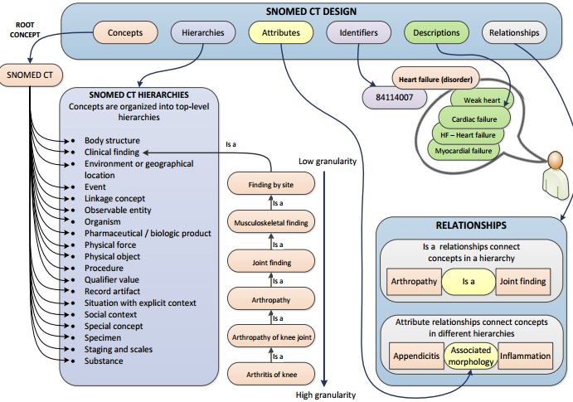

Slide 17
Concepts
Represent clinical thought with wide range from abscess to zygote.
Each one represents a unique clinical meaning
Each has a unique numeric concept identifier.
In heirachy’s are organised from general to more detailed
“Common cold”
“On Exam Blood Pressure”
“Gout”
Common cold (disorder)
On examination – bp reading (finding)
Gout (disorder)
SCTID: 82272006
SCTID: 163020007
SCTID: 90560007

Slide 18
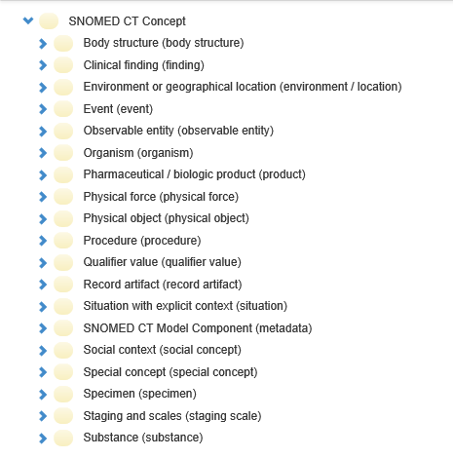

Slide 20
Attributes (Relationship Types)
Links concepts whose meaning is related in some way
Further defines concepts
Finding Site – what bit does it affect?
Causative Agent – what thing causes this?
Associated Morphology – what happens at a tissue level?
50 types used by 9 hierarchies, each has unique numeric relationship identifier
Logical model stops silliness
Domain – The Hierarchy to which the attribute can be applied |Procedure| cannot have |associated morphology|
Range – the set of concepts allowed as values The range for the attribute |finding site| is |body structure|

Slide 21
Concept Relationship type Concept
(source) (destination)
______________________________________________________________________________________
44054006 116680003 73211009
diabetes mellitus type 2 Is a diabetes mellitus
(disorder) (attribute) (disorder)
44054006 363698007 113331007
diabetes mellitus type 2 Finding site structure of endocrine system
(disorder) ( attribute) (body structure)

Slide 22
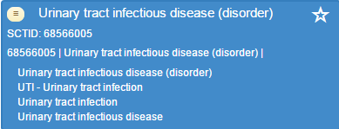
Identifiers
Is the number
Unique for every concept, description, relationship
Up to 18 digits
Not going to remember them!
Have to use the words

Slide 23
Descriptions
Description Types
Fully Specified Name (has brackets (hierarchy))
Not meant to be used in records interfaces (!)
Synonyms
Acceptability
Preferred (only one)
Acceptable (none to many)

Slide 24
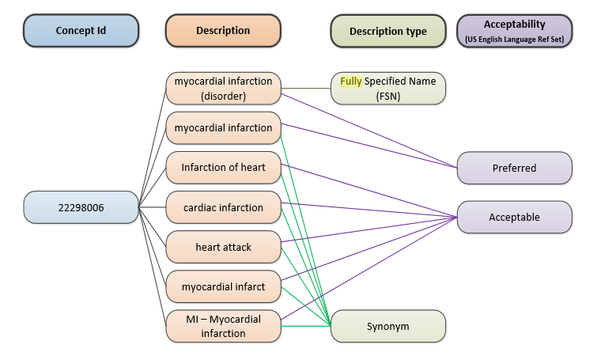

Slide 26
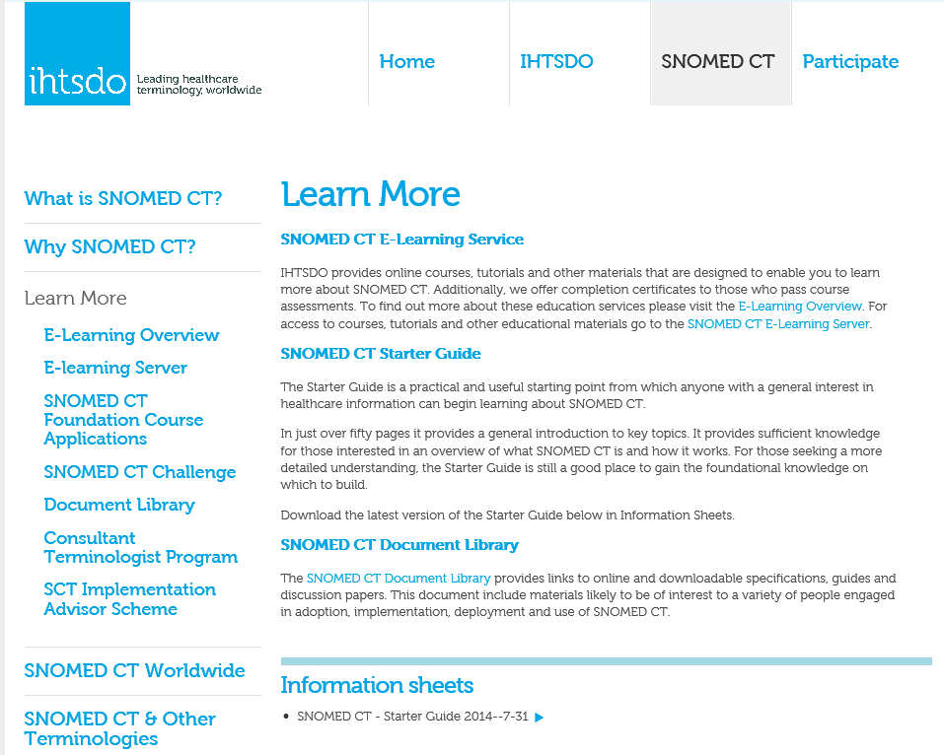
More Information
Browser:
http://browser.ihtsdotools.org/
IHTSDO Learning Centre:
http://www.ihtsdo.org/snomed-ct/learn-more

Slide 27
