Slide 1
NHS Scotland Clinical Models
Dr Paul Miller – paulmiller@nhs.net

Slide 2
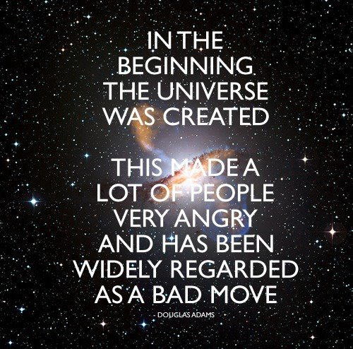
Notes:
In the beginning GP practices started using computers to do things. This was great.

Slide 3
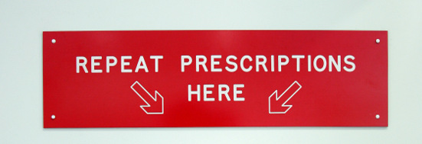
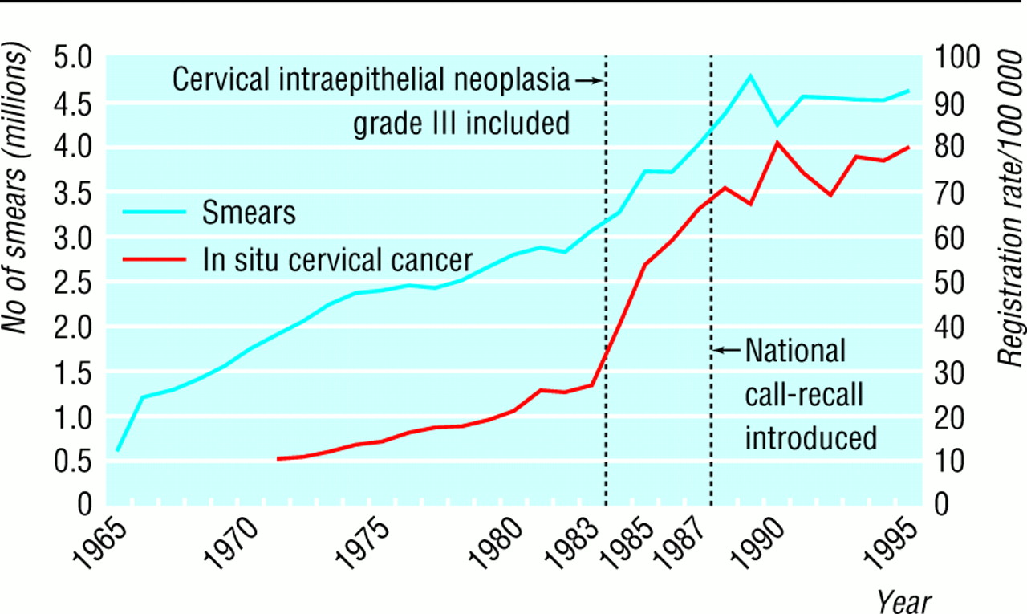
Notes:
Everyone loved them because we could hack out new systems for managing repeat prescribing and call / recall systems

Slide 4
Notes:
While we all worked in relative isolation, sharing records using a standard format – the A4 file – and exhanging them by little green men running round with packages.
As soon as we started hooking up our computer systems, however, we lost this communication standard and ran into some problems. Now we no longer work in silos.

Slide 5


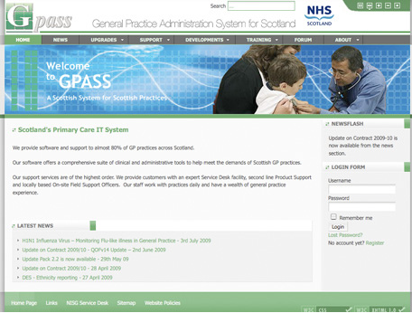
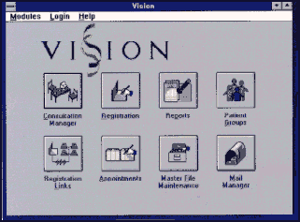
Notes:
The developed further and we got more and more complex clinical information systems allowing us to manage all the day do day tasks of record keeping for our patients and practices.
And that was fine…

Slide 6
Notes:
While we all worked in relative isolation, sharing records using a standard format – the A4 file – and exhanging them by little green men running round with packages.
As soon as we started hooking up our computer systems, however, we lost this communication standard and ran into some problems. Now we no longer work in silos.

Slide 7

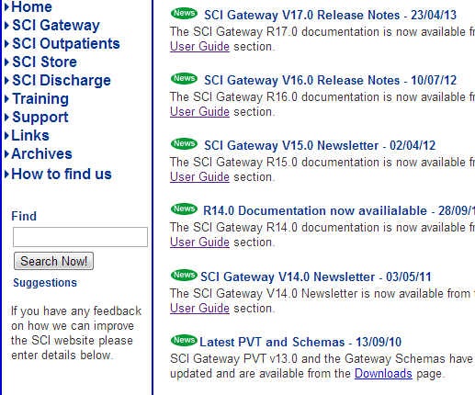
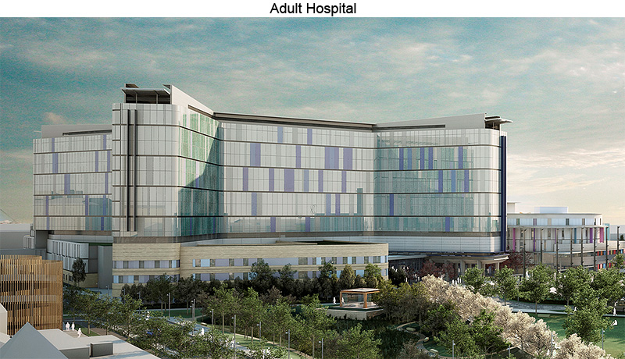
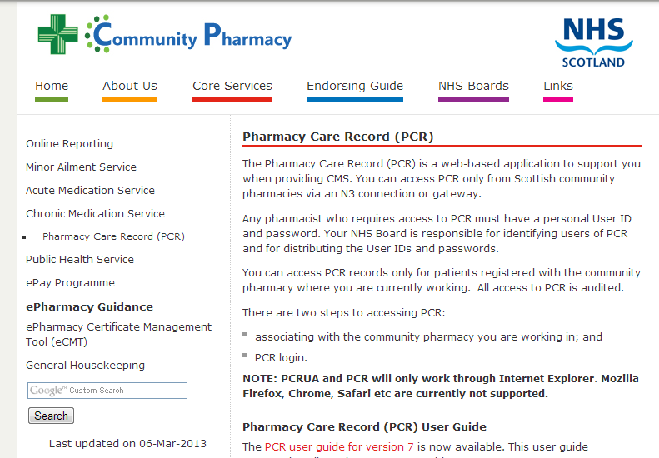

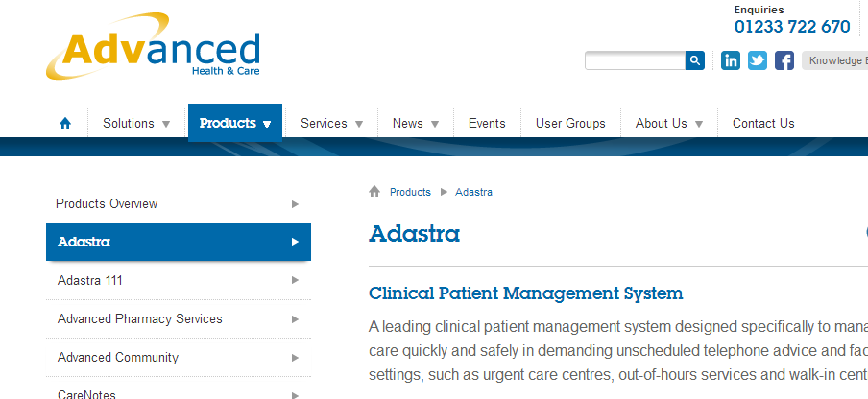
Notes:
Now all these organisations and more are extracting and using and exchanging data from GP systems.
And to do this reliably they have all run into the same problem.
The way one systems defines a clinical concept, may not be the way another defines it.
To fix this, we have had great work done by a variety of different organisations to meet their specific use cases.
And this in itself has led to some problems

Slide 8
Current designs
HSCIC Messaging – GP2GP
NHS Scotland SCI XML
NHS Wales IHR
dm+d
RCP Core Clinical Headings
RCP Standards for structure & content
Emergency Care Summary
EMIS
Vision
OpenHR – MIG
Adastra
Gemscript
FDBE
HL7v3
Notes:
So we have a multiplicity of different formats for exchanging information between systems.
The work we are doing at the moment focuses on medications and adverse reactions.
You can see from this list how many different ways organisations and projects have devised to exchange medication information between disparate systems.
Not one of these is the same. Each fixes a bespoke problem in a bespoke way.

Slide 9
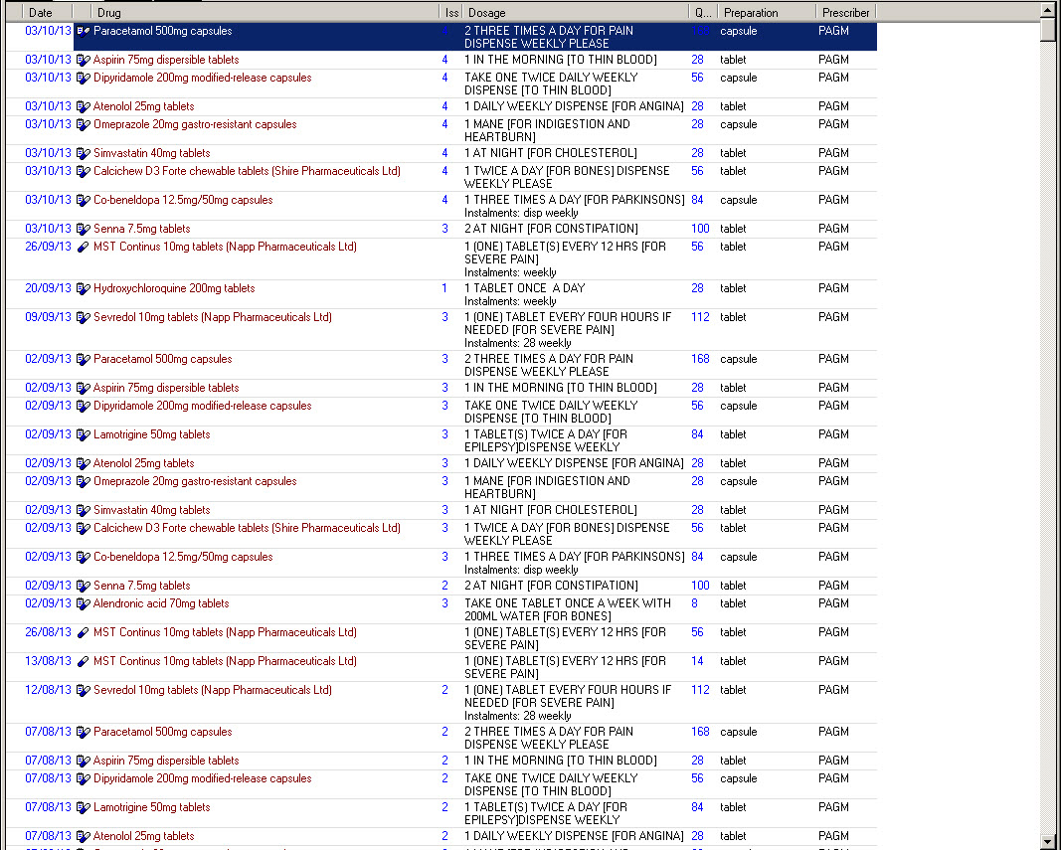
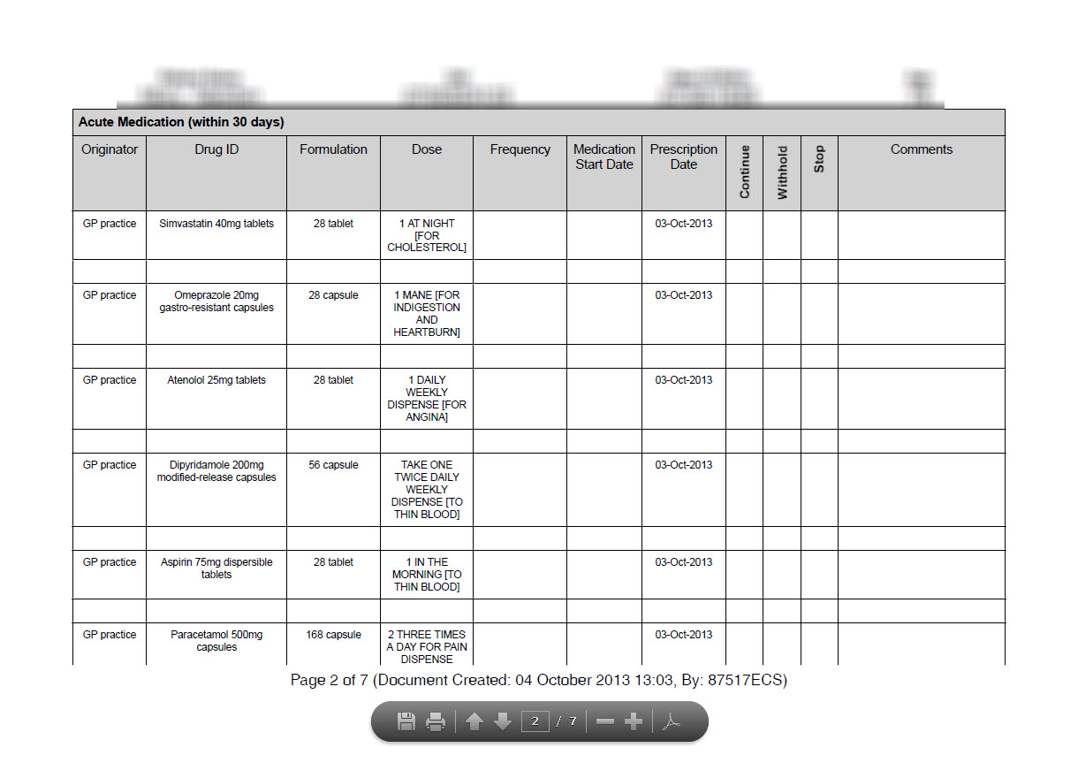
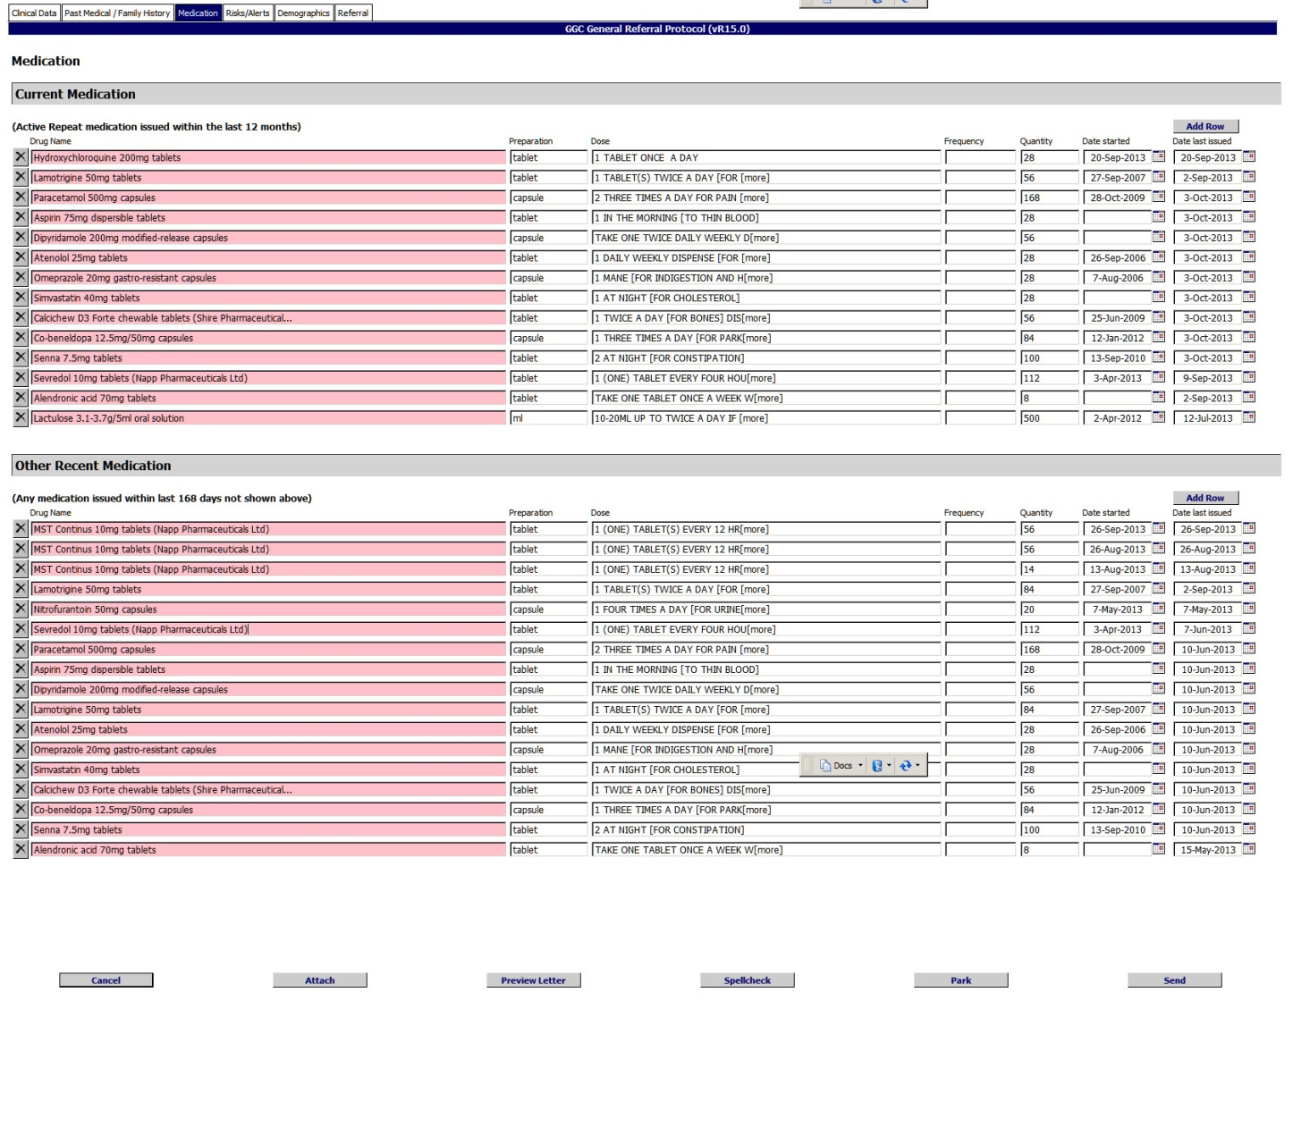
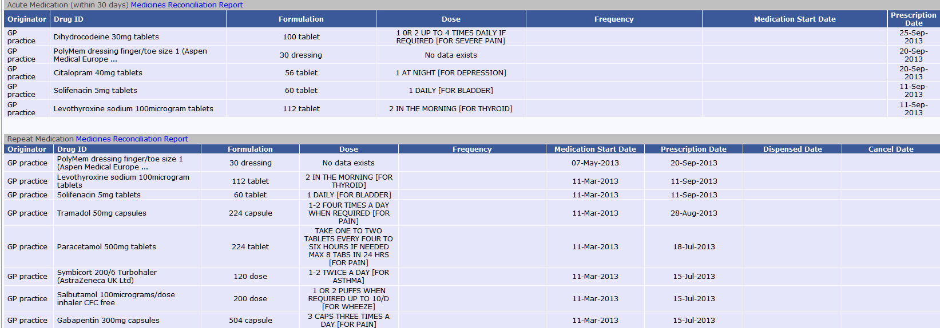
Notes:
Here we have displays of the same medication data in different systems.
The original comes from INPS Vision, shown here in INPS Vision.
This is the same record imported and viewed in ECS web viewer.
And here in SCI GW.
And here it is generated as a report for in hospital medications reconciliation.
The same data represented 4 different ways, and each way changing the meaning and usability and safety of the information shown. Acute prescriptions and issues of repeat prescriptions and ‘current’ repeat medications all showing subtly differently with different labels in different places.
Why is this happening? Because fundamentally we have at least 4 different ways of representing a prescription across all these disparate systems. My understanding of what constitutes an ‘active repeat medication’ may not be yours. What is meant by authorise? What is meant by issue? What is meant by ‘dose’, ‘start date’.
It is not only confusing, it has led to real and apparent risks as users of this crucial clinical data find they do not understand it when translated to their own clinical contexts.

Slide 10
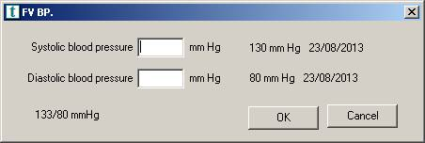
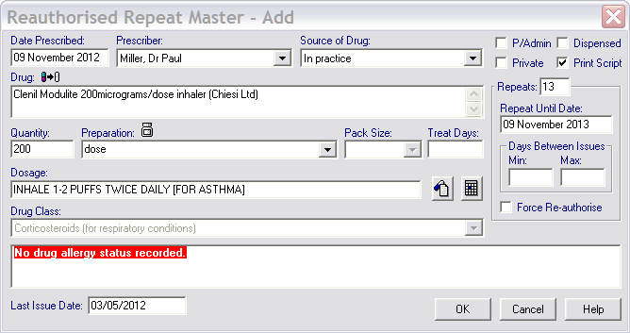
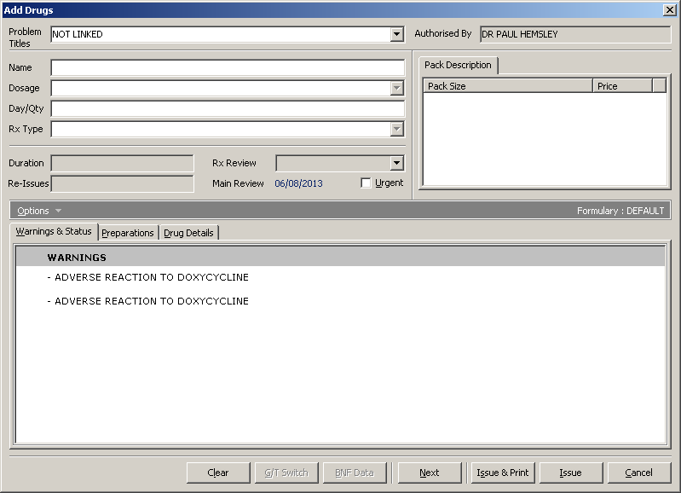
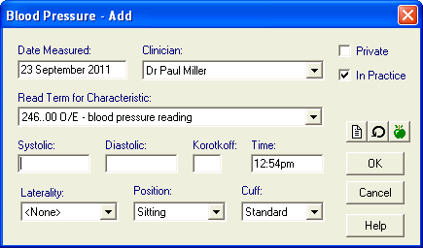
Models!
Notes:
So lets take a step back, and have a look at the sending systems for some of these problems. Here in Vision we have a form for adding a new repeat master. Or template. Or prescription. Or order. Or whatever you call it where you are. You can see it has places for dates, prescribers, drug name, source, dosage etc – lots of field for defining the prescription. The same form in EMIS carries many of the same attributes, but with some variation.
The same thing happens if we look at allergies, blood pressures, weight. All these forms and interfaces are different, and yet they are defining the same things clinically – they are dealing with the same clinical concepts.
What we have here in Vision and EMIS are a whole lot of subtly differing *models* of clinical things. And the concept of a model is so important to this talk we are going to have a closer look at what we mean.

Slide 11
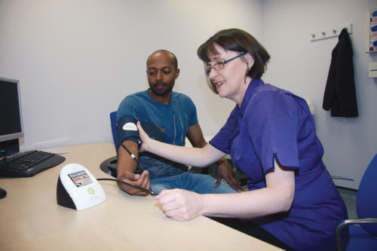
Computable Clinical Model
The representation of a clinical concept in a structured format in computer software
Notes:
So when we come to talking about ‘Computable clinical models’ we mean turning a real world clinical concept such as a blood pressure into something that represents that in computer code, and that can then be processed by these machines – that is it is computable. Listed, compared, reported on for patient care, performance management, qof.

Slide 12



Notes:
Models are very important, and it is helpful if we use the correct ones or even better the same ones. If we don’t we end up crashing spacecraft, or risk making something look like something it is not. Such as a stopped medication made to look current. Or a cat a bit like a penguin.

Slide 13
If…
Notes:
So if my system and your system have a clinical model that is the same then it is a no brainer to exchange messages. It just works.
If we have different systems, however, then my system cannot directly talk to yours unless we use some kind of mapping. The best way to do this to allow common exchange of data is to have some common model in the middle that all our systems can talk to.
This happens already, to an extent. Gp2GP for example, or HCG with the MIG – this is what they are doing. But they are doing it with their own models in the middle, and their own models round the outside.

Slide 14

?
Notes:
Always runs into boundaries
Unable to adapt to multiple care contexts
Reliant on the interface
The data should be separate from the interface
Proprietary lock in
Instead
Multiple front ends
Common data models

Slide 16
Notes:
But a problem: the requirements of clinical data differ in different care contexts. Us simple GPs may only want to know about diastolics and systolics, but super duper clever hospital doctors may want to know all sort of other things, like position and cuff size.
So how do we get around needing multiple models for different care contexts?
In health informatics the concept of ‘Clinical Archetype’ is well established.
This is essentially just a model with all the elements in it that we need to cover most situations. So this is the blood pressure archetype with all the diastolic, systolic, korotkoff, laterality, cuff size position, machine etc – the works.
This is more stuff than is required in most clinical situations. So when it comes to using this archtype in real world situations we talk about using a ‘template’. This uses all the defined elements from our archtype that we require.

Slide 17

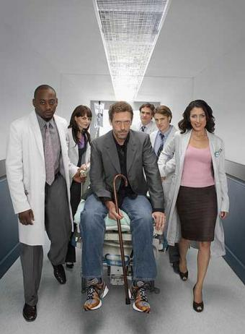
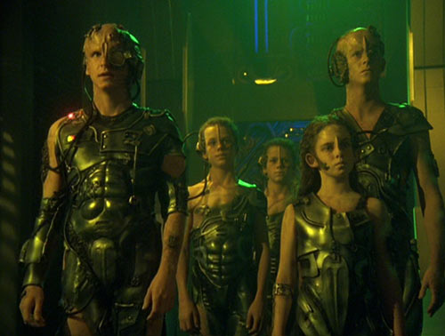
Notes:
Fundamentally we have a disconnect between the shiny clinical teams using the informations systems, and the uber techs that build them using magic computer dust. There is a wall between them that has been hard to overcome, with each side occasionally lobbing over a morsel or two.

Slide 18
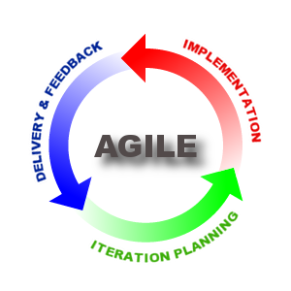

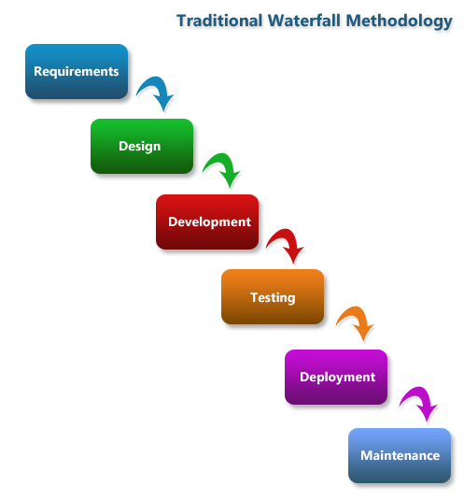
Notes:
So the traditional method of delivering standards doesn’t really work in the clinical domain, where new requirements come along frequently, and clinical demands change almost as quickly. We need something a bit more like the Agile model. And somewhere where clinical teams and technical teams can join together to agree good usable archetypes.

Slide 19
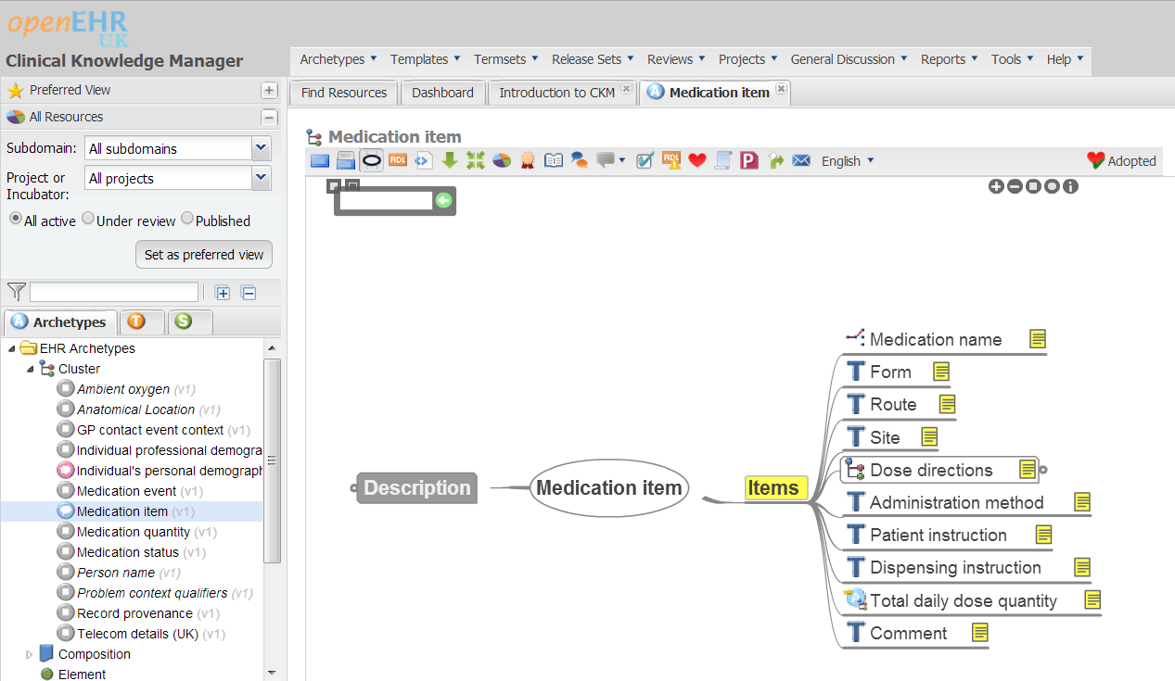
Clinical Knowledge Manager
Notes:
So for this project we are using CKM. This is is a Web based
Collaborative
Iterative
Edit & Review Clinical Models
Joins clinicians and technologists
Archetypes & Templates & XML
Tool that spews out XML once the clinical agreement is complete.

Slide 20
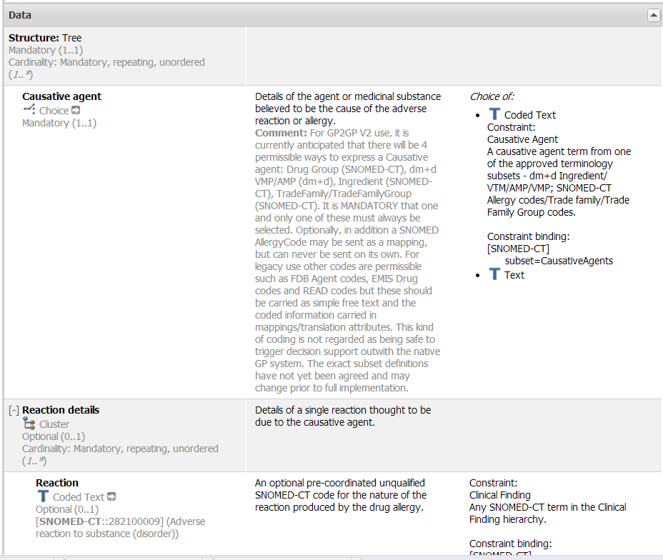
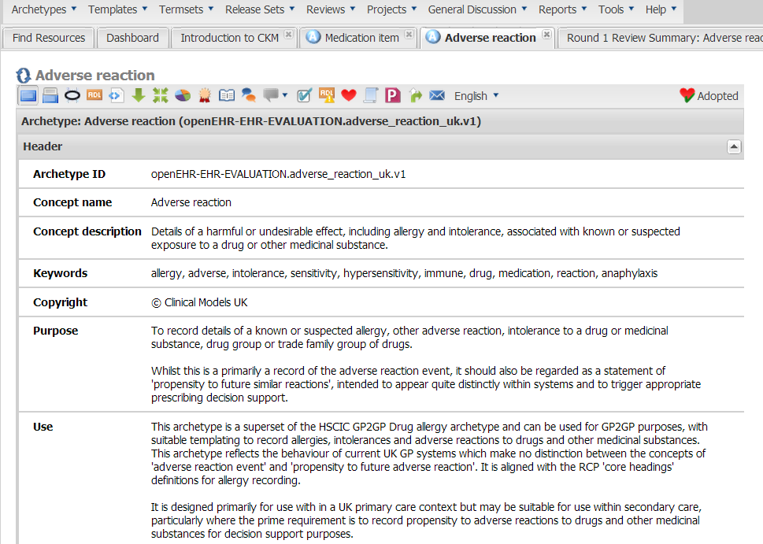
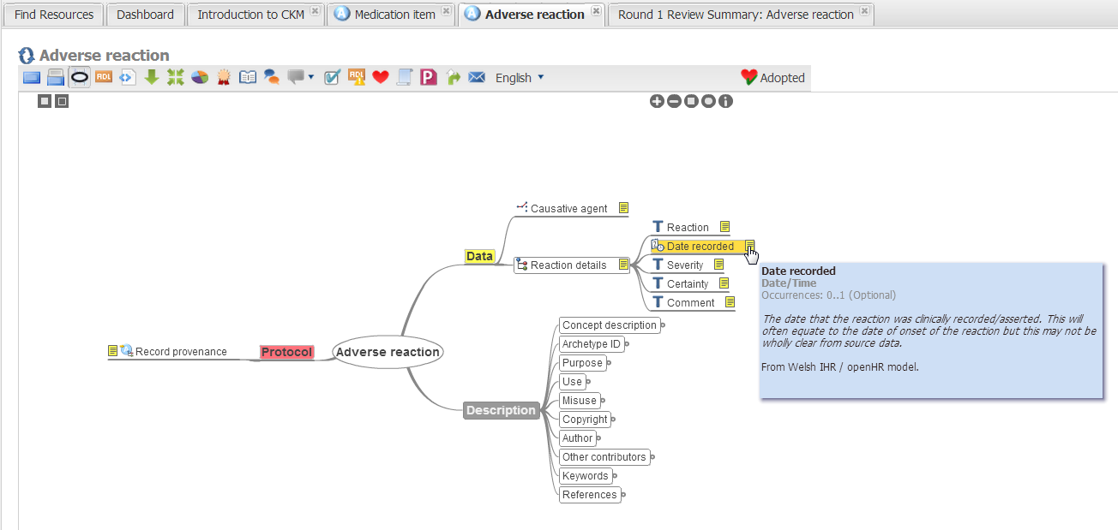
Adverse Reactions

Slide 21
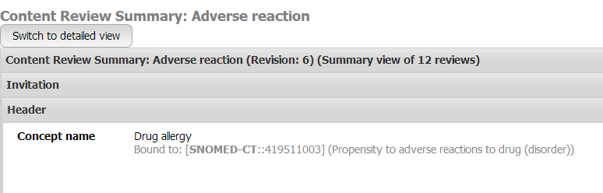
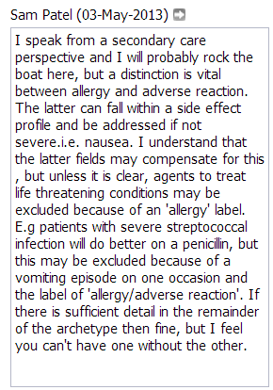
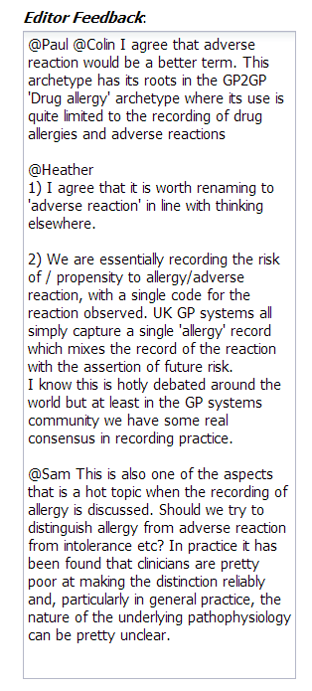
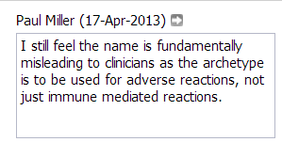
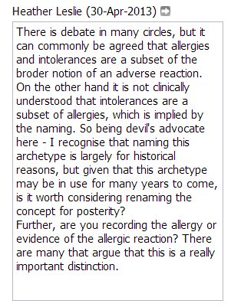
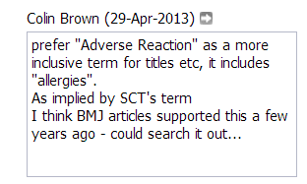

Slide 22
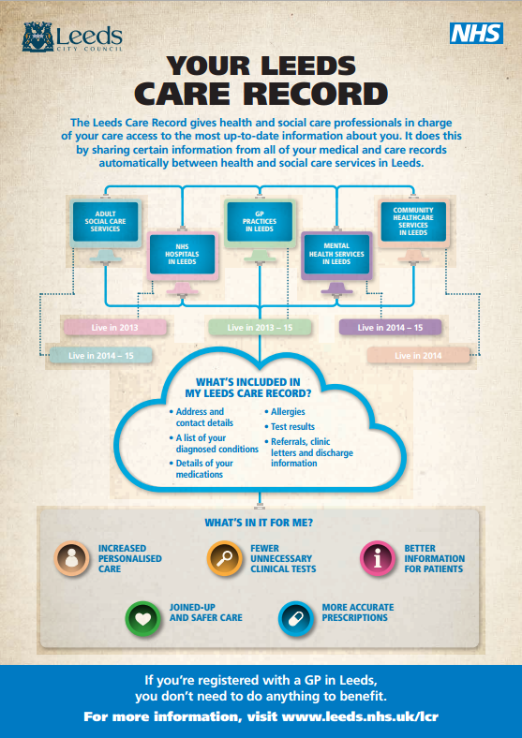
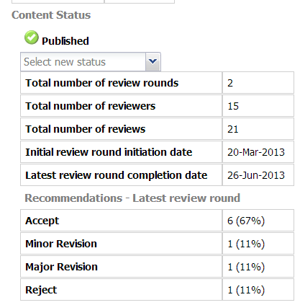
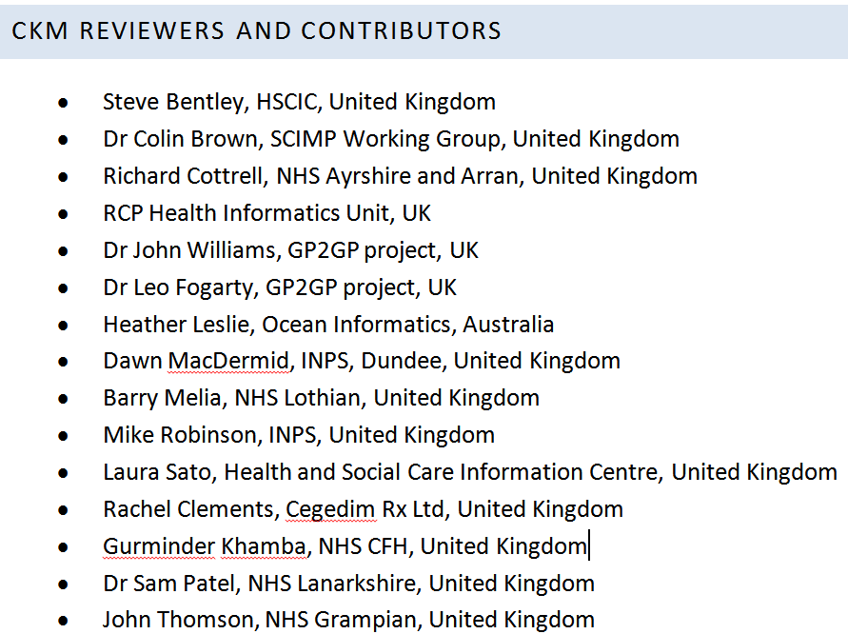

Slide 23
Lessons
Usability
eHealth / Informatics knowledge
Community
Leadership
Administrative Support

Slide 24
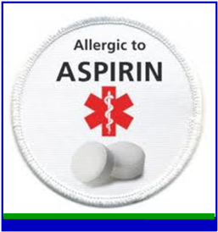

Outputs
Ingredients
Drug Groups
Dose Syntax?
Other models?

Slide 25


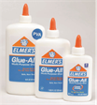




Slide 27
Plans
Publicity
Engagement
Education
Support
Timetable
Implementation

Slide 28
‘Clinical Archetype’
Is a ‘clinical model’
Has all the items (elements)
Fully defined
More than most clinicians require

Slide 29
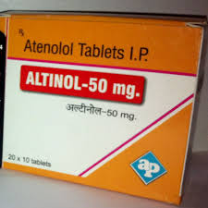
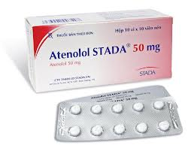
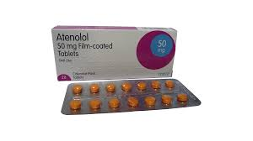
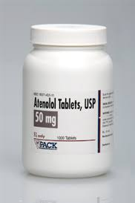
Notes:
But surely, you think, when it comes to medication particularly – a drug is a drug is a drug, however you package it up.
Atenolol 50mg tablets is always atenolol 50mg tablets.
So surely then it cannot be too complicated for us to devise a way of sharing this data reliably using one system.
And to an extent that is correct, as with dm+d this model does give us a reliable way of describing the medicine, of coding and recording it. In dm+d atenolol is always atenolol. But this is sadly not the whole picture. Dm+d is only a useful model for the medicine itself, the drug. Not all the stuff we have around a medicine to make it a prescription that can be safely taken or administered.

Slide 30
CKM is:

Slide 31



Slide 32
Structured Data
Not just view!
  Your computer is not a projector
Computable, machine process-able data
  Reduce or eliminate re-keying
  Decision support
Data rich records = Better Medicine
  = Happy, healthy people

Slide 33
One Record?
Always runs into boundaries
Unable to adapt to multiple care contexts
Reliant on the interface
  The data should be separate from the interface
Proprietary lock in
Instead
  Multiple front ends
  Common data models

Slide 34
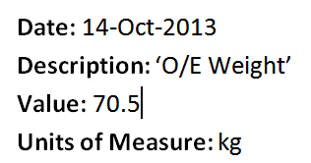
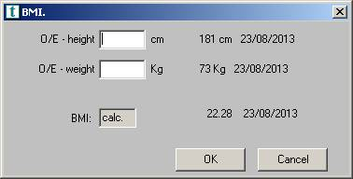
For Example
Clinical Term
Value
Date
Unit of Measure

Slide 35
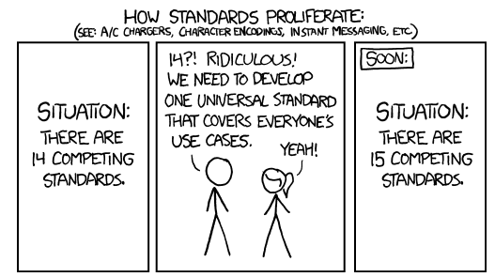
Notes:
And every time we try and fix this we get caught in a time warp. Experience shows that standards cannot be top down things imposed on communities of real users – standards need to be bottom up, emerging through practical value; through real life use.

Slide 36

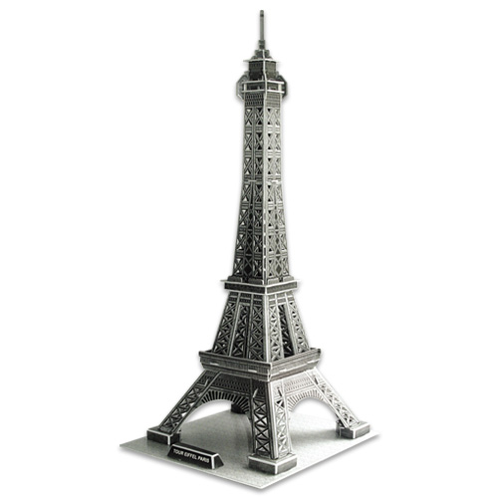
What is a Model?
A representation of a real world object or phenomenon
Notes:
Or the eiffel tower. It is just a way of representing some other real world thing without actually being that thing.

Slide 37
Process and Progress

Slide 38
Lessons

Slide 39
Next Steps

Slide 40
Objectives

Slide 41
The big picture

Slide 42
Become involved

Slide 44
Clinical Template
Just the bits you need
  Systolic / Diastolic
  Not Cuff, position, laterality
Allows for context
Can use elements from other Archetypes
Flexible, complex, adaptable models

Slide 45
Proc
Hand written prescriptions
Computer printed prescription
Transmitted Prescriptions
New models of prescribing
New uses for prescribing data
New

Slide 46
Clinical Requirements
Developer Requirements
Rapid, repsoni

Slide 47
What is this about?
Medication Messages
  Safe
  Easy
  Reliable
  Computable
Objectives
  Save work
  Save money
  Reduce harm
  Save lives
Provide a 21st century solution to medication
To last till the 22nd Century?

Slide 48
What needs to happen?
Every system needs to be able to
  Express
  Store
  Exhange
  Clinical data in the same way.

Slide 49
Medication Messages
SAS
NHS24
SCI Gateway
Hospitals
ePharmacy
OOH - Adastra
Portals
Community Pharmacies
PSD
ECS / KIS

Slide 50
So what’s the problem?
It’s complicated
The words used
The concepts
The culture
The requirements
The solutions
The political will

Slide 51
What’s the solution
Models
What is a model anyway?
Eiffel Tower
Pretty people
CAD
In health care this means:

Slide 52
What’s out there?
SCI XML
EMIS
Vision
Adastra
SCI GW
ECS / KIS
HEPMA
ePharmacy

Slide 53
And yet:
Atenolol is Atenolol wherever you put it IRL
We have dm+d
  This does the medicine
  But not the ‘order’ or ‘prescription’
We need clinical input.
We need developer input
How do we get this?

Slide 54
CKM
The story so far
What we get out the box
Tricky things:
  Learning
  Navigation
  Concepts
  Core knowledge

Slide 55
Community

Slide 56
The Difficutly with Allergies

Slide 57
The dose / product conudnrum

Slide 58
Next Steps

Slide 59
Solutions and outputs

Slide 60
Become involved

Slide 61
Medication Models
Ah the problem

Slide 62
What does this do

Slide 63
How we fix this

Slide 64
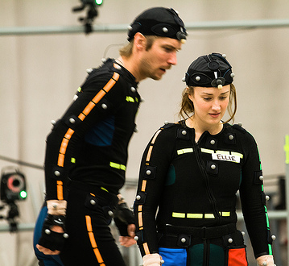

What is a computer model?
The representation of a real world concept, object or phenomenon in computer software
Notes:
And in computer terms this is where we take a real world thing, and make a representation of it in computer software. So here we have a character being motion captured and modelled in the playstation game The Last of Us. We have taken the real person, and provided a computer model of her for the game

Slide 65


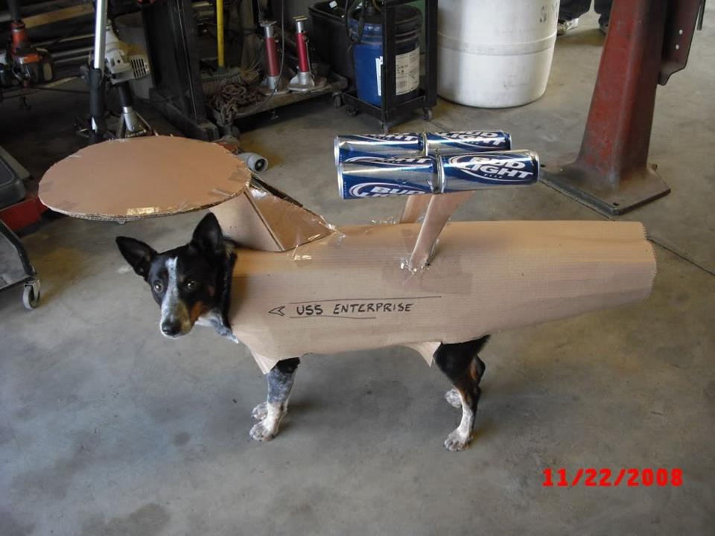
Notes:
So what do we mean by a model?
These two pretty people are professional models. In this context we use the word model to mean a ‘representation of the perfect human being’.
A model is just that – it is a representation of something else. Like a star ship.

Slide 66
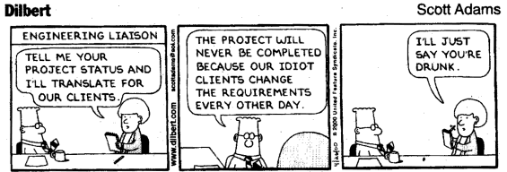
Notes:
So all that’s good, but how do we actually, IRL get these models designed and built encompassing all the requirements, and make it easier for developers at the same time?

Slide 67
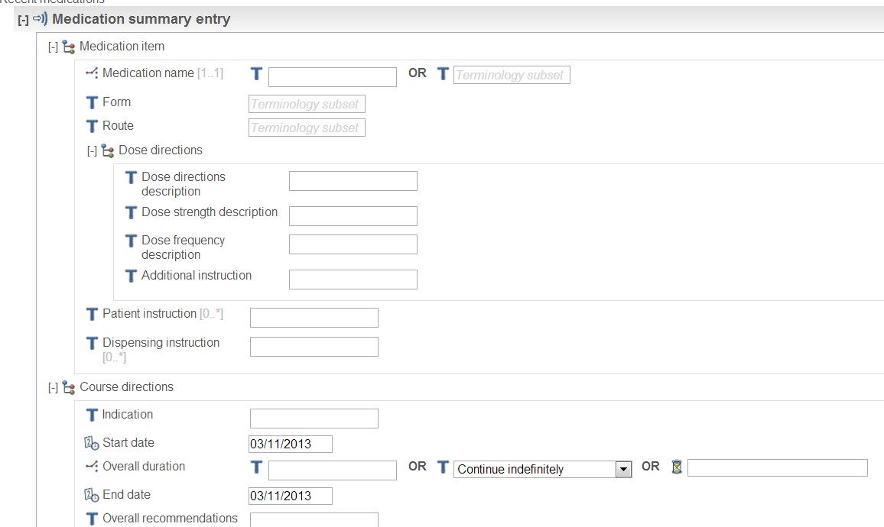
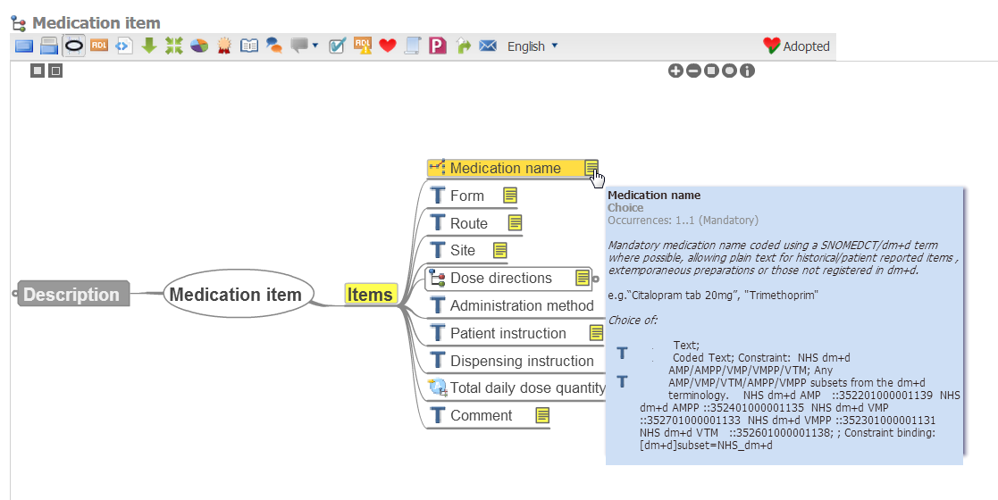

Slide 68
NHS Scotland Clinical Models
We need models!
Bring together clinical and technical
Simple, agile, iterative
Open Source
Join in:
  http://www.clinicalmodels.org.uk/ckm/

