Slide 1
NHS Scotland Clinical Models
One Medication (Model) to Rule them All
Dr Paul Miller – paulmiller@nhs.net

Slide 2
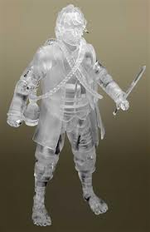


No Invisibility!

Slide 3


Slide 4

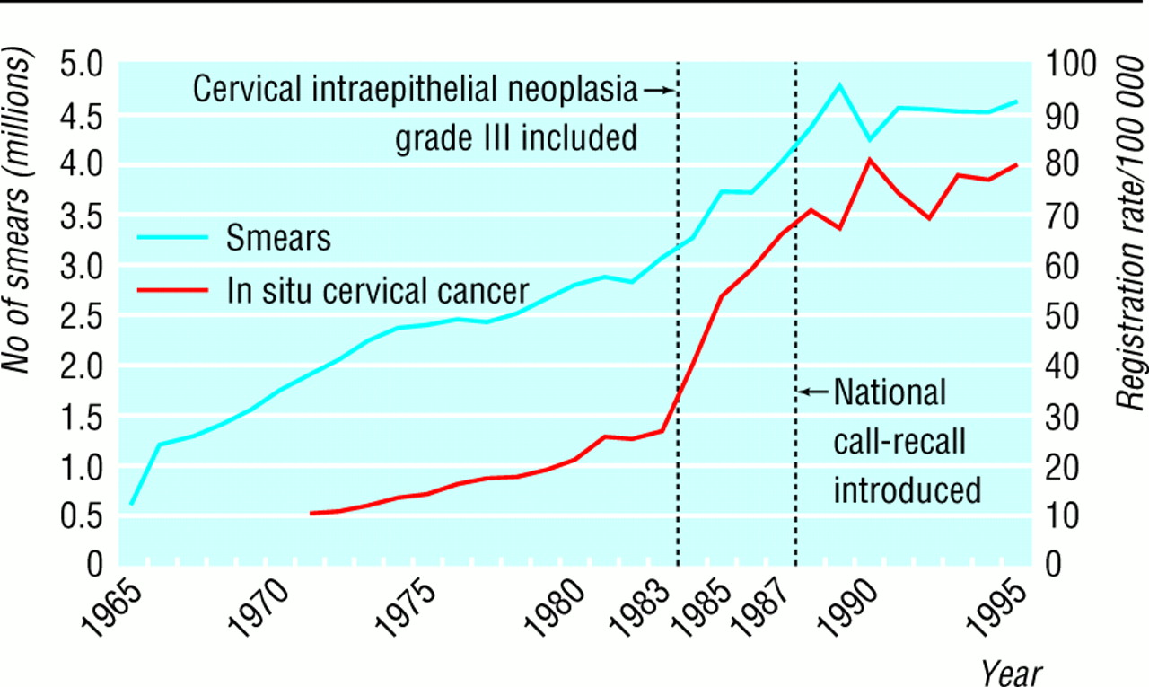

Slide 6


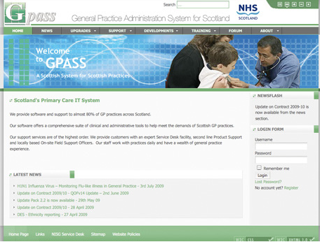
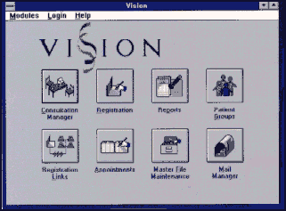

Slide 8

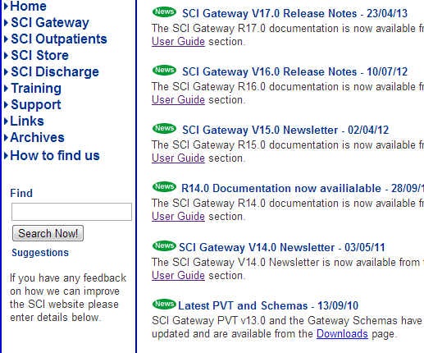
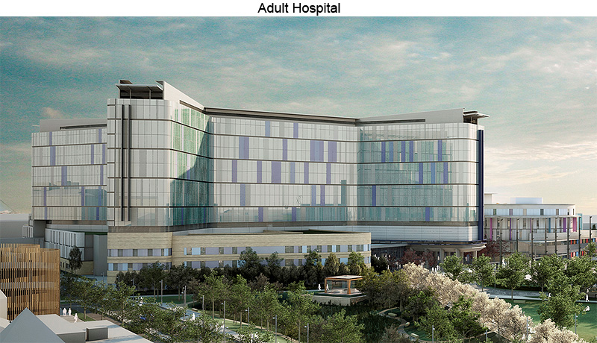
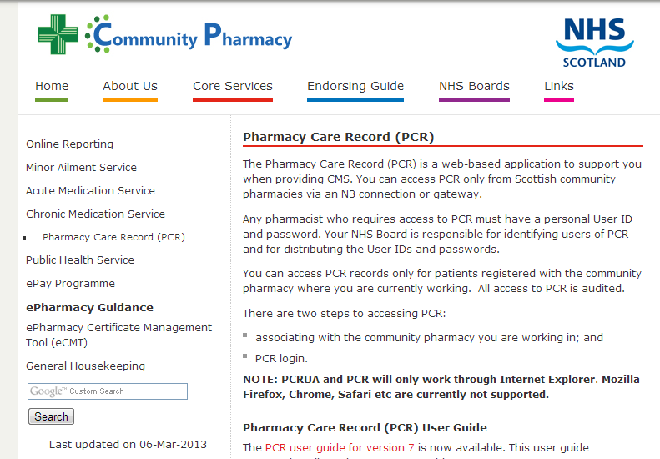

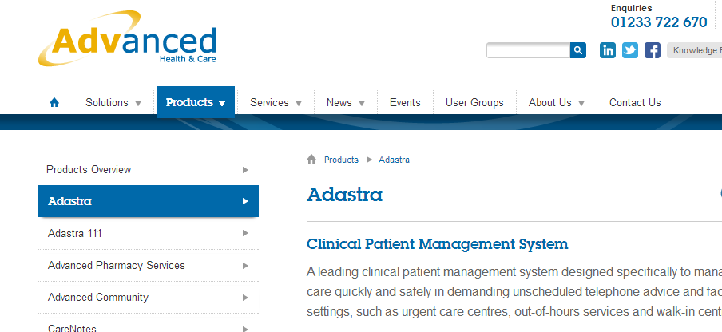

Slide 9
Current designs
HSCIC Messaging – GP2GP
NHS Scotland SCI XML
NHS Wales IHR
dm+d
RCP Core Clinical Headings
RCP Standards for structure & content
Emergency Care Summary
EMIS
Vision
OpenHR – MIG
Adastra
Gemscript
FDBE
HL7v3

Slide 10
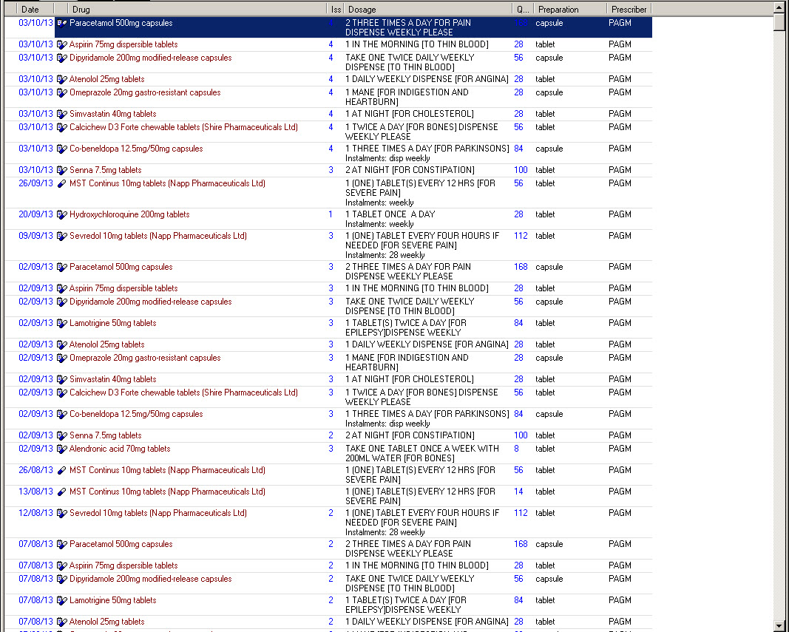
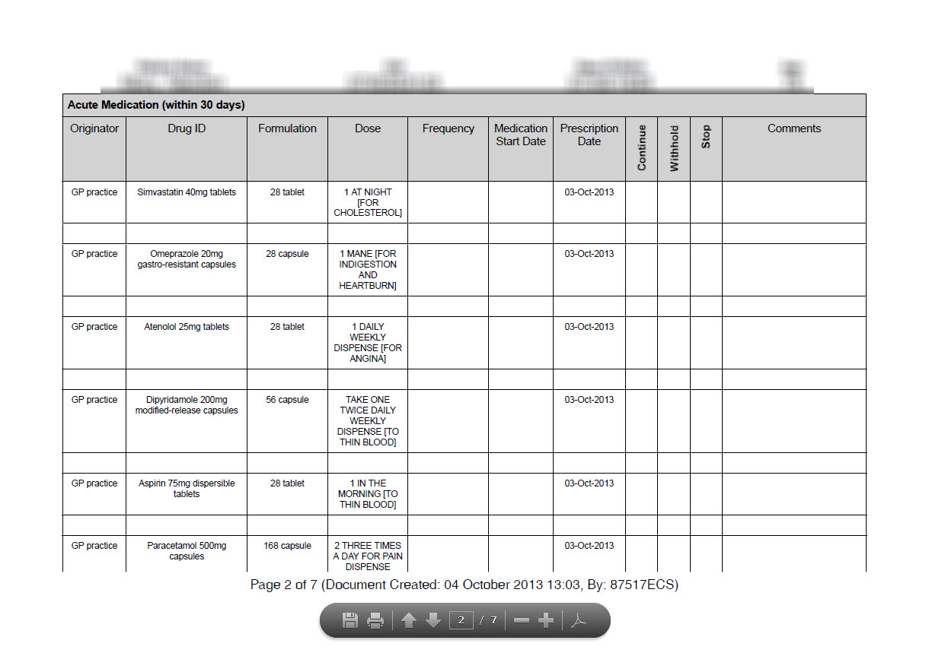
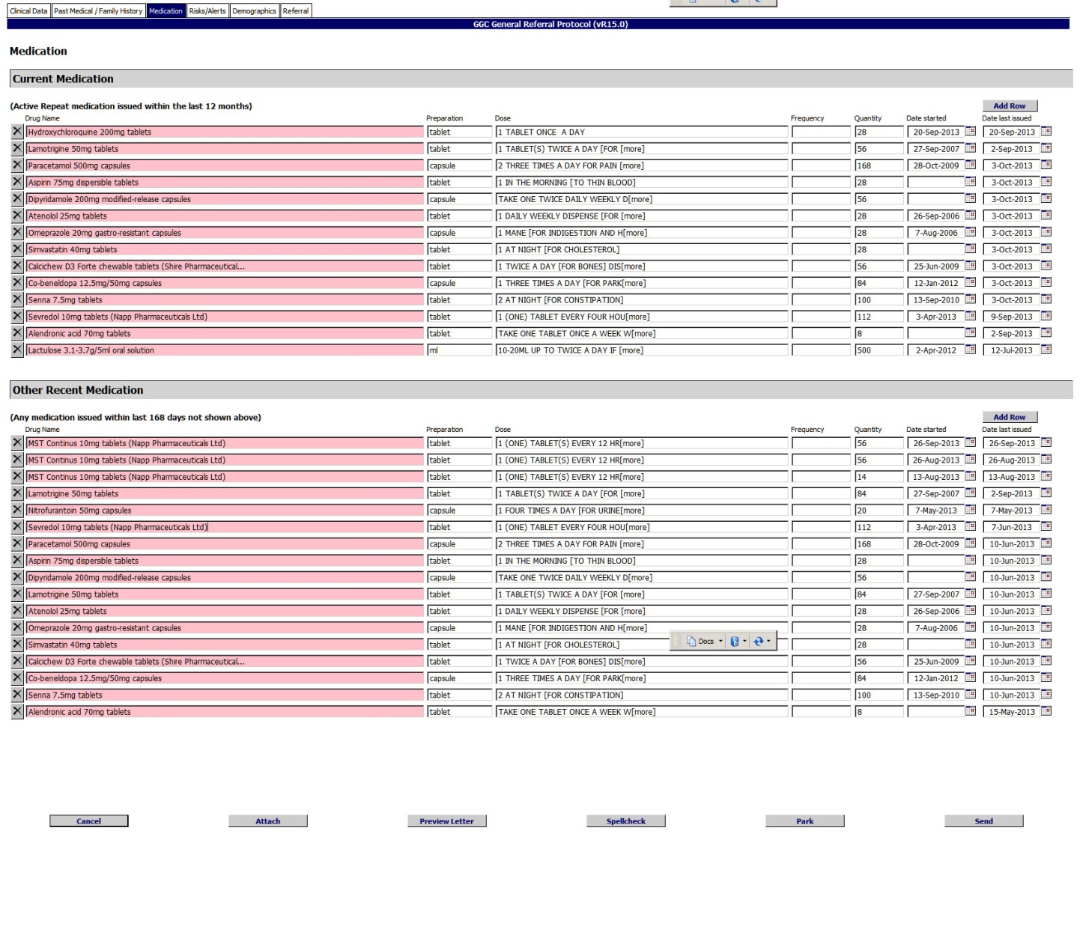
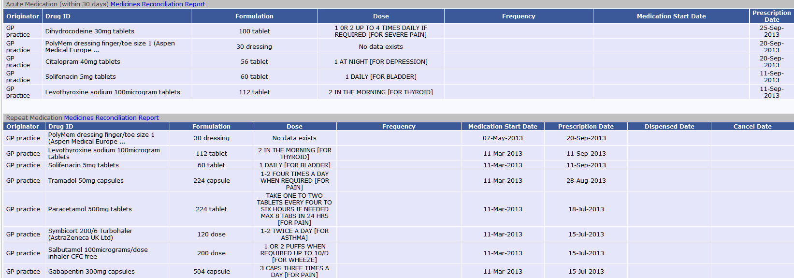

Slide 11
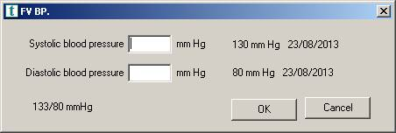
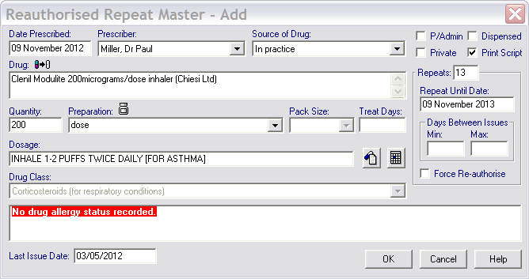
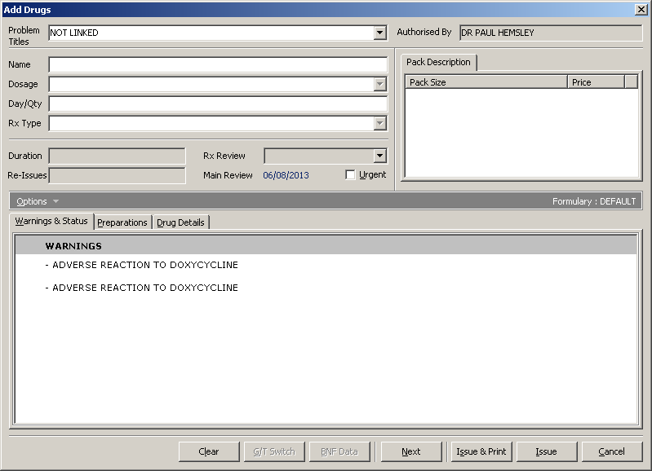
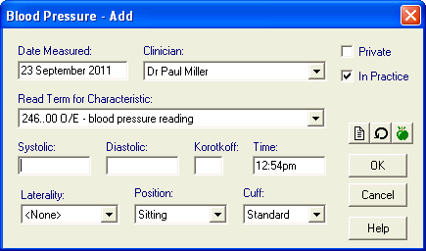
Models!

Slide 12


What is a Model?
A representation of a real world object or phenomenon

Slide 13


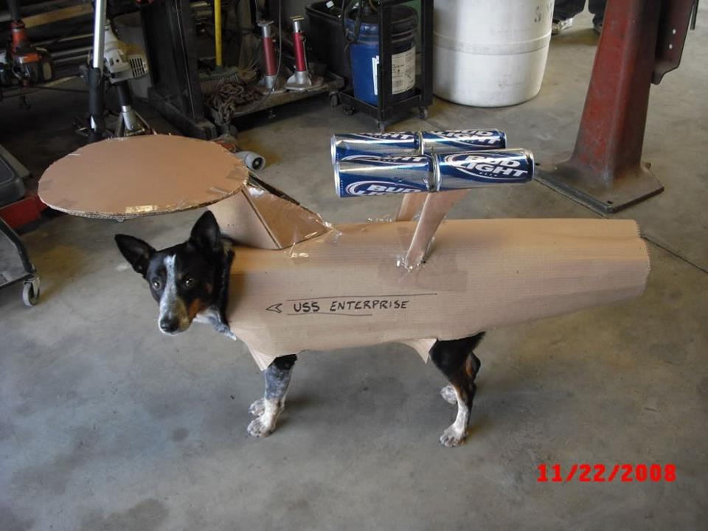

Slide 14
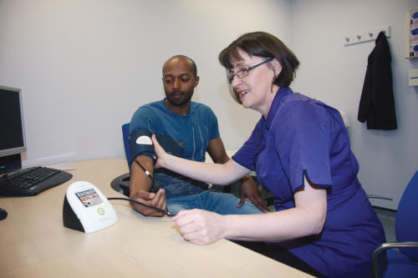
Computable Clinical Model
The representation of a clinical concept in a structured format in computer software

Slide 15
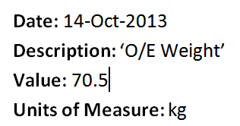
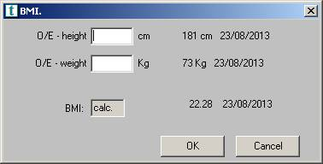
For Example
Clinical Term
Value
Date
Unit of Measure

Slide 16




Slide 17
If…

Slide 18

?

Slide 21
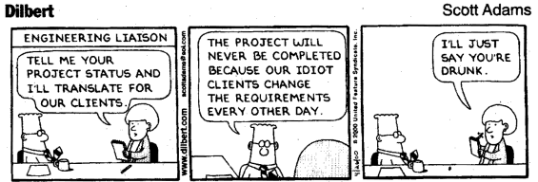

Slide 22


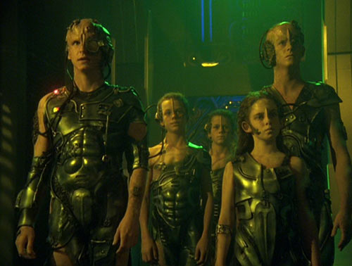

Slide 23
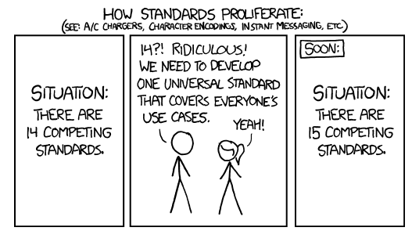

Slide 24
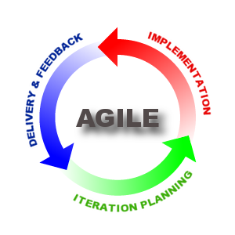

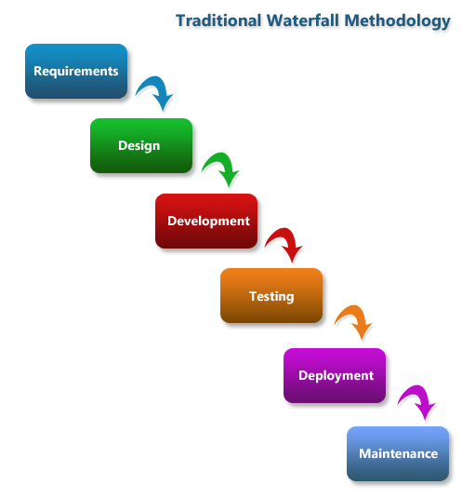

Slide 25
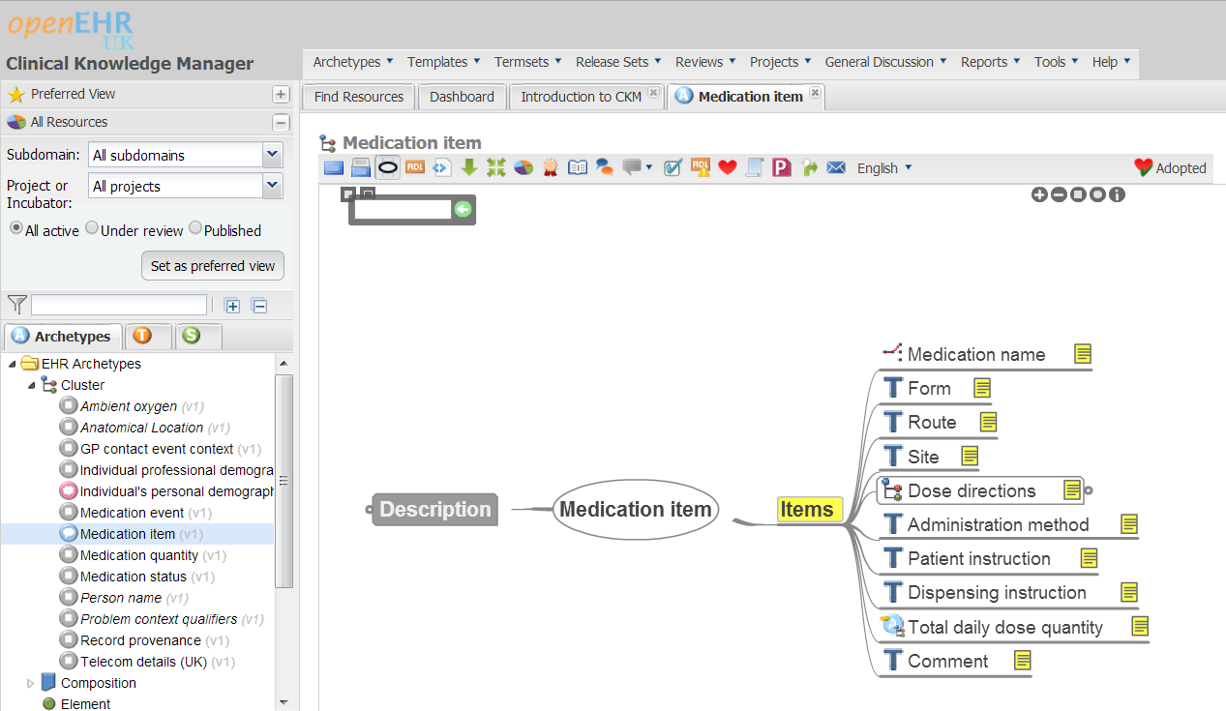
Clinical Knowledge Manager

Slide 26
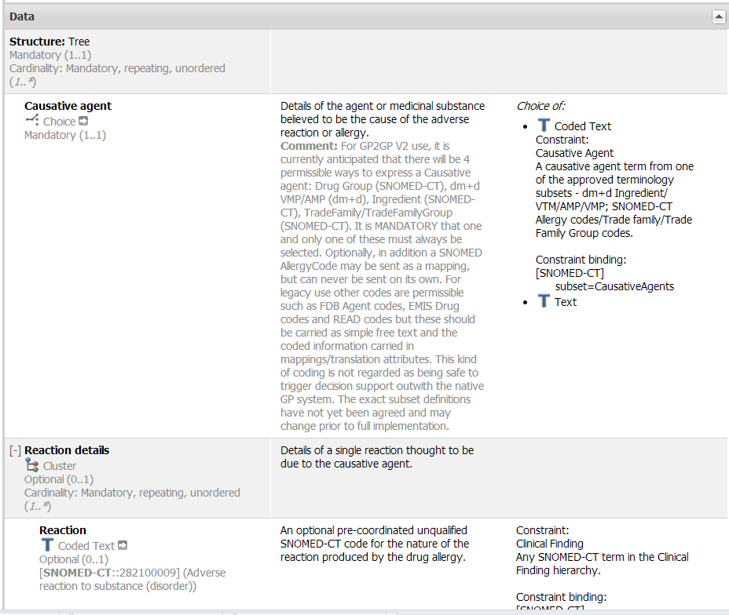
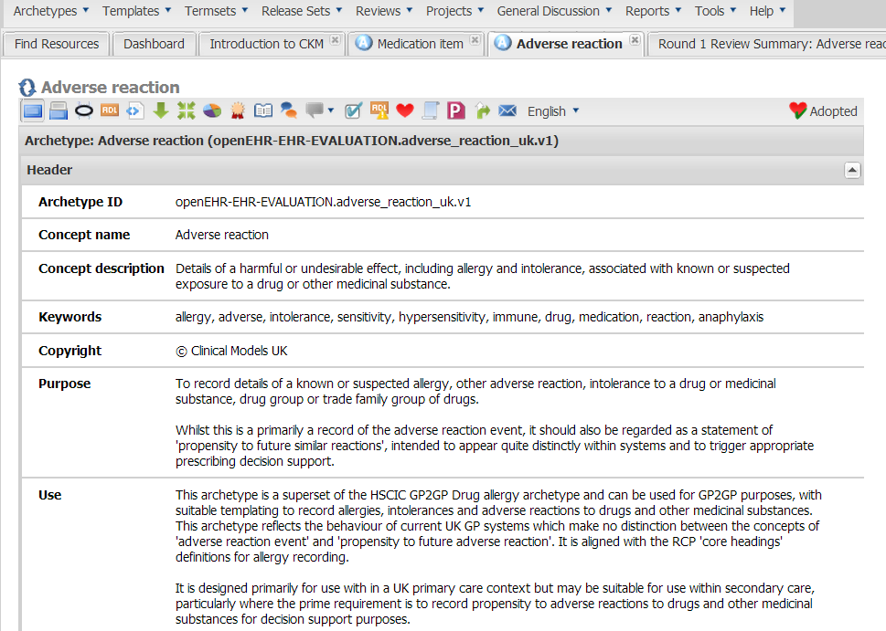
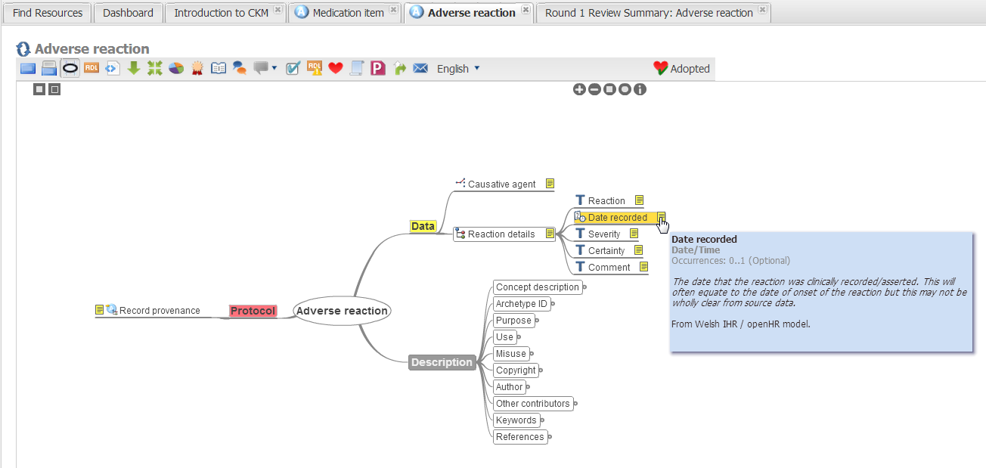
Adverse Reactions

Slide 27
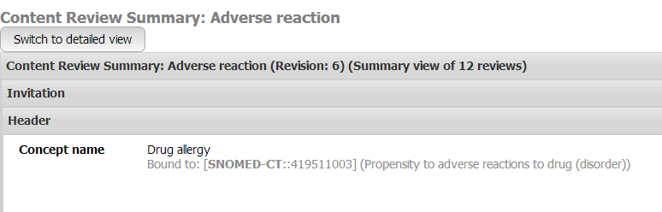
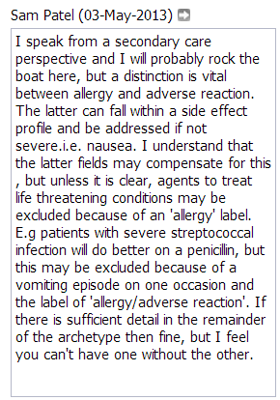
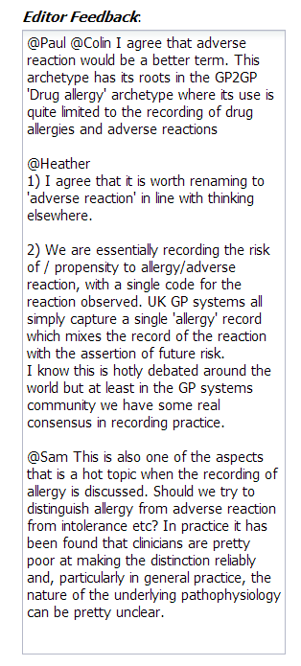
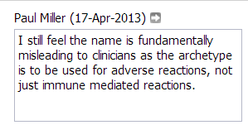
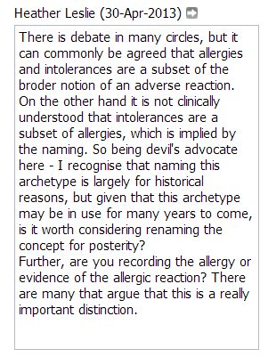
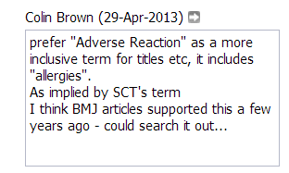

Slide 28
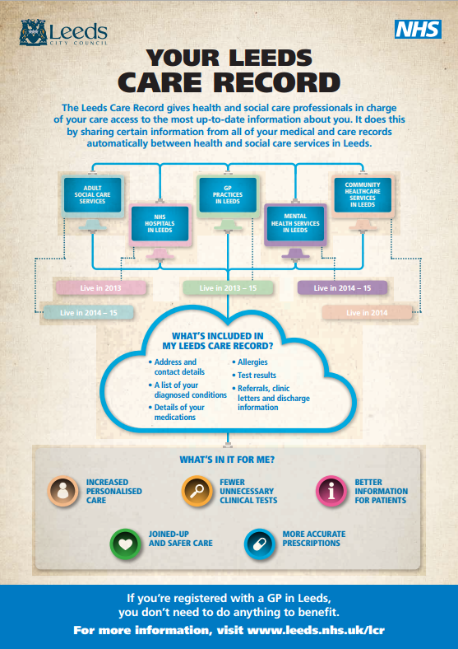
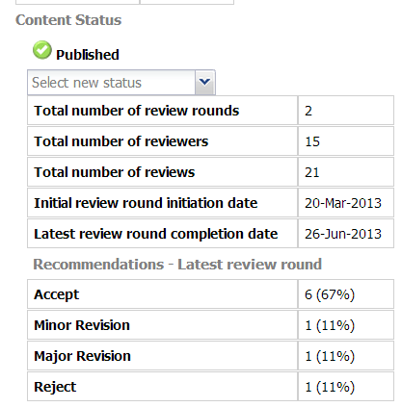
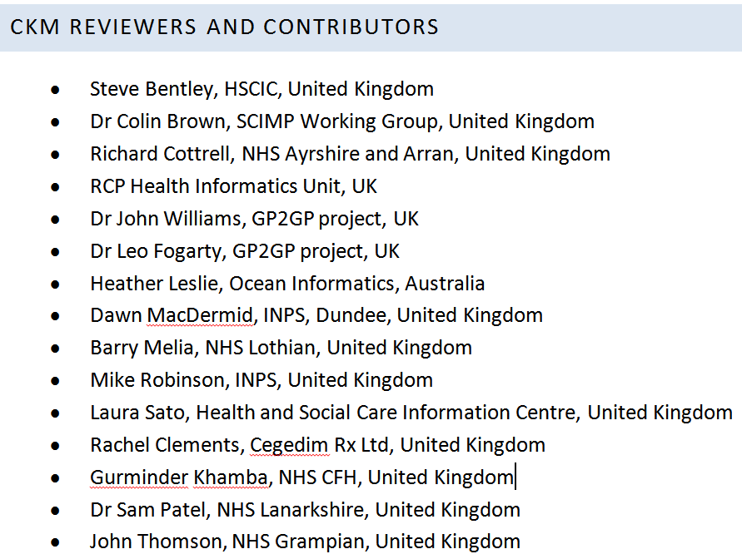

Slide 29
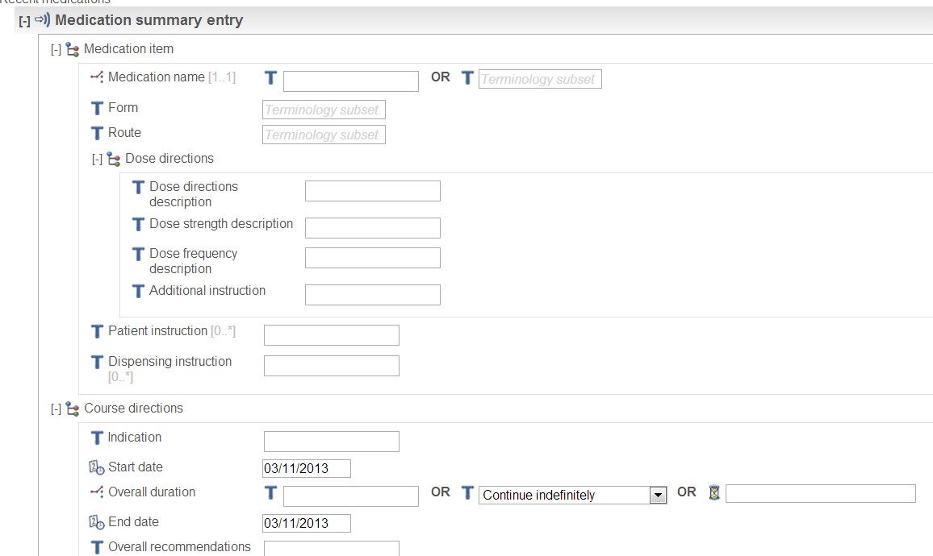
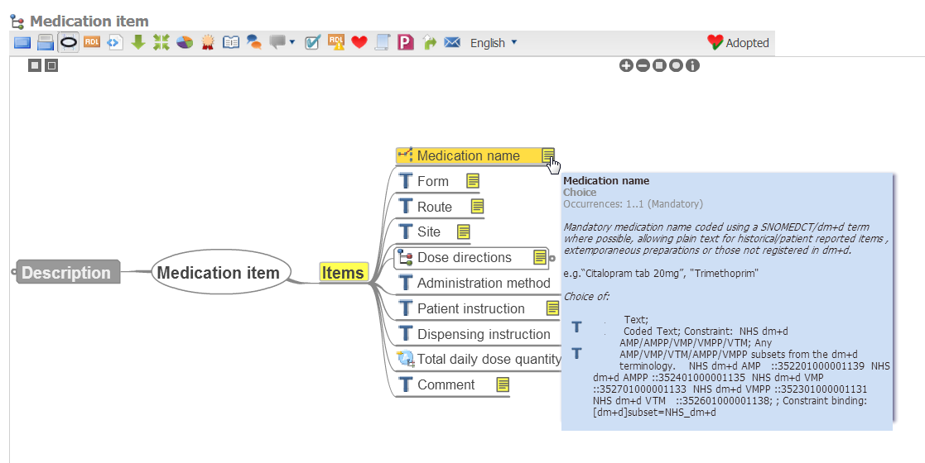

Slide 30
Lessons
Usability
eHealth / Informatics knowledge
Community
Leadership
Administrative Support

Slide 31


Outputs
Ingredients
Drug Groups
Dose Syntax?
Other models?

Slide 32







Slide 33
NHS Scotland Clinical Models
We need models!
Bring together clinical and technical
Simple, agile, iterative
Open Source
Join in:
  http://www.clinicalmodels.org.uk/ckm/

