Slide 1
Terminologies
A bit more about Read Codes and SNOMED CT

Slide 2
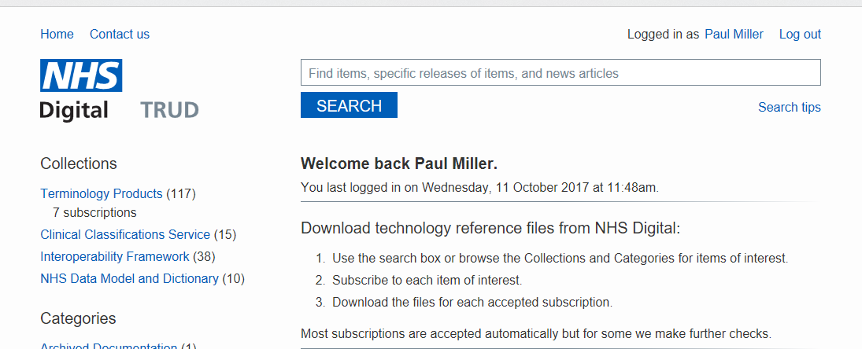
TRUD

Slide 3
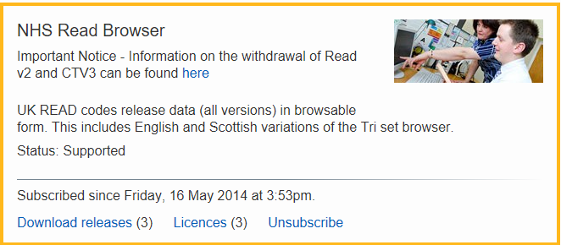
Read Code Browser

Slide 4
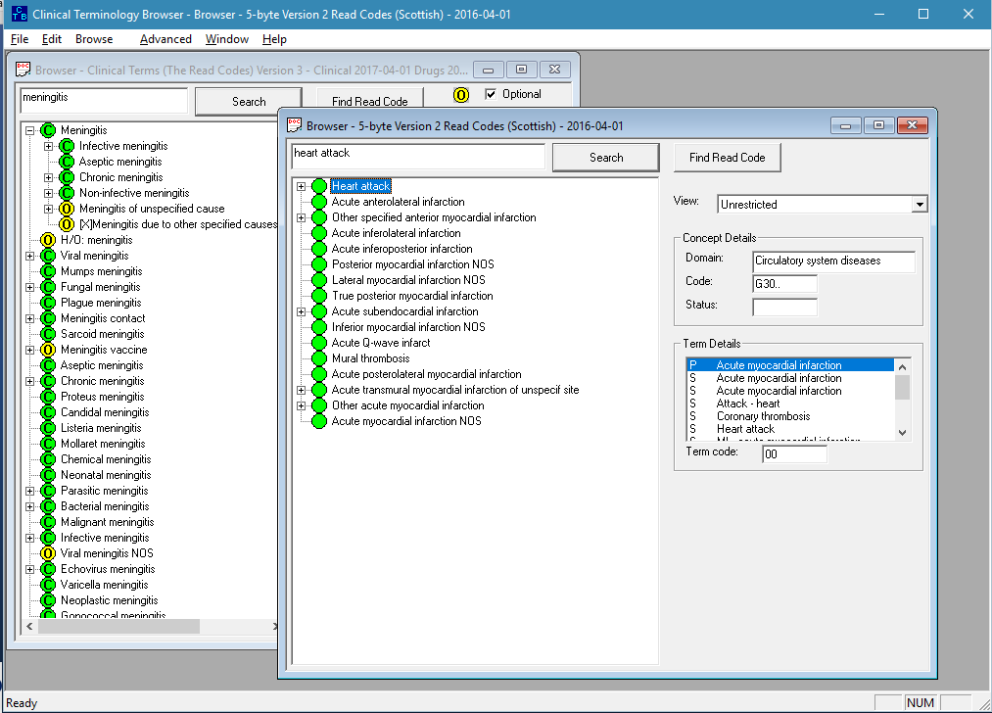
NHS Browser

Slide 5
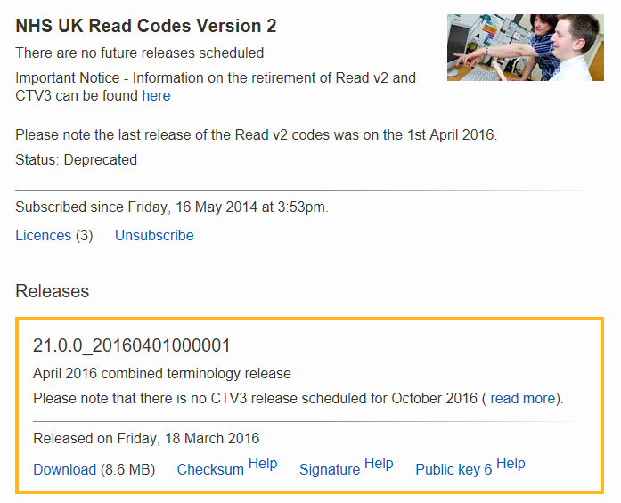
Content

Slide 6
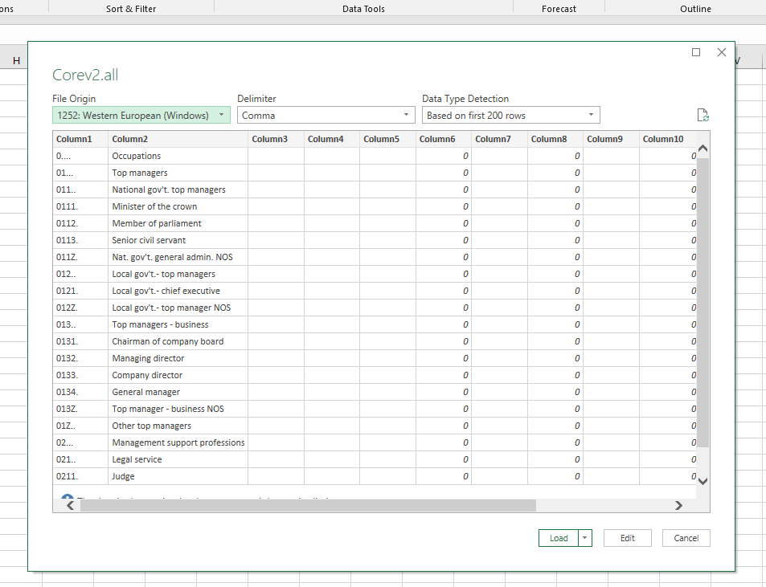
Import to Excel

Slide 7
Description length and Keywords

Slide 8
Read Codes
Version 1
Not in use
Version 2, 5 byte
NHS Scotland / Vision / Emis
Clinical Terms Version 3 (CTV3)
TPP SystemOne

Slide 9
CTV3
A bit like SNOMED
But not quite!
Relational hierarchy
ConceptID.TermID

Slide 10
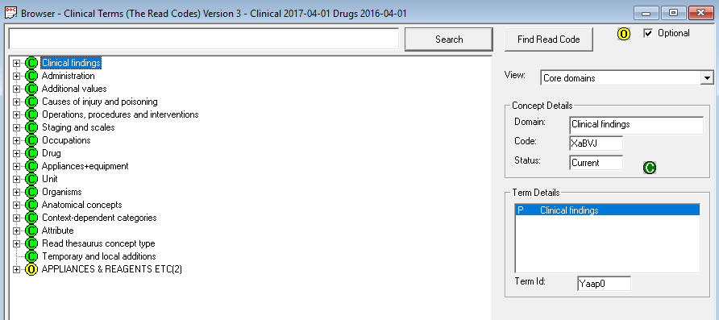

Slide 11
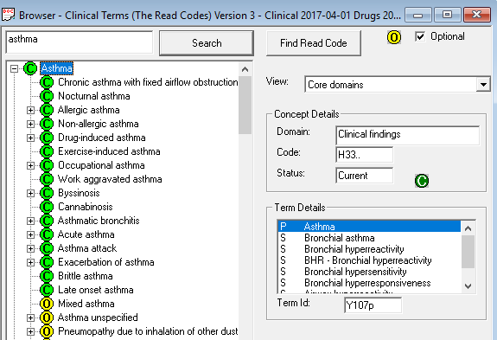

Slide 12
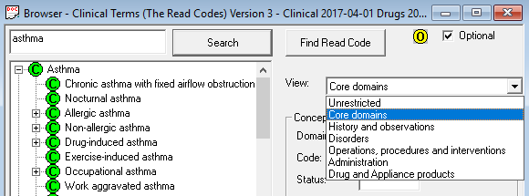

Slide 13
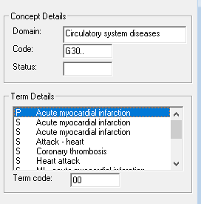
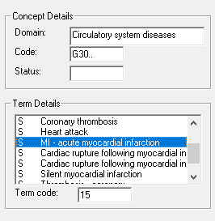
Read V2, 5 Byte – ‘Term Codes’

Slide 14
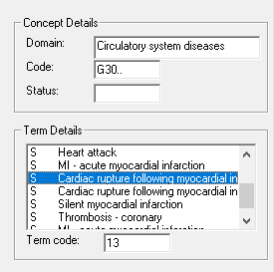
Incorrect Synonyms

Slide 15
Abbreviations / Short Codes

Slide 16
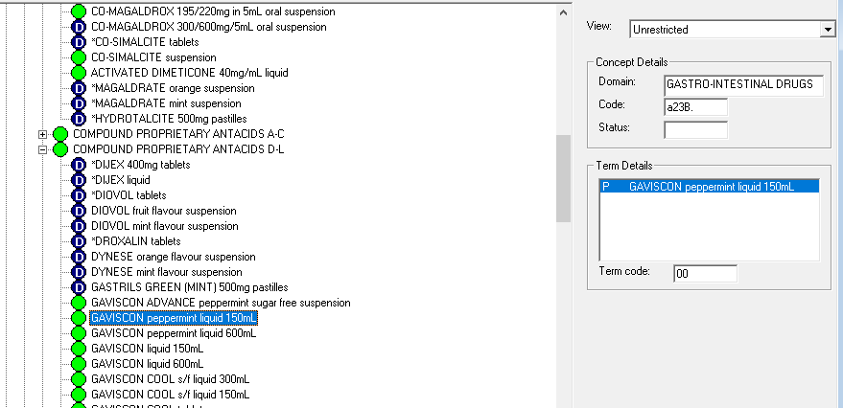
Drugs in Read

Slide 17
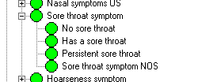
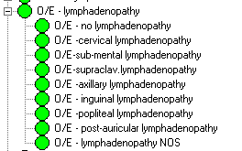
Negation Issues

Slide 18
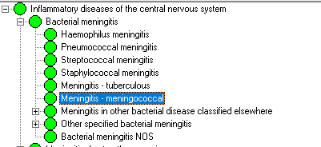
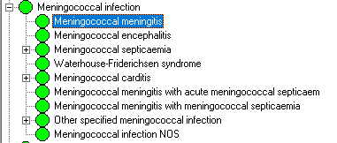
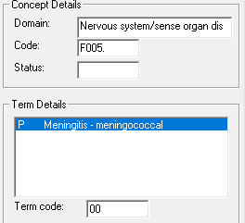
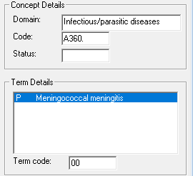
Flat Hierarchy – Single Meaning

Slide 19
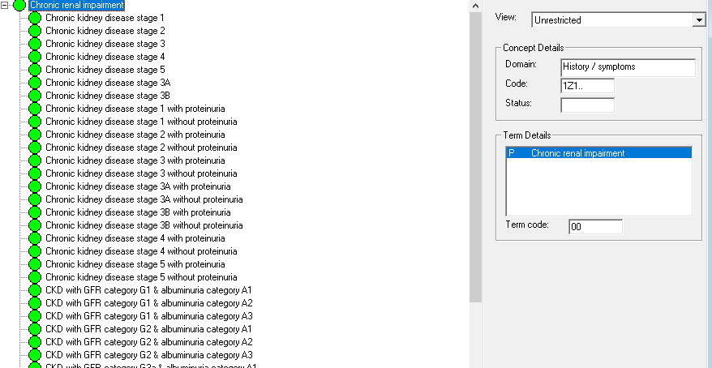
Full!

Slide 20
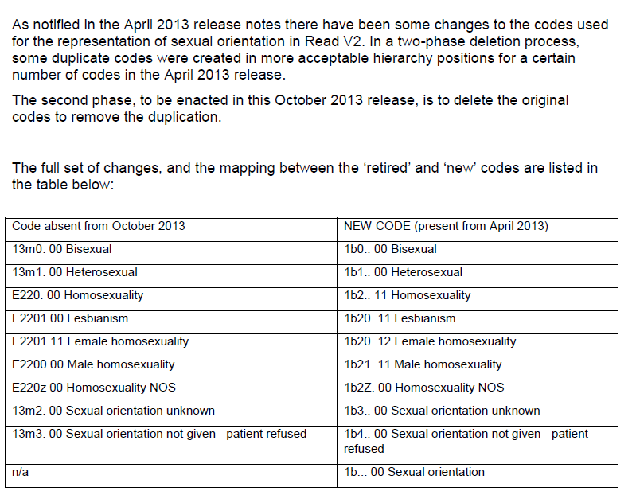
Changes and Deletions

Slide 21
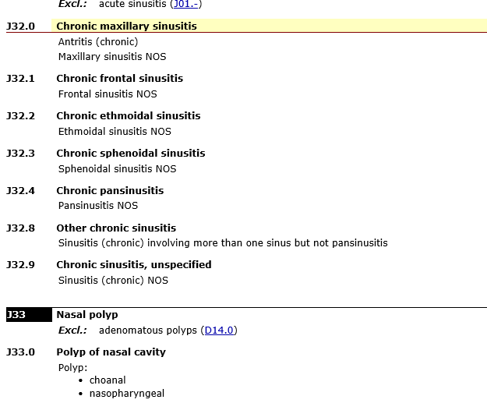
…Only UK General Practice

Slide 23
SNOMED CT
Advanced features

Slide 24
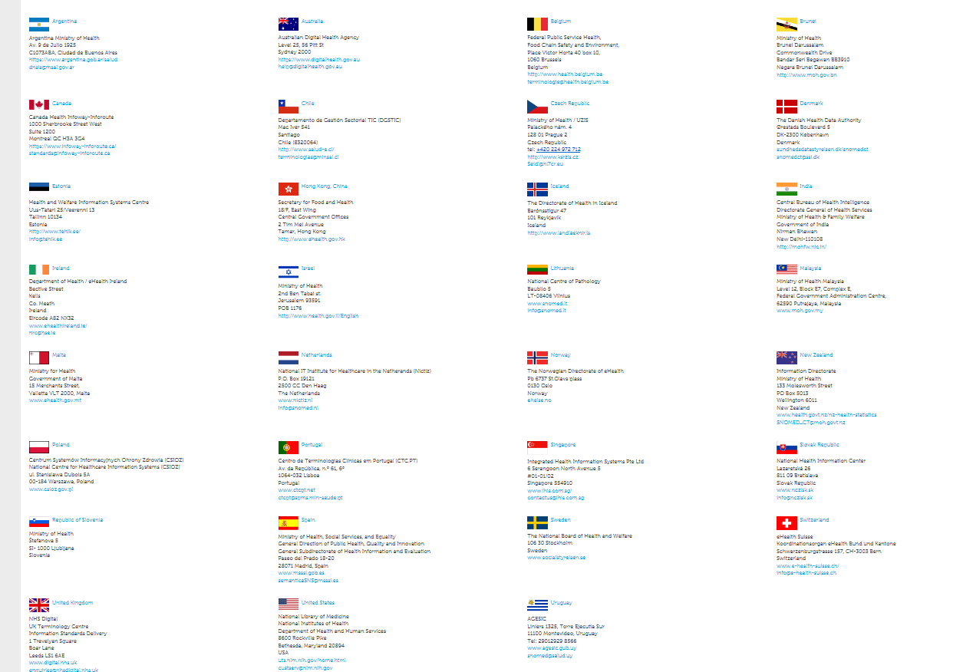

Slide 25
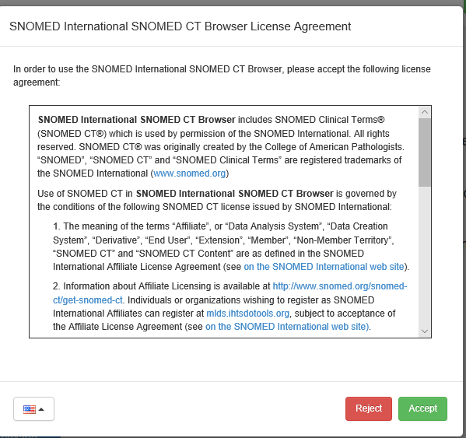
Browser

Slide 26
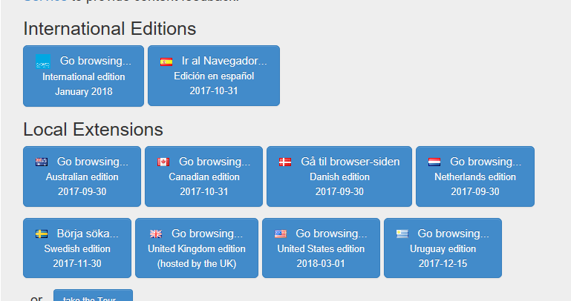
Browser - Editions

Slide 27
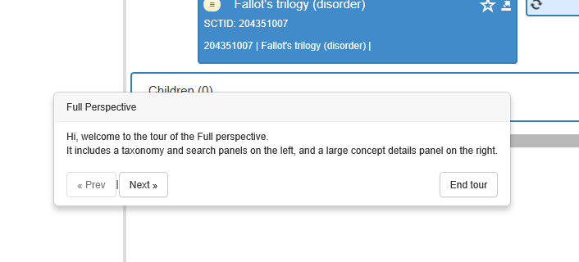
Tour!

Slide 28
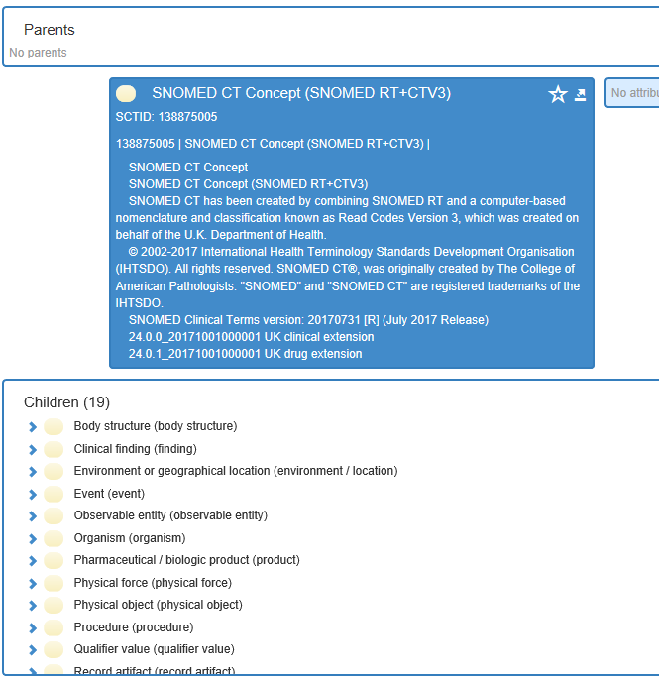
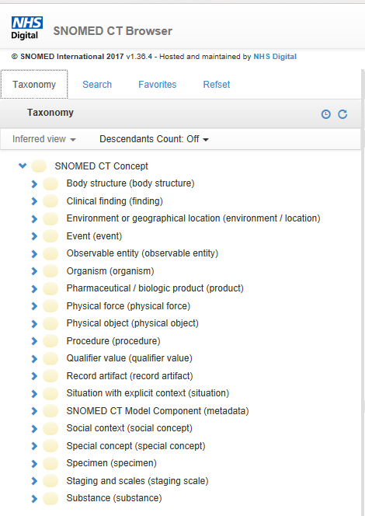
Hierarchy / Taxonomy / Root Concept

Slide 29
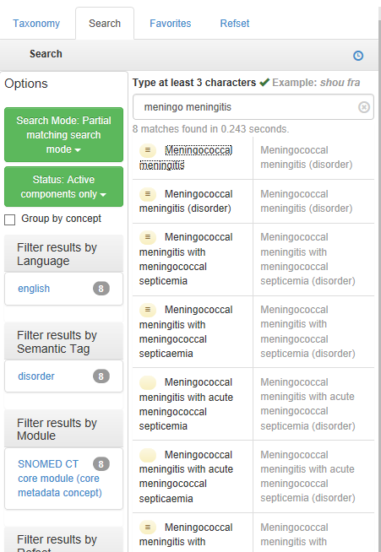
Search

Slide 30
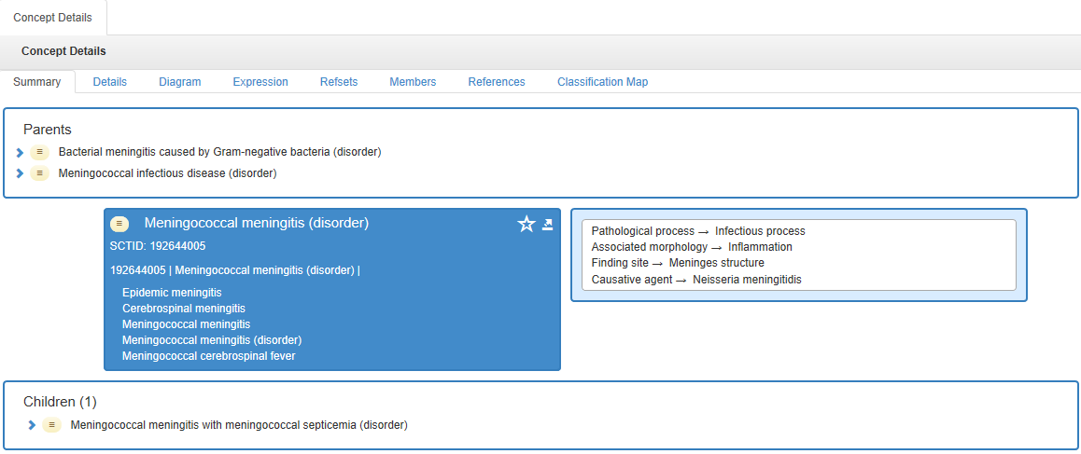
Meningitis

Slide 31
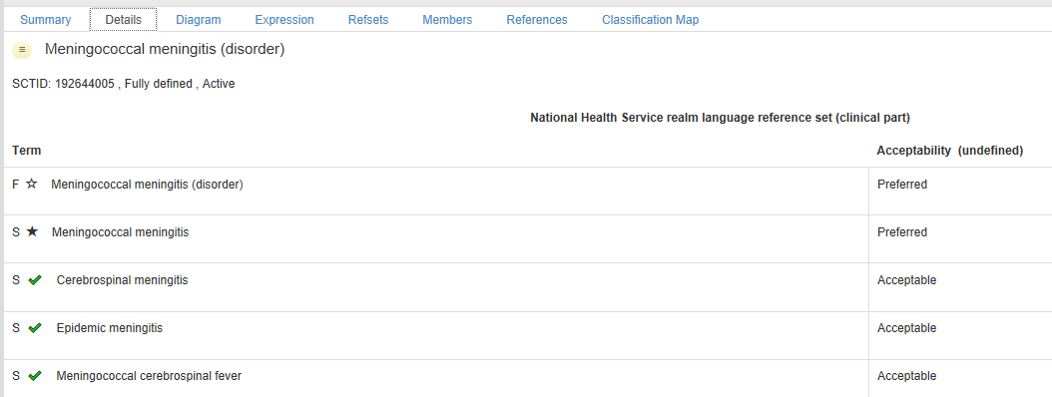
Meningitis

Slide 32
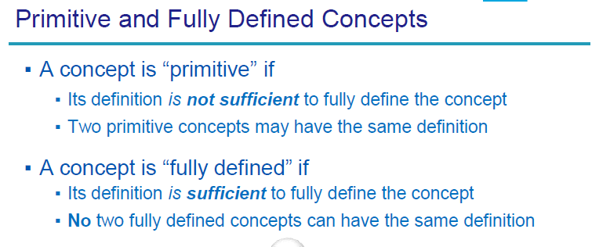
Fully Defined / Primitive

Slide 33
Fully Defined or Primitive?

Slide 34
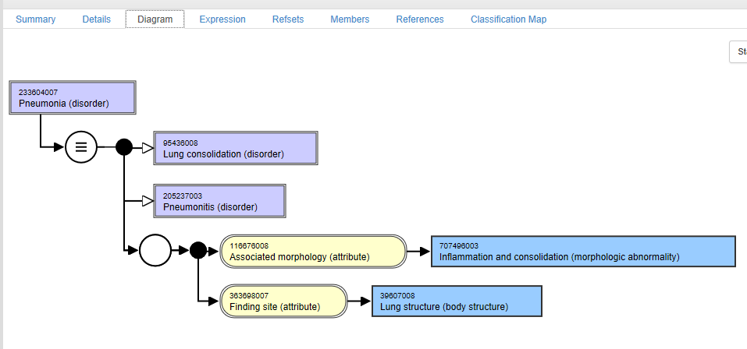
Diagramming

Slide 35
Release formats
Release Format 2 (RF2)
From 2012
RF1 before that!
Release Formats represent
Concepts (Injury of Head)
Descriptions (HI –Head Injury)
Relationships (ISA Head and Neck Injury)
Also provide for
Reference Sets
And provided as:
Tab-delimited files
Full
Everything and all the history
Snapshot
Just the current release
Delta
Just the changes since last time

Slide 36
Maintenance
Changes to:
Concept
Description
Relationship
Changes types:
Addition
Inactivation
Reactivation
Managed by
Release Files
EffectiveDate and Active Column
Consider
Changes to relationships
Concept inactivation
Loss of relationships!
Query Table NHSD

Slide 37
Reference Sets
“Subset”
Is just any collection (set) of components
Typically component of only one type
“Refset”
= Reference Set
A formal file format for distributing and defining subsets
And the uses of that subset
E.g. Language, mapping
“Value Set”
A set of concept representations from one or more code systems
Usually provides the picklist / terminology binding in an information model
Can be determined from a Refset

Slide 38
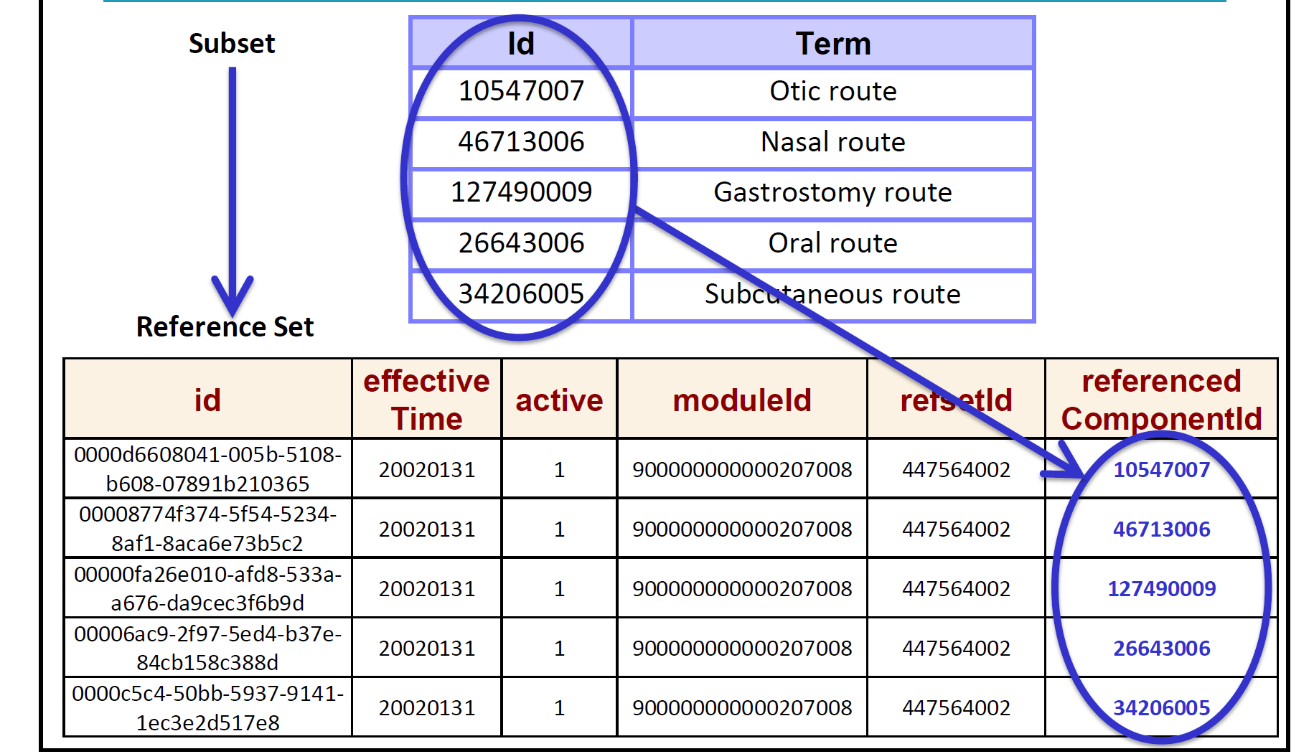

Slide 39
More on Refsets
Extensional
By Enumeration
Someone picks the components
“That one, that one and that one”
Intentional
A rule defines the content
“All the ones that mean the patient has ‘Asthma’”
Types
Simple
Only for subsets
Must be extensional
Language
Only the descriptions change…
Attribute value
Assign some metadata value to a component e.g. ‘Inactivation Reason’
Association Reference Set
E.g. this concept is replaced by that concept

Slide 40
More on types of Refset
Ordered
A way of producing bespoke hierarchies and sort orders
Annotation
Can add some additional text to a component e.g. ‘use this code for…’
Query
Used to store a query that creates a simple refset
Simple Map
1 to 1
Complex Map
1 to Many etc
Can have ‘mapAdvice’ value which clarifies the mapping
MapRule which can be computed ‘if this then that’

Slide 42
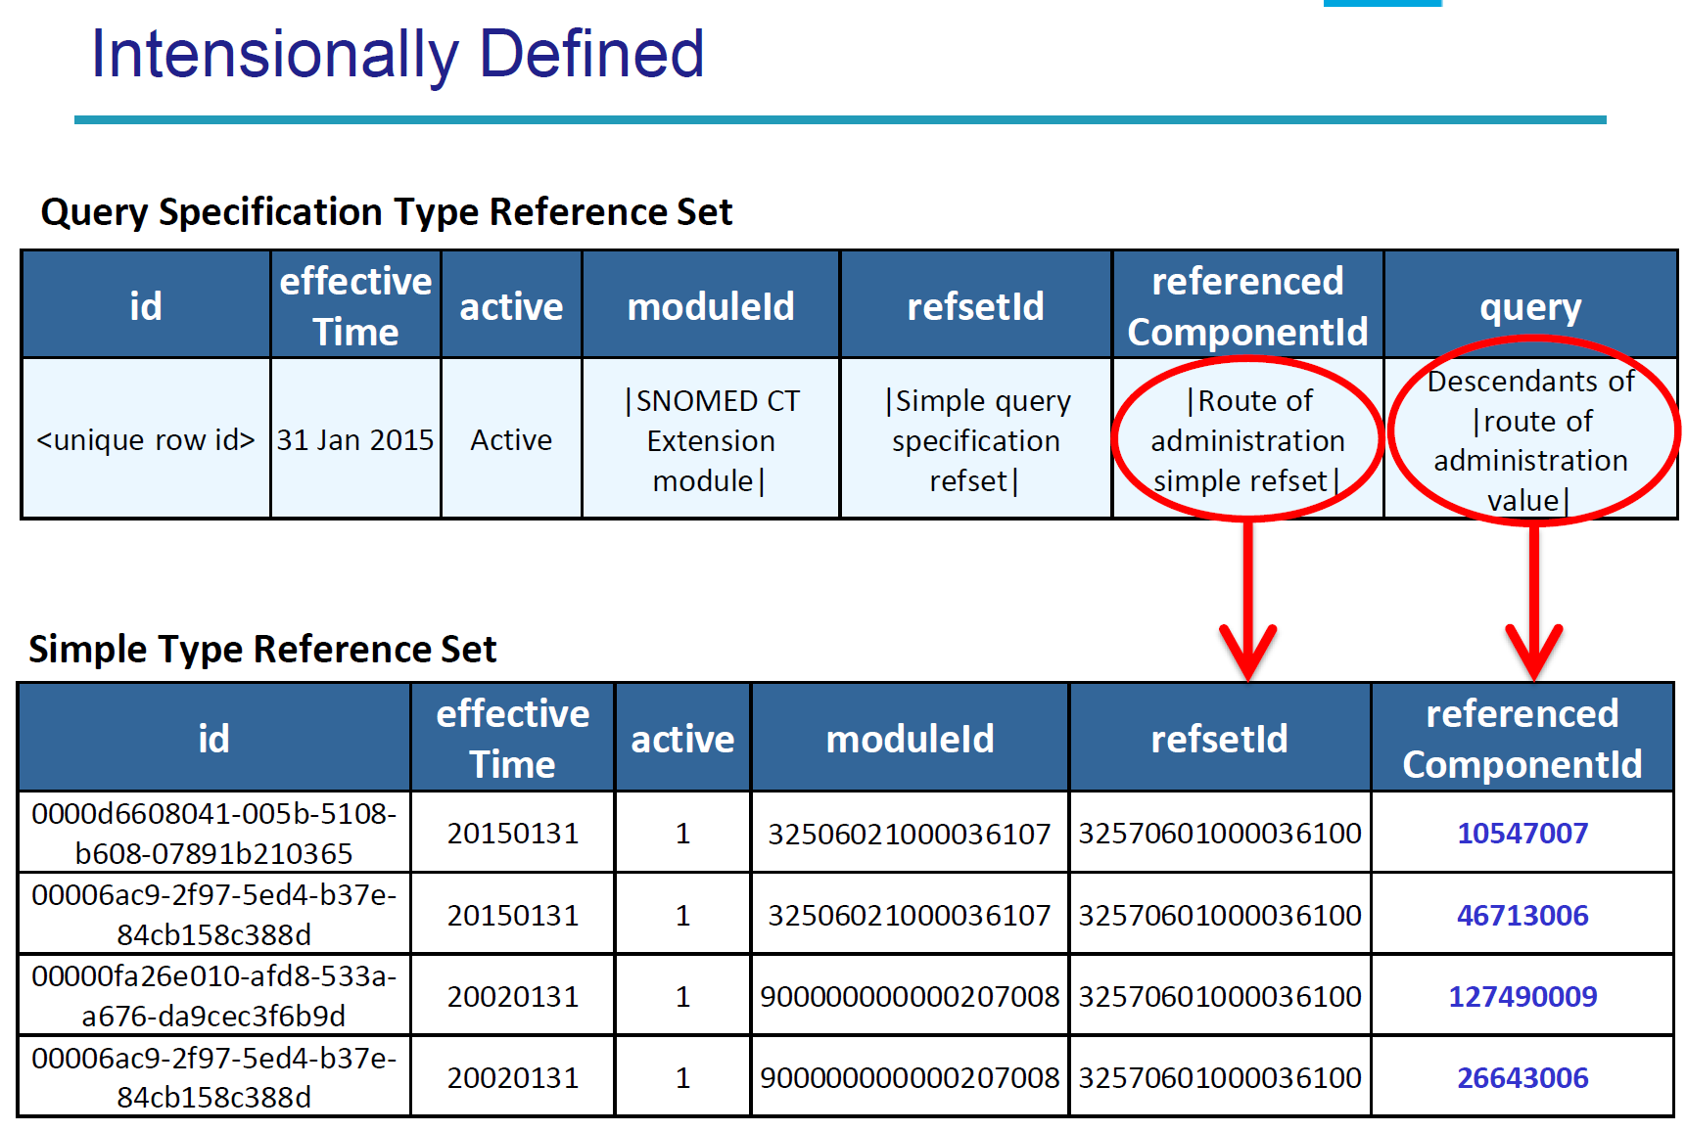

Slide 43
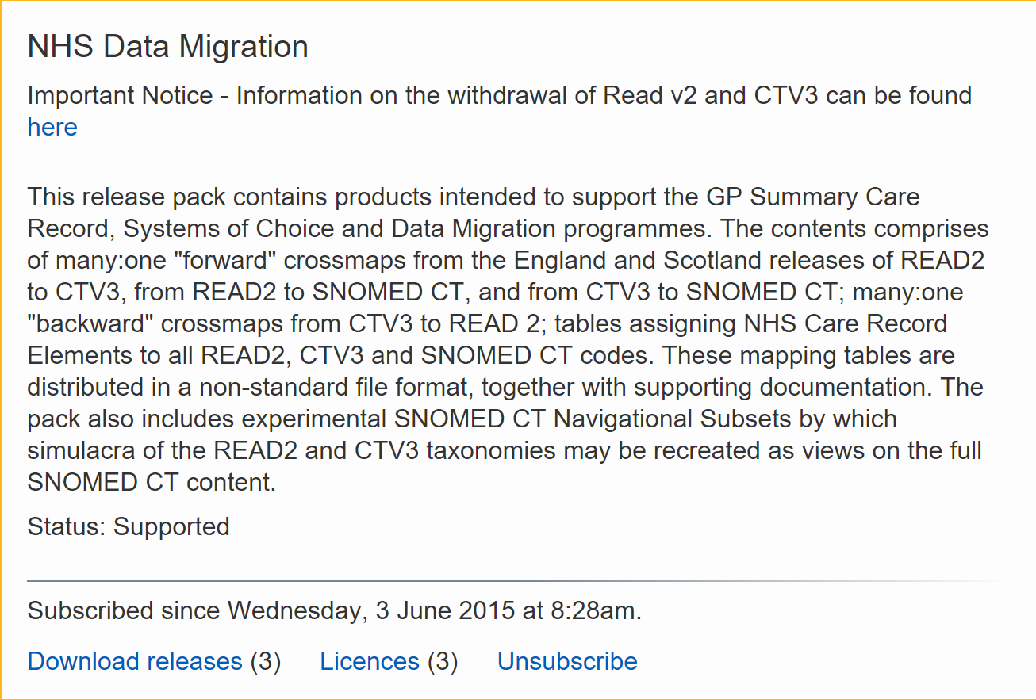

Slide 44
Extensions

Slide 45
Pre and Post-coordinated
Pre coordinated
Just means the concept is provided for you
The whole of Read 2 is pre-coordinated
Post coordinated
Join up the concepts to make a new one!
Complex – not any time soon
But…

Slide 46
SNOMED CT Compositional Grammar
SNOMED CT Compositional Grammar provides a syntax that enables clinical ideas to be represented, even when a single SNOMED CT concept does not capture the required level of detail.
Clinical expressions using SNOMED CT concepts can be of two types: precoordinated expressions, which use a single SNOMED CT concept identifier; and postcoordinated expressions, which contain more than one SNOMED CT identifier.

Slide 47
Examples
73211009 |Diabetes mellitus|
421720008 |Spray dose form| + 7946007 |Drug suspension|
83152002 |Oophorectomy| : 405815000 |Procedure device| = 122456005 |Laser device|
65801008 |Excision| : 405813007 |Procedure site - direct| = 66754008 |Appendix structure| , 260870009 |Priority| = 25876001 |Emergency|

Slide 48
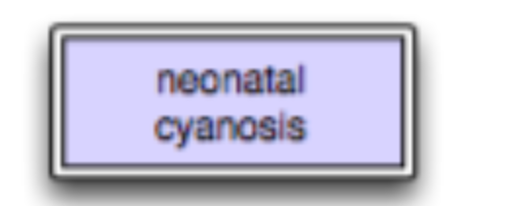
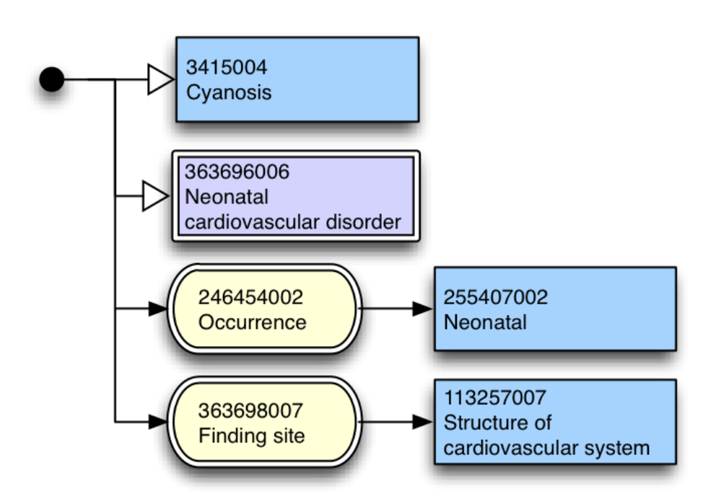
Diagramming

Slide 49
Expression Constraint Language
The SNOMED CT Expression Constraint Language enables the intensional definition of a bounded set of clinical meanings. This is important for a number of use cases, including:
Terminology Binding;
Intensional Reference Set Definitions;
SNOMED CT Content Queries; and
SNOMED CT concept model specifications
Is basically a syntax for queries on content
E.g. Find all concepts of abscess affecting lungs

Slide 50
Expression Constraint Language
< 404684003 |Clinical finding|
descendantOf 404684003 |Clinical finding|
<< 73211009 |Diabetes mellitus|
descendantOrSelfOf 73211009 |Diabetes mellitus|
< 19829001 |Disorder of lung| And < 301867009 |Edema of trunk|

Slide 51
More info
https://confluence.ihtsdotools.org/display/DOC
Starter Guide
Technical Implementation Guide
Guides on compositional grammar etc
https://hscic.kahootz.com/

