Slide 1
Terminologies 101
What are clinical terminologies and why do we need them ?
Roslynne O’Connor
Practice Manager
Notes:
When Paul sent me the proposed agenda with me down against this topic.
I wasn’t sure who was madder.
Paul asking me a Practice Manager to explain clinical terminologies to a bunch of informatic specialist/enthusiasts.
Or Me for agreeing to it.

Slide 2
Terminologies 101
What is Clinical Terminology?
A structured collection of descriptive terms which are used in clinical practice at the point
of care.
Terminology includes items such as treatments, diagnoses, administrative terms, social
and environmental factors.
ISD
www.isdscotland.org
Notes:
So
I thought lets start at the obvious place.
What is a clinical terminology system- so looked up NHS Scotland who maybe know better than anyone. Since it’s their job to collect it and do something with it. This is what they say…… Seems straight forward, how can I fill 15 minutes.

Slide 3
Terminologies 101
The need for controlled (structured) vocabulary or 'codes' has become so widely accepted that few stop to ask why they are using codes or specialised terminology in a given situation.
Professor A.L. Rector, University of Manchester
BJHC, 2000
Notes:
But then as I thought about it ..and came across this.

Slide 4
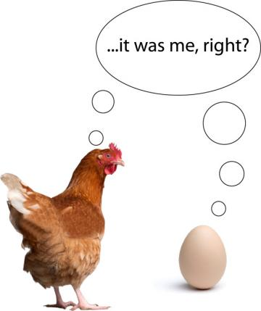
This Photo by Unknown Author is licensed under CC BY-NC-ND
Notes:
So where do we start?

Slide 5
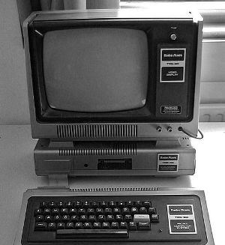
Terminologies 101
Clinical terminology has been around since Plato.
One of the 1st “modern” clinical terminology systems was accredited to he New York Academy of Medicine in 1929.
This innovation introduced the notion of multi-axial coding and the ability to compose and express clinical concepts. But it was two dimentional
x and y
“x” being the procedure and “y” the anatomy
Image credit: Wikimedia Commons, 2009 © Flominator.
Notes:
It wasn't until 1987 that the Kroner Steering Group on Health Information recommendatons made in October 1982, were introduced.
The same year as the Committee for Regulating Information Requirements was created.

Slide 6
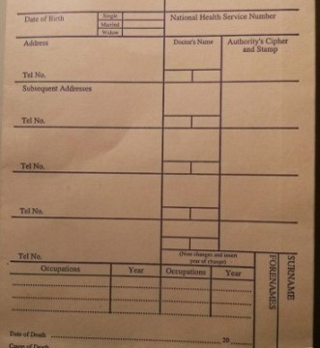
Terminologies 101
Lloyd George envelopes were first used in 1911, when the politician David Lloyd George introduced a national health insurance scheme for low-paid working men.
These envelopes also resolved issues around ownership of medical records: the State provided the stationery, the doctor provided the ink and was guardian of the record until the patient died, at which point the stationery became the property of the State again
Notes:
and possibly the 1st significant data collecting system. And to be honest I don’t think that confidentiality was an issue and no-one could read the content of them anyway! Although Scotland moved to A4 files, it still didn’t change much.

Slide 7
Terminologies 101
Vision 19?
Gpass 1984
EMIS 1990
System One
Microtest
Notes:
Along side this came the introduction of GP clinical IT systems
When computers became available, they were applied to automate what had previously been done manually. The impact on patient care was minimal, but itdid automate appointments, prescritions and some disease information.
But some innovators did use the clinical recording when available.

Slide 8
Terminologies 101
How do we do it?
Coding
The translation of clinical terminology into an (alpha) numeric code to make it easier to analyse the data collected.
By supporting the process of collecting better quality information through accurate coding we contribute to the decisions that inform health care policy which ultimately leads to improvements in patient health.
ISD
www.isdscotland.org
Notes:
Although some innovators did code more.
So the technology to record clinical encounters increased the demand on being able to collate, analyse and utlises and this was supported by the development of Read terminology.
Roll on 2004 and GMS – and structured coding ISD have different descriptions or a change the use - from care at the clinical point to data analysis. And from a particular point of care to decisions on health care policy.
And that need created 3 requirements:
1. To do this the terminology needs to be human friendly - flexible context-sensitive and to have rigid logical for the computer
2. Compactness and symbolic representation. 'Codes' rather than text, and this was an important motivation for early terminologies such as Read.
3. Ease of entering, indexing, retrieval - linking clinical records, decision support, quality assurance, and other information

Slide 9
Restaurants and healthcare are both customer-centred industries. Diners and patients arrive with certain expectations – usually it’s that they’ll receive “treatment” for a condition or concern (in a restaurant, the concern is hunger), and, if all goes well, they’ll leave the experience better off than they were when they arrived. That, however, is where the similarities end. Because if restaurants were run by healthcare, the experience would probably look more like this:
Terminologies 101
https://www.healthcatalyst.com/if-restaurants-were-run-like-healthcare
Notes:
But there is so much data – how do we know what is important an how do we turn it into information ? Depends on who wants to use it? And what for?
Also lots of “interested parties” as those who provide the care and manage, plan and direct the care widens.
There are different healthcare languages used by different professionals and specialities. So we needed solutions to the ambiguity of language when we count and index clinical entries.
Technological changes give the exponential ability to analyse and interpret data but this has brought other considerations.

Slide 10
Terminologies 101
225g (1 cup) caster sugar.
300g (2 cups) plain flour (sifted)
200g (1 cup) of butter melted.
1tsp vanilla extract.
1tsp of baking powder.
A pinch of salt.
1 egg.
100g-200g chocolate bar or chocolate chips (if you want to make them as chocolate chip biscuits)
250g self-raising flour
2 teaspoons ground cinnamon
400g caster sugar
350ml vegetable oil
4 eggs
350g grated carrots
120g chopped walnuts
Cream cheese icing
225g cream cheese
110g margarine, softened
450g icing sugar
120g chopped walnuts
1 teaspoon vanilla extract
Notes:
A simple analagy.
|f I want to bake some cookies, I get a recipe go to the shops buy the ingredients and bake the cookies. Simple two dimentional axis.
But maybe I am not sure what I want to make so instead I go to the shop and get more varied ingredients to give me options . A multi dimentional axi.

Slide 11
Terminologies 101
2017 onwards...... We have the technology..
Moving into sophisticated data collection, data linking and for uses that we haven't even identified yet.
But current terminologies can't cope as they are 2 dimensional.
Need the support of 3 and/or multi-dimentional terminologies.
Notes:
so not 1 demetional - paper records
2 dimentional read
multi dimentional - like the elevator in the original willie wonker - it can go upways. downways, sideways, and any other ways imaginable. so roll on snomed.

Slide 12
Terminologies 101
Thank you
Notes:
or we have all been given a golden ticket for a trip on the Wonka vator

