Slide 1
Unique Prescribing ID
Dr Ian M Thompson
GP in East Linton
Chair of Emergency Care Summary Service Board
SCIMP

Slide 2
Unique Prescribing ID: The Problem
Current GP cypher: Problem
  Prescribers
  Locations
Examples
  Locums
  GPs working in multiple roles/locations
    OOH
    Salaried in various practices
  Nurse Prescribers etc.

Slide 3
Partial Solutions
Current approaches
  Scotland: 7 colours of paper
  England: Smart Cards/electronic sigs
  OOH: Just dispense
Current Issues
  Constraints by GP system design
  Repeat Prescribing Processes
    Issuer vs. authoriser

Slide 4
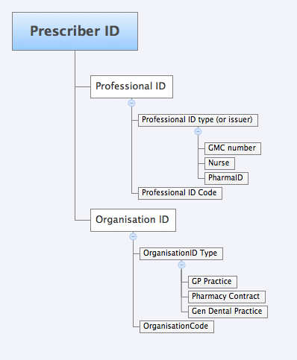
Unique Prescribing ID

