Slide 1
Improving GP summaries
SCIMP conference
1St November ‘11
Dr George Fernie – Senior Medico-legal Adviser
Dr Andrew Power - Medico-legal Adviser
Edinburgh

Slide 2
Purpose of summaries
To provide a GP summary dataset for use by other clinicians in unscheduled care settings. The GP summary will provide the clinician who is seeing the patient with an extract of events in the patient’s medical record that may have a bearing on the current consultation.

Slide 3
The Data Protection Act 1998
Principles and mechanisms for processing and protecting personal data
The right to seek factual corrections
Data controllers are those who determine purposes and manner in which any personal data are to be processed
Patient = ‘data subject’

Slide 4
The First Data Protection Principle
The information to be contained in personal data shall be processed, fairly and lawfully and, in particular, shall not be processed unless certain conditions are met

Slide 5
The Second Data Protection Principle
Personal data shall be obtained for one or more specified lawful purposes and shall not be further processed in any manner incompatible with that purpose

Slide 6
The Third Data Protection Principle
Personal data…shall be adequate, relevant, and not excessive in relation to that purpose

Slide 7
The Fourth Data Protection Principle
Personal data shall be accurate and where necessary, kept up to date

Slide 8
The Fifth Data Protection Principle
Personal data held for any purpose or purposes shall not be kept for longer than is necessary for that purpose or purposes

Slide 9
The Sixth Data Protection Principle
Personal data shall be processed in accordance with the rights of data subjects under this Act

Slide 10
The Seventh Data Protection Principle
Appropriate security measures should be taken against unauthorised access to, or alteration, disclosure or destruction of, personal data and against accidental loss or destruction of personal data

Slide 11
The Eighth Data Protection Principle
Personal data shall not be transferred to a country or territory outside the EEA unless…an adequate level of protection…

Slide 12
Essential factors
Accuracy
Completeness
Up to date
Safety
Relevance
Consistency
appropriateness
  Any information (particularly relating to third parties or family members) should not contain any personal data that could breach Caldicott Guidelines.

Slide 13
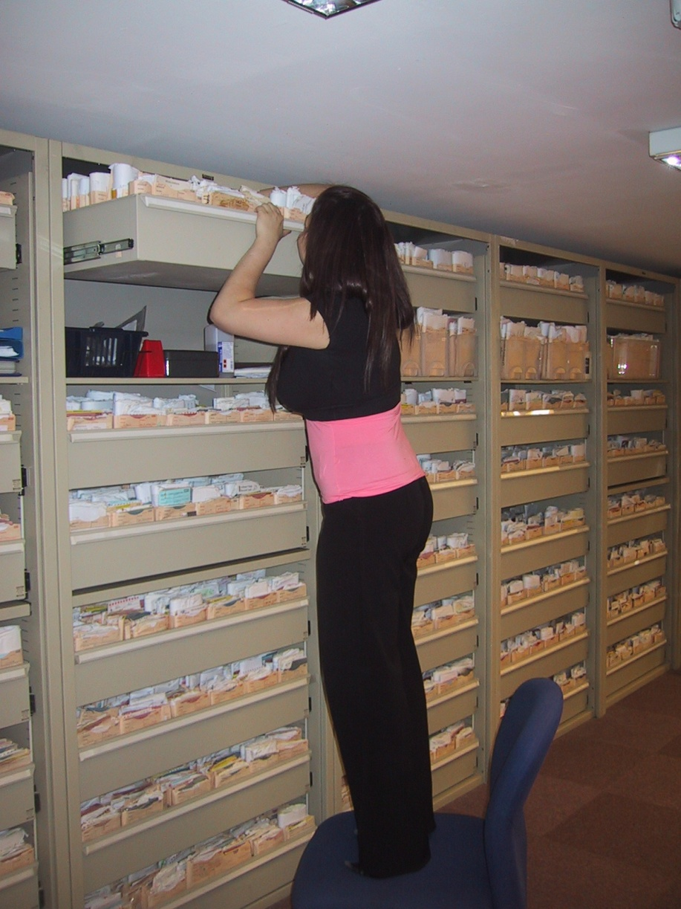
Content: basic
Drugs
Allergies and adverse reactions
Additional information agreed by patient and GP

Slide 14
Local system
Major diagnoses
Conditions that may have a relapse or chronic course
Conditions for which the patient receives repeat medication
Conditions that are persistent and serious contraindications for classes of medication
Major operations
Significant therapies and treatment plans
Significant investigations
Fractures
immunisations

Slide 15
For example
Major diagnoses: MI, diabetes, terminal illness
Conditions that may have a relapse or chronic course: gout
Conditions for which the patient receives repeat medication: diabetes
Conditions that are persistent and serious contraindications for classes of medication: dyspepsia, asthma
Major operations: hysterectomy, cardiac surgery
Significant therapies and treatment plans: radio-, chemo- therapy
Significant investigations: CT, Echocardiogram
Fractures: significant
Immunisations: including batch numbers

Slide 16
Where GP summary may have helped
44 year old female
Documented penicillin allergy on three occasions
CLO positive endoscopy
Consultant writes to GP suggesting ‘triple therapy of your choice’
GP prescribes, clarithromycin, omeprazole and amoxicillin
Patient sustains severe allergic reaction
Inevitable settlement of claim

Slide 17
Where GP summary may have helped
28 year old female 4 months postnatal
Attends with constipation
GP plans to add bisacodyl to Movicol®
In error chooses bisoprolol 5mg
Patient calls OOH service complaining of fatigue
Admitted for observation and develops bradycardia of 30bpm
Inevitable settlement of claim

Slide 18
Where GP summary may have helped

Slide 19
GP summary
Is dynamic and needs to be actively reviewed
Tension between salience and inclusiveness
Clinical judgement is required to decide which parts are relevant to include in discussion with patients

Slide 20
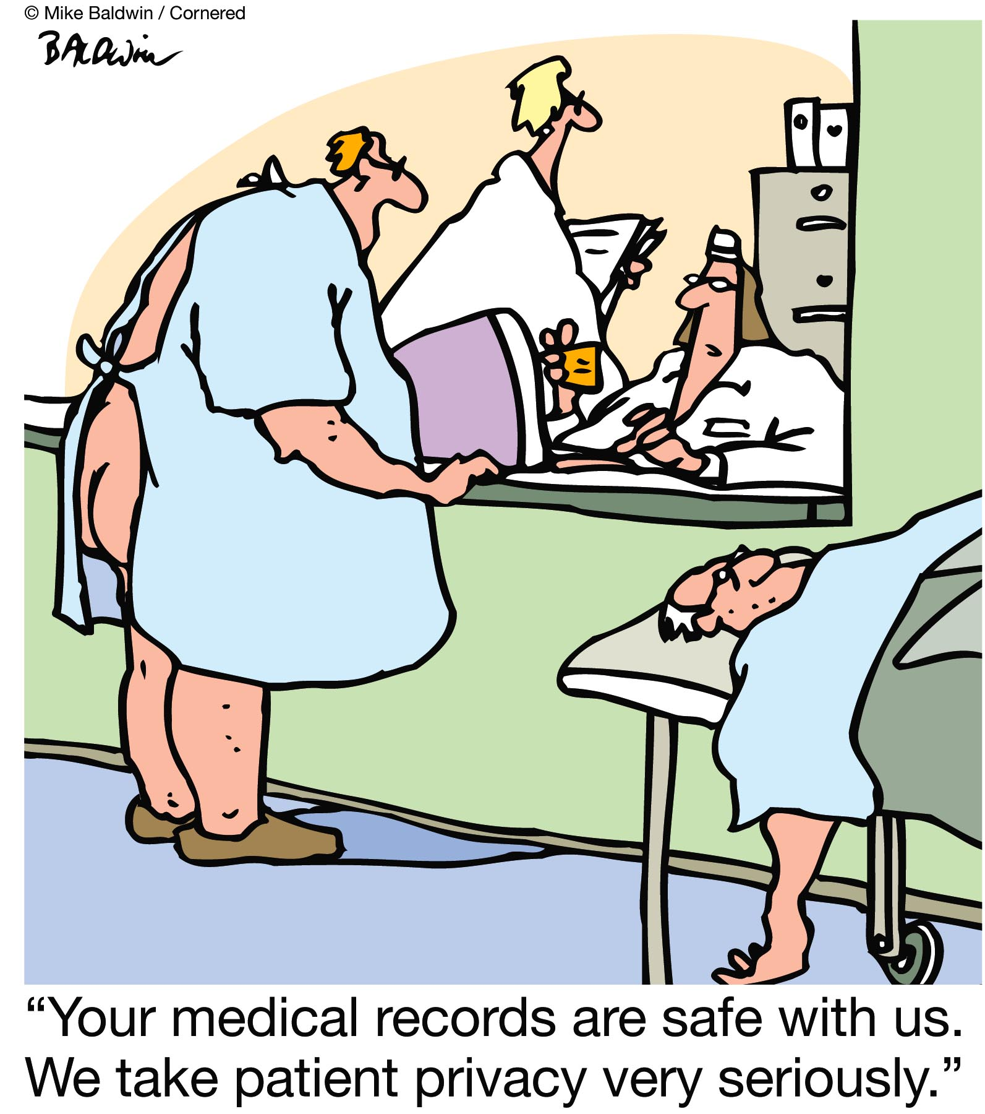
GP summary

Slide 21
Improving GP summaries
Dr George Fernie – Senior Medico-legal Adviser
Dr Andrew Power - Medico-legal Adviser
Edinburgh

